Slide 1
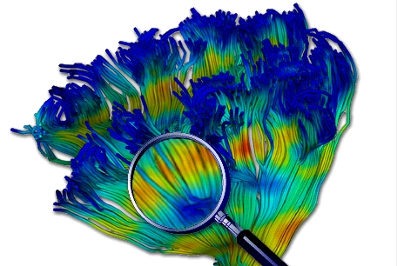
Diffusion MRI - Lesson 4
Atlases, Fibers and Profiles
Martin Styner UNC
Thanks to Guido Gerig, NYU
And many, many folks

Slide 2
Content
The UNC-NAMIC Atlas Fiber Analysis (done)
Unbiased DTI atlas building via DTIAtlasBuilder (done)
Tracking fibers via AutoTract
  Editing tracts in Slicer and FiberViewerLight
Extracting fiber profiles via DTIAtlasFiberAnalyzer
Statistical Analysis via FADTTSter

Slide 3
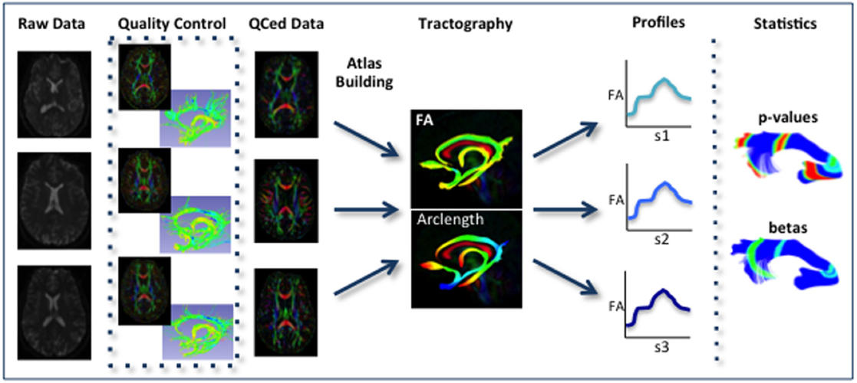
UNC-NAMIC DTI Fiber Analysis - AutoTract
AutoTract/Slicer/FiberViewerLight
FADTTSter/Slicer
DTIPrep/Topup/Eddy
DTIAtlasBuilder
DTIAtlasFiberAnalyzer

Slide 4
Automated Fiber Tractography
Manual fiber tracking is highly variable and time consuming (~ weeks for brain)
  Seed region specification
  Clean up
  Consistency in definition
Fully automated
  Error prone due to large variability across subjects

Slide 5
Semi-Automated Fiber Tractography
Try fully automated
  Add manual intervention to correct
Here:
  AutoTract for automated tractography
  3D Slicer for removing tract parts that reach incorrect locations
  FiberViewerLight to remove small fibers and fibers the fold over

Slide 6
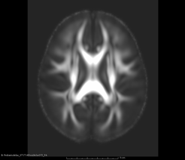
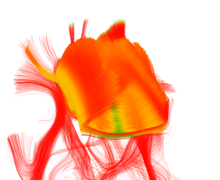
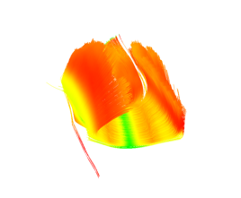
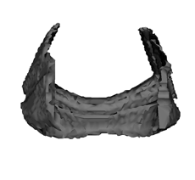
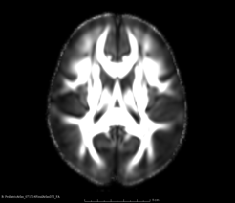
AutoTract Pipeline
Seed Regions from Propagated Tracts
Registration of Atlas with Known Tracts
Fiber Filtering via
TRAFIC
Tractography from Seed Regions
Notes:
Make inputs/outputs explicit
Voxel + dilation

Slide 7
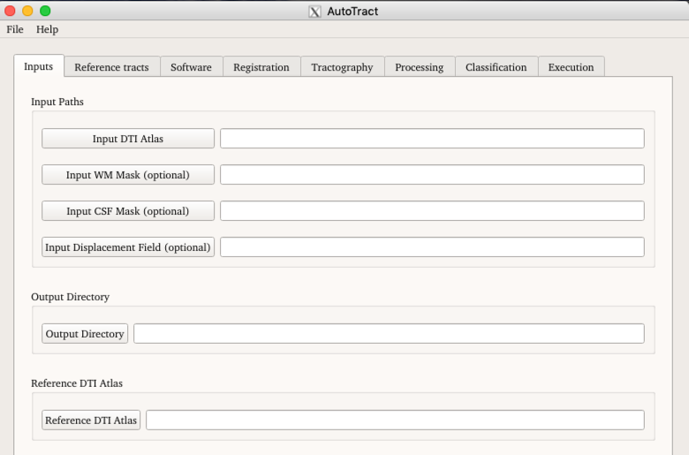
AutoTract GUI
AutoTract (v 4.0)
Set your DTI input data
  Optional data is rarely needed
Set Output dir

Slide 8
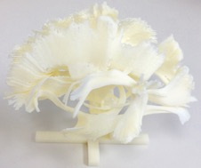
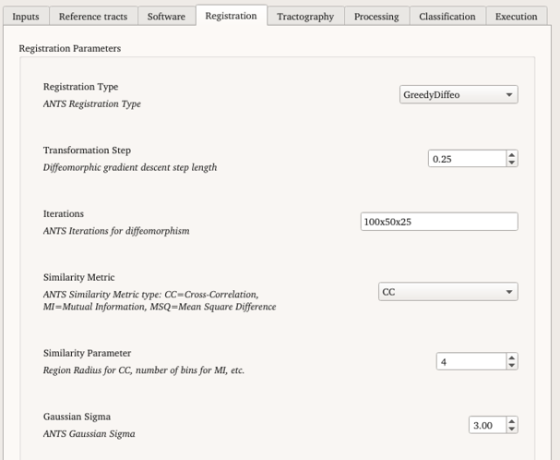
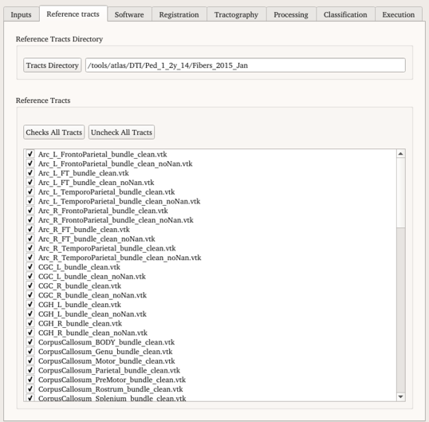

Atlas Registration
Prior atlas/template with
  DTI Image (as NRRD) on first tab
  Known fiber tracts (as VTK files)
Registration with DTI-Reg
  Same as DTIAtlasBuilder
  Same settings
Output
  Registered DTI
  Propagated data
    Tracts: *_t.vtk
Notes:
The transformations generated during this process are concatenated and a global displacement field is generated for each subject. Each subject is transformed into the atlas space. However, to re-sample the tensors, Riemannian methods are used to preserve their shape and orientation.
The transformed images are averaged using the Log-Euclidean method to produce a tensor atlas. The tensor atlas provides an image with improved signal-to-noise ratio (SNR) that is used to create template fiber tracts. These template bundles are traced and validated by experts. In the following section, the traced fiber bundles will be used to train the neural network.

Slide 9
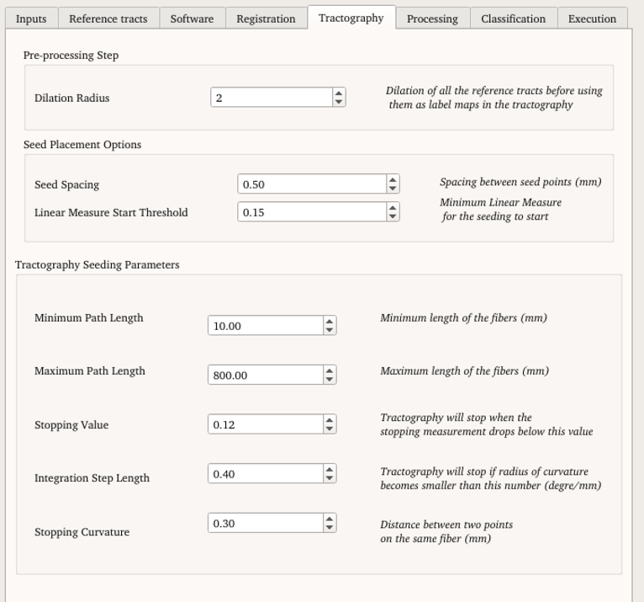
Tractography
Voxelized propagated tracts => see regions
  Dilation for optimistic regions
Slicer based seed region tractography (forward propagation with 2nd order Runge Kutta)
  Same parameters as interactive tractography
Result: optimistic tracts
  Fibers of interest in tract
  But also much more…
Notes:
2. Tractography was performed by following small steps along the principal diffusion direction
3.
Concise s
Standart deterministc tract

Slide 10
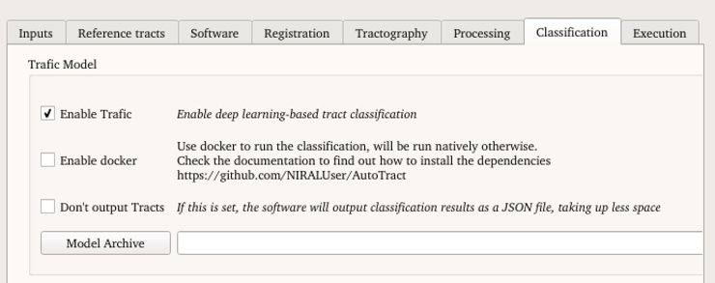
Automatic Cleanup: TRAFIC
TRAFIC: TRAct Fiber Classification
Deep neural network to label fibers
  Needs to be trained:
    Currently: 1-2y EBDS atlas, primate atlas
  Best run on a GPU node/station
  Features: curvature & distances to atlas landmarks

Slide 11
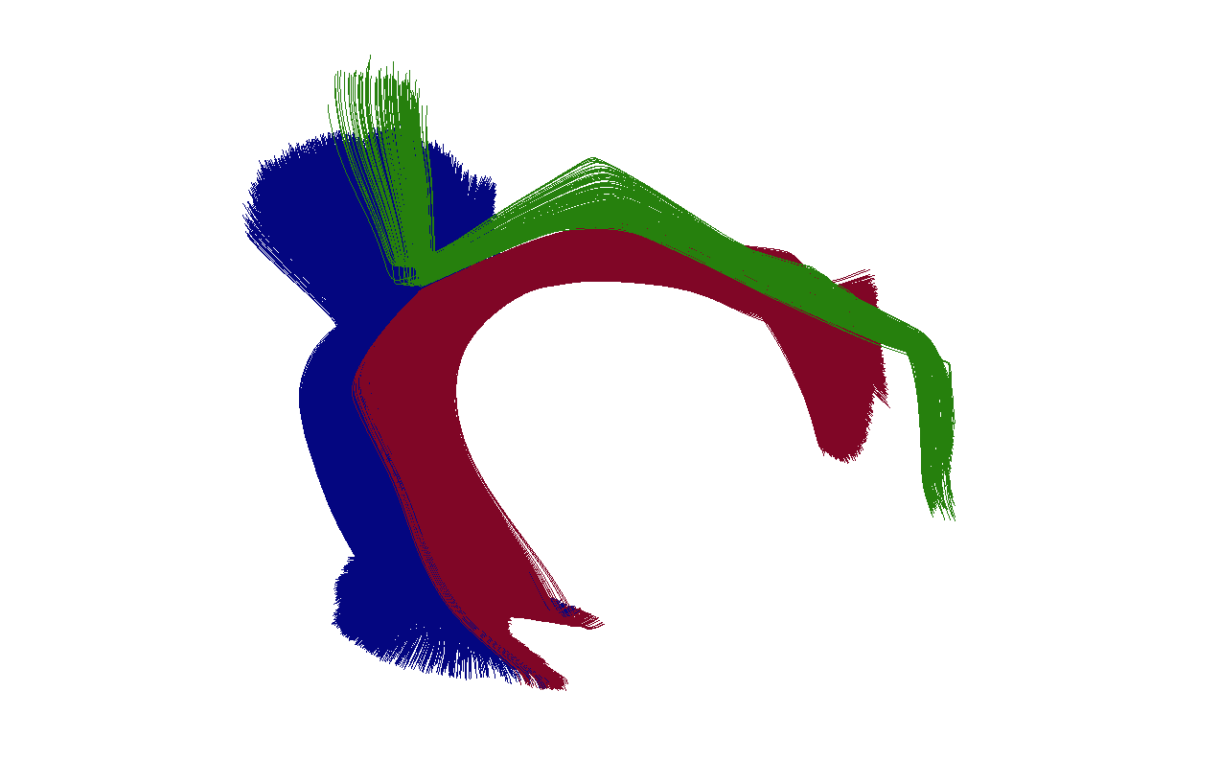
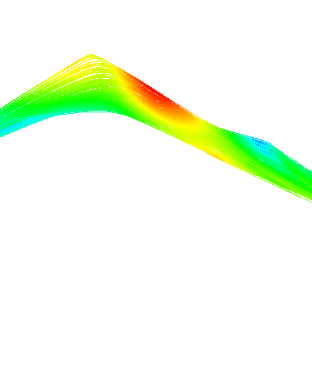
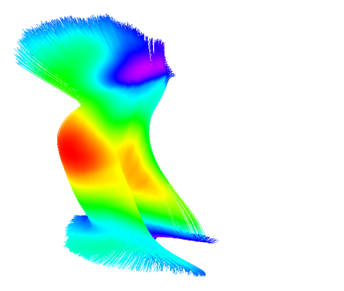
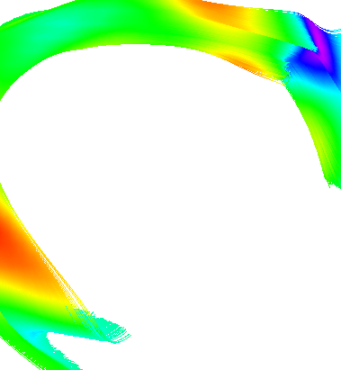
Structure of interest - Arcuate Fasciculus
a) Whole Arcuate Fasciculus
b) Arcuate Fronto Parietal
c) Arcuate Temporo Parietal
d) Arcuate Fronto Temporal
Notes:
The Arcuate Fasciculus Right Frontotemporal (ArcRFT) shown in Figure 5, was chosen to test our method because it is a bundle that is difficult to trace, is not always present, or it may be a short bundle.
The role of this fiber bundle is still uncertain and current evidence suggests that it has an important role in language development.
We used 8 different brain atlases of neonate infants of 1-2 years old to build our data set.
50 subjects for classification.

Slide 12
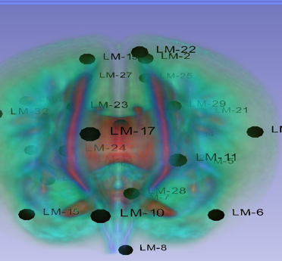
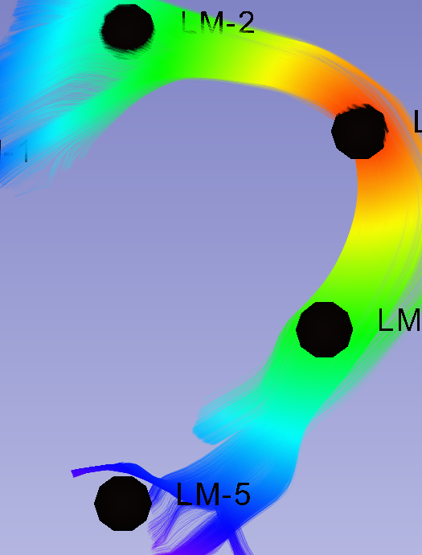
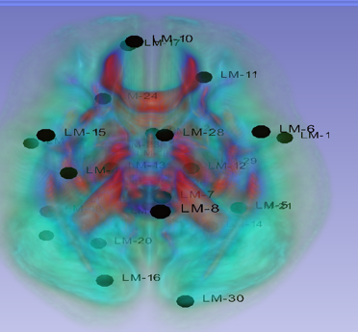
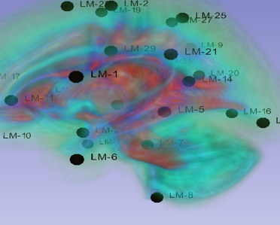
Training features - Landmarks clustering
5 landmarks per tract
53 bundles, i.e., 265 landmarks
  Clustering using affinity propagation.
  Final number of LM: 32
Notes:
In a multi-class classification scenario, we aim to create 53 different classes. Since the number of classes is 53, this will increase the number of features to 268 and rend the neural network training impractical. To reduce the number of landmarks, we applied affinity propagation, which is a type of clustering algorithm that finds N “exemplars points” representative of a cluster given the number N. Figure 2 shows the number of landmarks kept after the affinity propagation algorithm was applied to the set of 265 landmarks (5 for each bundle) which is set to N = 32.

Slide 13
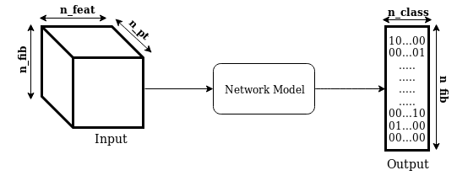
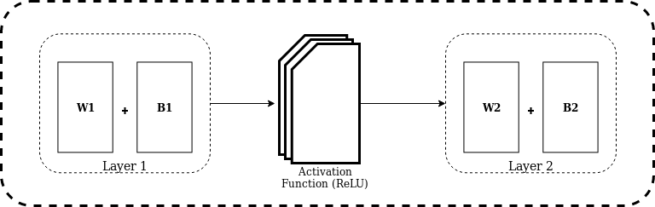
Neural Network Design
Batch normalization
4 Hidden layers
  1024 hidden units
  Rectified linear units
Score layer
  Softmax with 53 outputs
Adam optimizer
  Learning rate 1⁻⁴
Number of epochs 10

Slide 14
Training features – Distance to landmarks
Video missing due to size restriction

Slide 15
Clean up
Load automatic fiber into Slicer
Use Fiber Bundle Display to remove unwanted fibers via ROI Selection (video)
Use FiberViewerLight to remove fibers that are too short or too long

Slide 16
Fiber clean up – Arcuate Fasciculus Left Fronto Temporal – no TRAFIC
Video missing due to size restriction
Notes:
The WM region can be provided as input to Autotract or it is calculated using the FA map and thresholding with Otsu’smethod.
The CSF mask can also be provided as input or it is generated with a multi Otsu threshold segmentation.
Specifically, the FA is divided into three clusters and the CSF is considered to lie in the first cluster.
The fibers are pruned according to following criteria:
Source => Fiber atlas,
User provide CSF and WM is best -> Automatic mask creation for CSF and WM

Slide 17
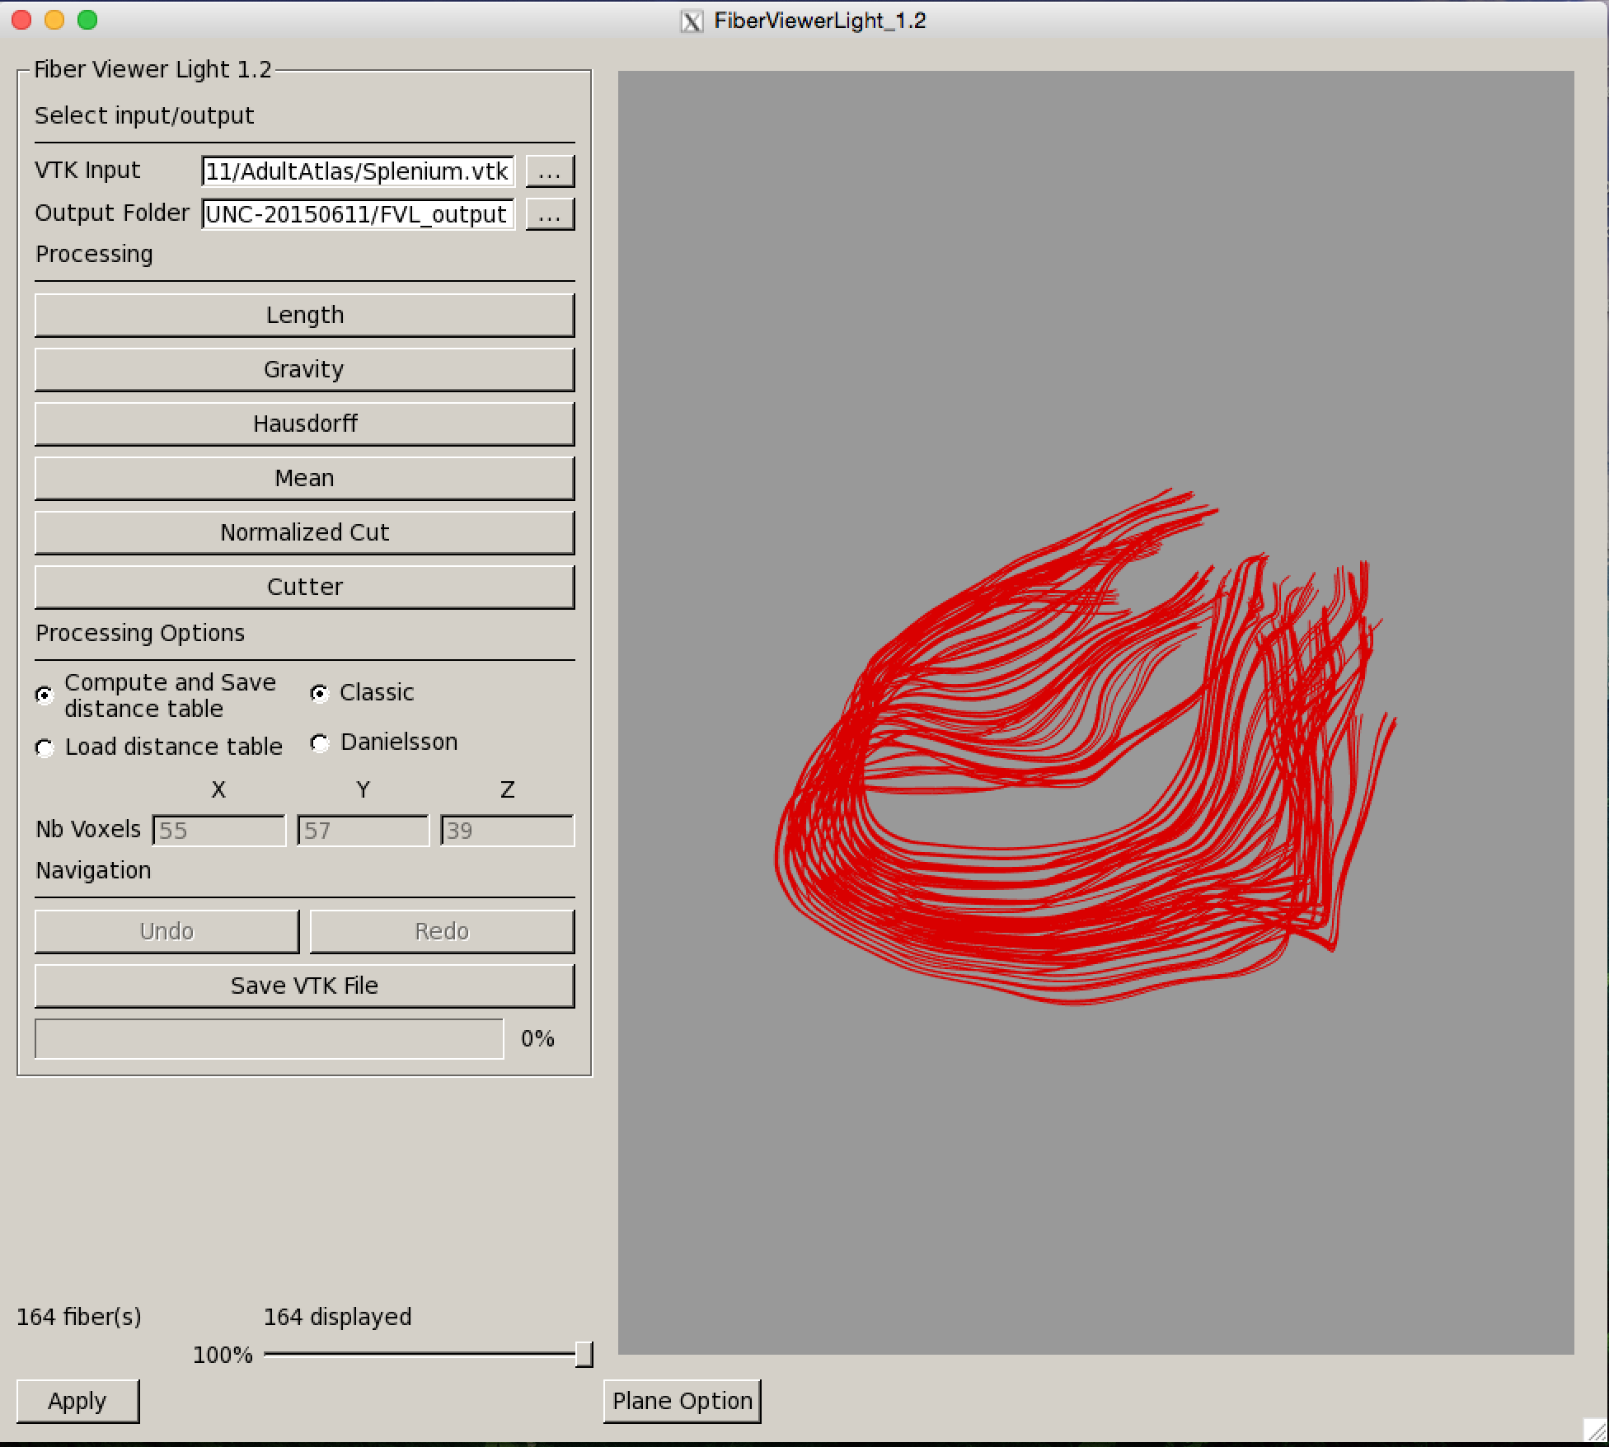
FiberViewerLight
Allows clustering based cleanup
Main use: length cleaning
  Select VTK Input
  Output Folder
    Distance matrixes
    Temp result
  Classic: Compute exact distances
  Danielson: Approximate via distance transform

Slide 18
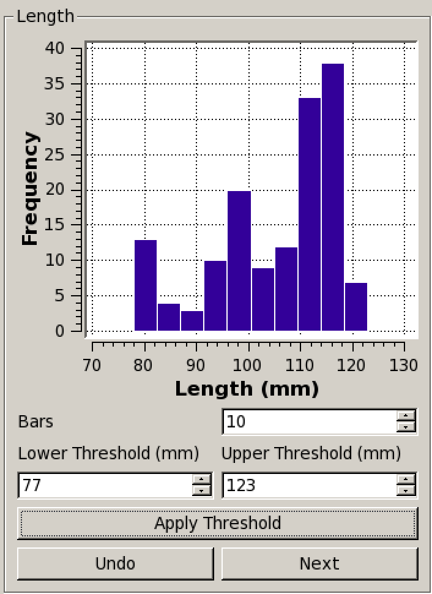
Length based Clustering
Fiber min/max are used as default values
Bars option is the number of bars that will be used on the histogram
Click on Apply Threshold to display the filtered fiber bundle
Click Next or Undo to go back to the main screen
Next will keep changes
Don’t forget to save!

Slide 19
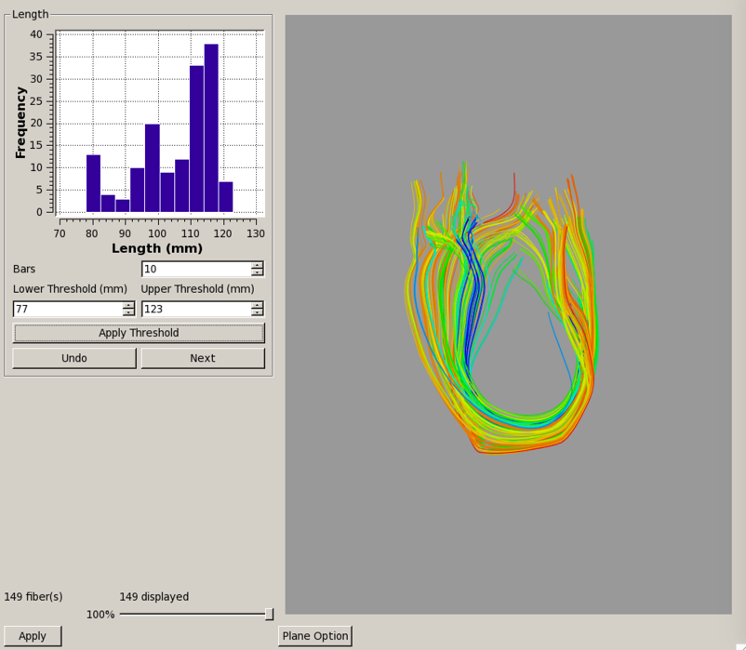
Length Method
Colors go from blue (shortest) to red (longest)
Adapt thresholds to remove too long or too short fibers
We should put this in 3D Slicer!
(we actually did, but I can’t find the module)

Slide 20
UNC-NAMIC DTI Fiber Analysis - DTIAtlasFiberAnalyzer
AutoTract/Slicer/FiberViewerLight
FADTTSter/Slicer
DTIPrep/Topup/Eddy
DTIAtlasBuilder
DTIAtlasFiberAnalyzer

Slide 21




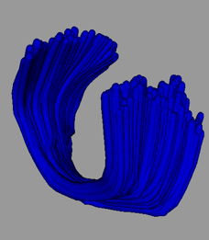



Fiber based Analysis
Analyze corresponding fiber locations across datasets via atlas
  Mapping into atlas
  Inverse map to sample fibers
  Compute fiber profiles
    FA, MD, AD, RD…
  Analyze the profiles
Atlas Fiber

Slide 22
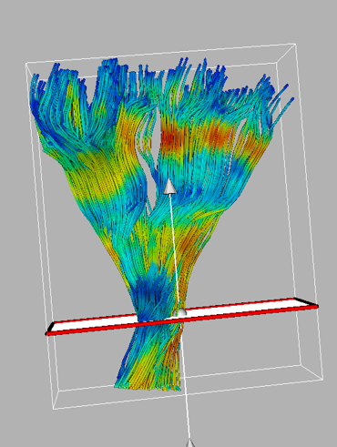
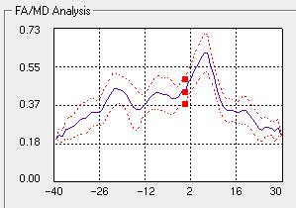
DTI Property Fiber Profiles
Profile = Distribution of DTI values across fiber bundle
  Average & deviation
Parameterization of each fiber along fiber bundle
  Uniform stepsize
  Origin definition
    Manual (FVL) or Automatic (x2)
Profile extracted via Gaussian Kernels
-L
0
+L

Slide 23
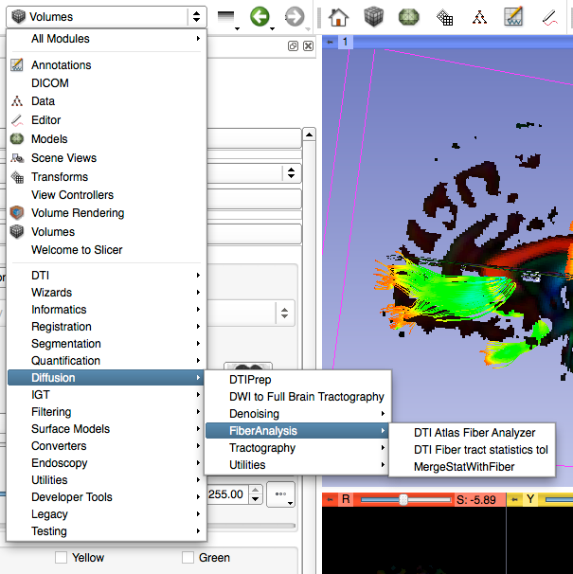
DTI Atlas Fiber Analyzer
Separate tool called from Slicer
  Diffusion
  FiberAnalysis
  DTI Atlas Fiber Analyzer
Command line call

Slide 24
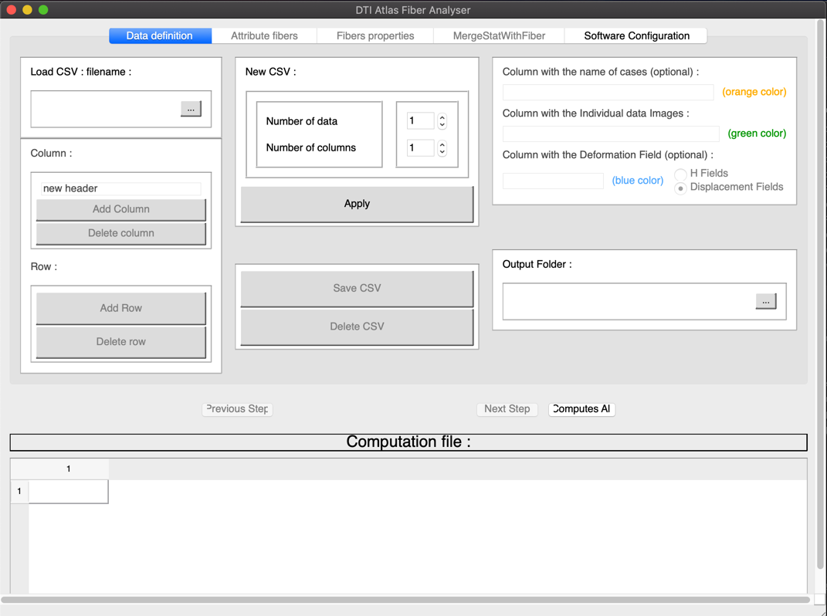
DTI Atlas Fiber Analyzer
Made for analyzing many datasets at once
.csv = comma separated value
Data can be prepared with Excel or other editors
Data from DTIAtlasBuilder can be directly loaded
Load prior csv file
Tabs for the 3 main steps
DataTable Area

Slide 25
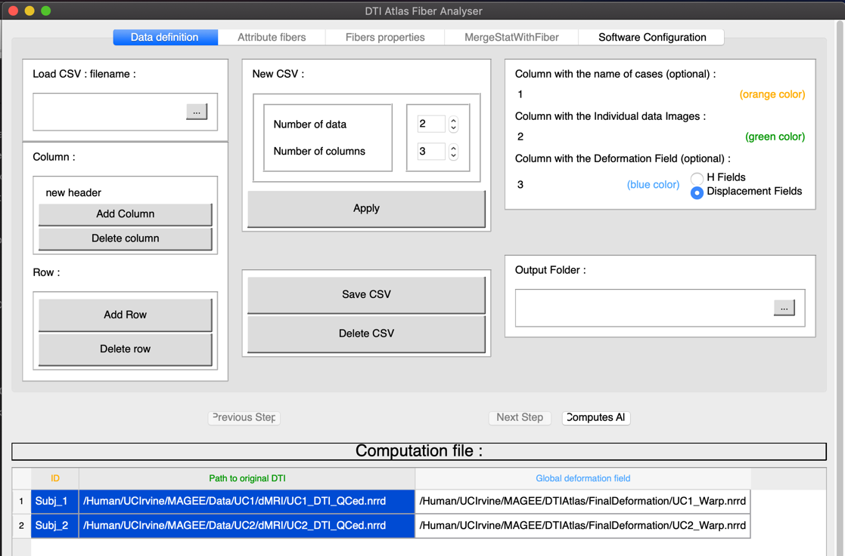
Data Definition
Double click headers to edit
Set ID column
Set orig DTI column
Set warp colum
Double click on “no data” to browse for datafile
Double click on “no deformation” to browse for deformation file

Slide 26
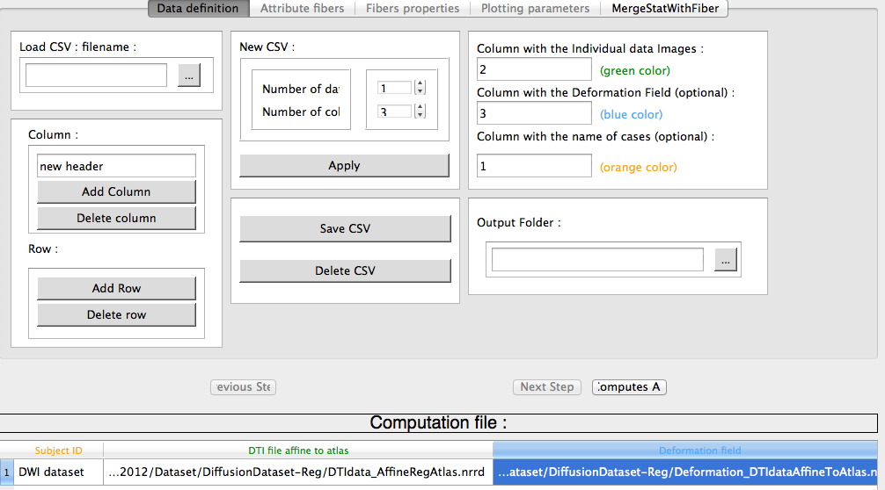
Save the CSV Data
Save CSF File (if necessary
Set Output folder for processing data
Next Step

Slide 27
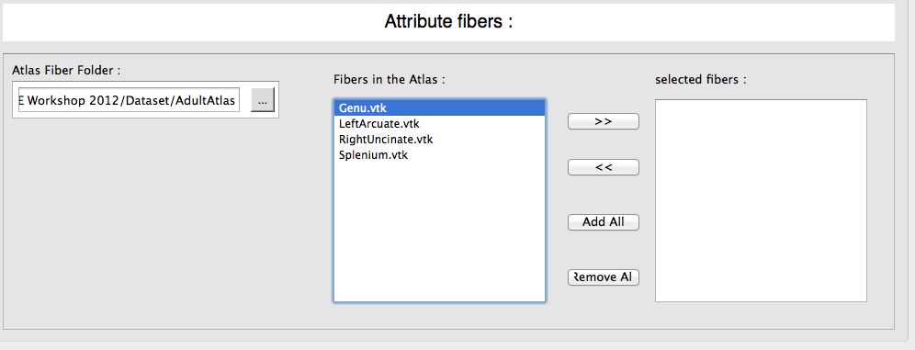
Step 2: Atlas Definition
Set Atlas to fiber atlas
  Available fibers are automatically detected
Select fibers to be analyzed
  Add Genu or Add All
“Apply” to run. If data already exists, it will ask about rerun
“Next”

Slide 28
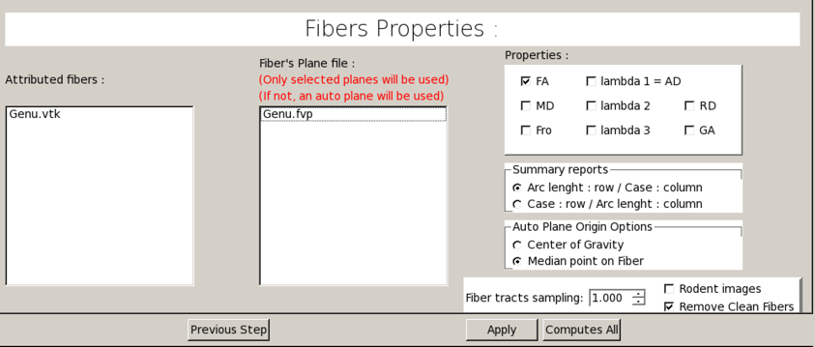
Step 3: Fiber Profiles
Manual vs Auto origin
  Use Auto with Median
Select Properties
Adapt Fiber tract sampling
  if needed. 1.0 is fine for human data
“Apply” to run & wait, then “Next”
  This can take long

Slide 29
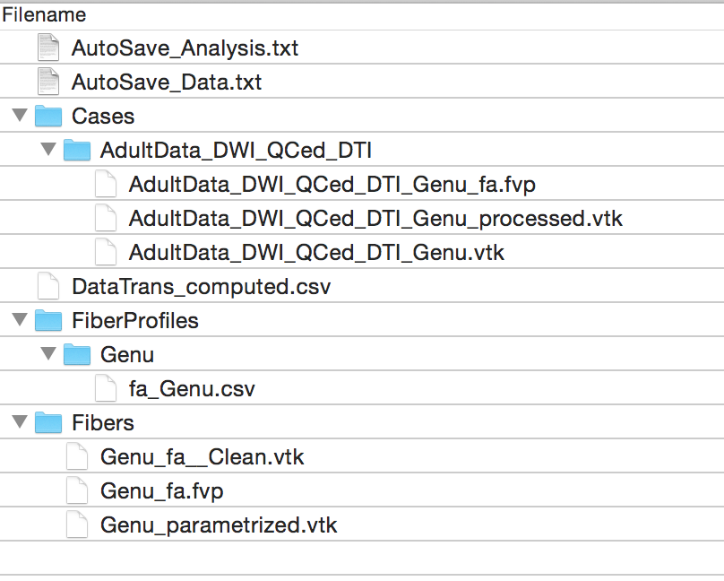
Output Organization
Parameters
Per Case Data
  Fiber with DTI data
  Profiles
Combined Profiles
  Per tract
Atlas Fiber Data
  Fiber params
    Arclength info

Slide 30
Stats in Summary CSV
Fiber profiles are all gathered in single CSV
Use Excel for plotting
Use your favorite stats tool for analysis
  FADDTSter
Average FA per tract is easy to compute
You can merge results back with parametrized fiber
  Last Step: MergeStatWithFiber

Slide 31
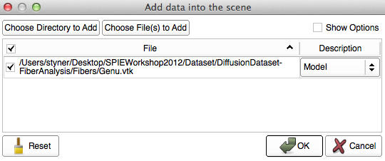
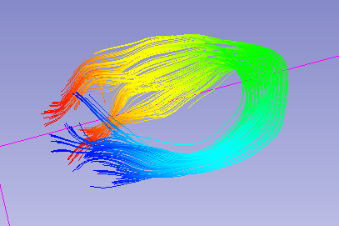
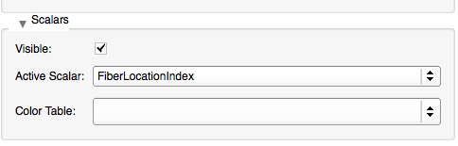
Visualization in Slicer
Load parameterized genu fiber
  Add Data => ProfileOutput/Fibers/Genu_parametrized.vtk => as Model
Enable scalars and use FiberLocationIndex

Slide 32
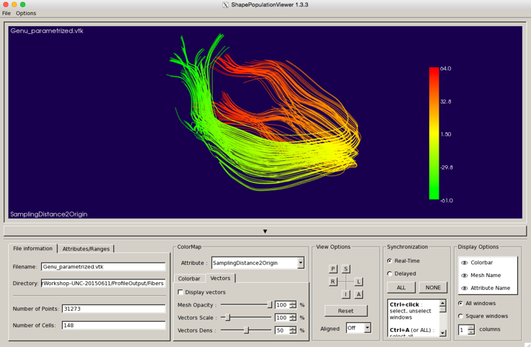
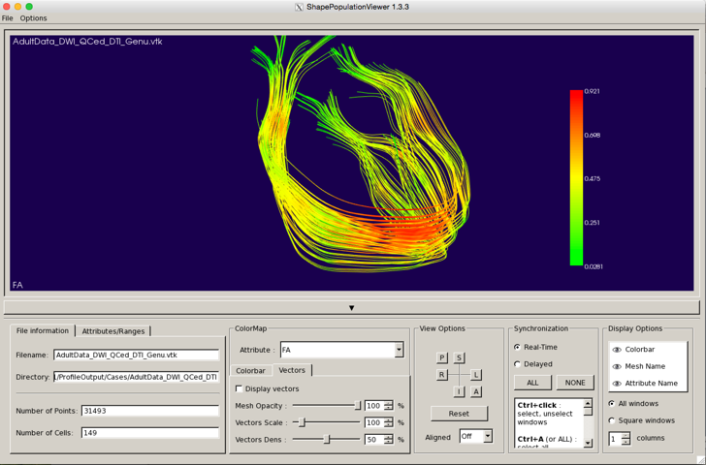
Alternative Visualization
ShapePopulationViewer
  Allows you to see multiple fibers & cases at the same time

Slide 33
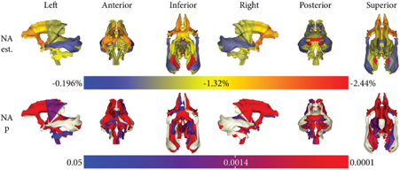
Example Visualization
Anesthesia effect in macaques

Slide 34
Conclusions
Define fibers in atlas space with AutoTract
Extract profiles with DTIAtlasFiberAnalyzer
Next: analyze the data! FADTTSter

Slide 35
FADTTSter
FADTTS = Functional Analysis of Diffusion Tensor Tract Statistics
  Method by Hongtu Zhu for the functional analysis of diffusion profiles
  Cross-sectional analysis
  Omnibus (combined FA, MD, RD, AD) and posthoc tests
FADTTSter: GUI tool by J Noel
  - Input: DTIAtlasFiberAnalyzer files + Demographics/Covariate file

Slide 36
FADTTSter: Input

Slide 37
Data Matchup
Matching profiles to subject info

Slide 38
Profile QC
Cropping profiles
Removing profiles with low correlation to average profile

Slide 39
Execution
Specify FADDTS location, #perms, output location
Computation time significant

Slide 40
Plotting Results: Raw Data
Raw data profiles & mean profiles

Slide 41
Plotting Results: Betas
Betas from GLM – by diffusion property or by covariate

Slide 42
Significance Plots
Beta & P-values combined

