Slide 1
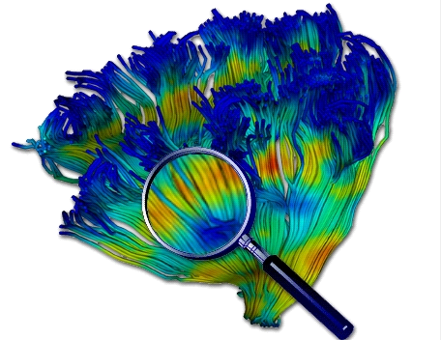
Diffusion MRI: A Brief Intro
Lesson 5
Martin Styner UNC
Thanks to Guido Gerig, NYU
And many, many folks

Slide 2
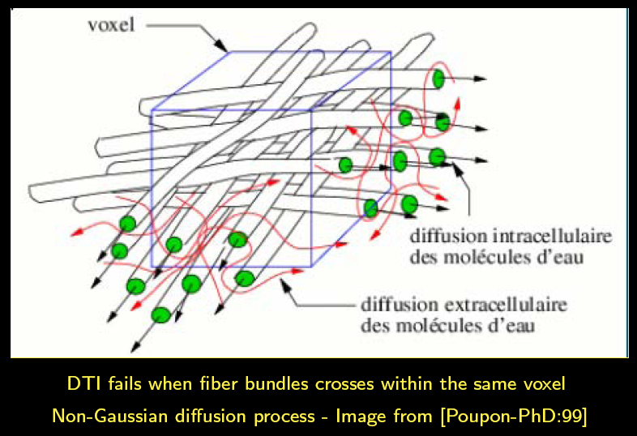
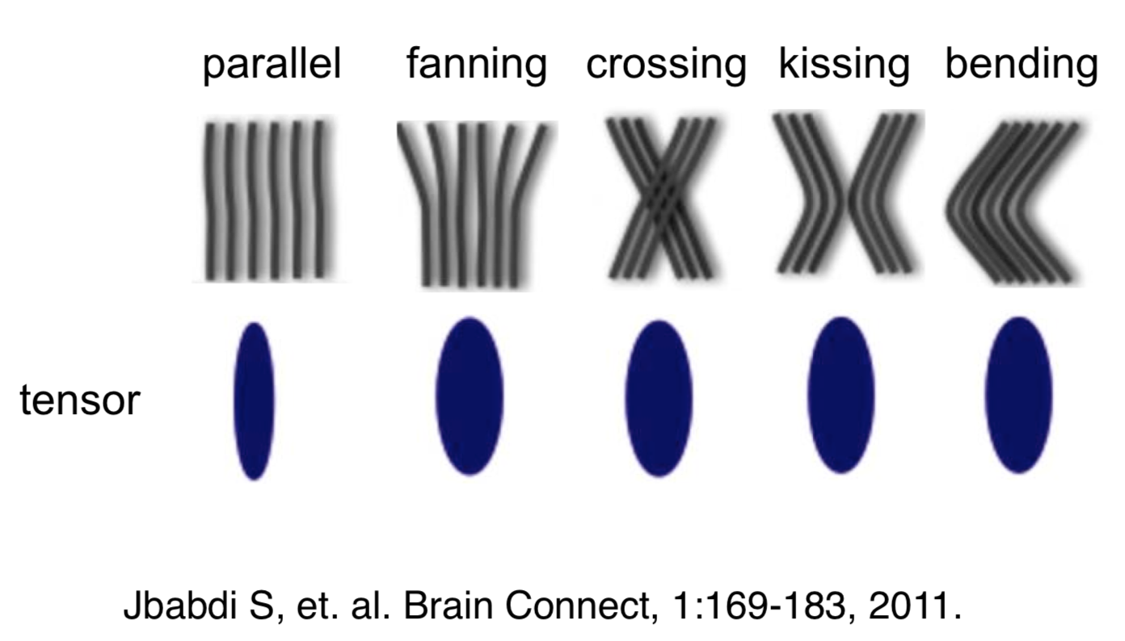
Limitations of the Diffusion Tensor Model

Slide 3
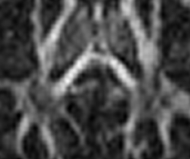
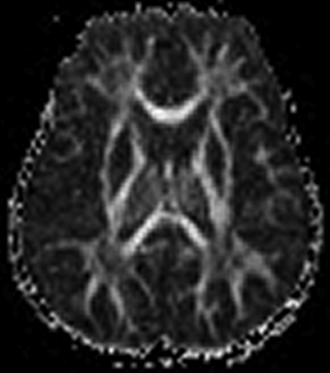
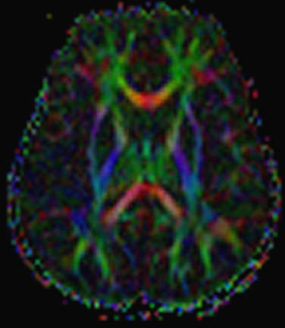
DTI with 12 directions & 2 averages
Crossing Fibers Dropout on FA
Courtesy R. McKinstry

Slide 4

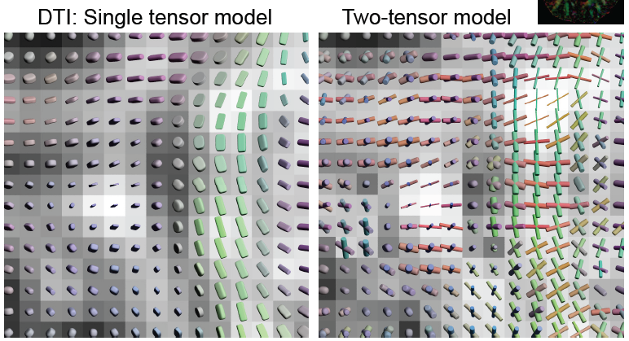
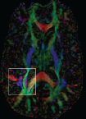
Two Tensor Model
Courtesy Carl-Fredrik Westin, MICCAI 2008 workshop

Slide 5
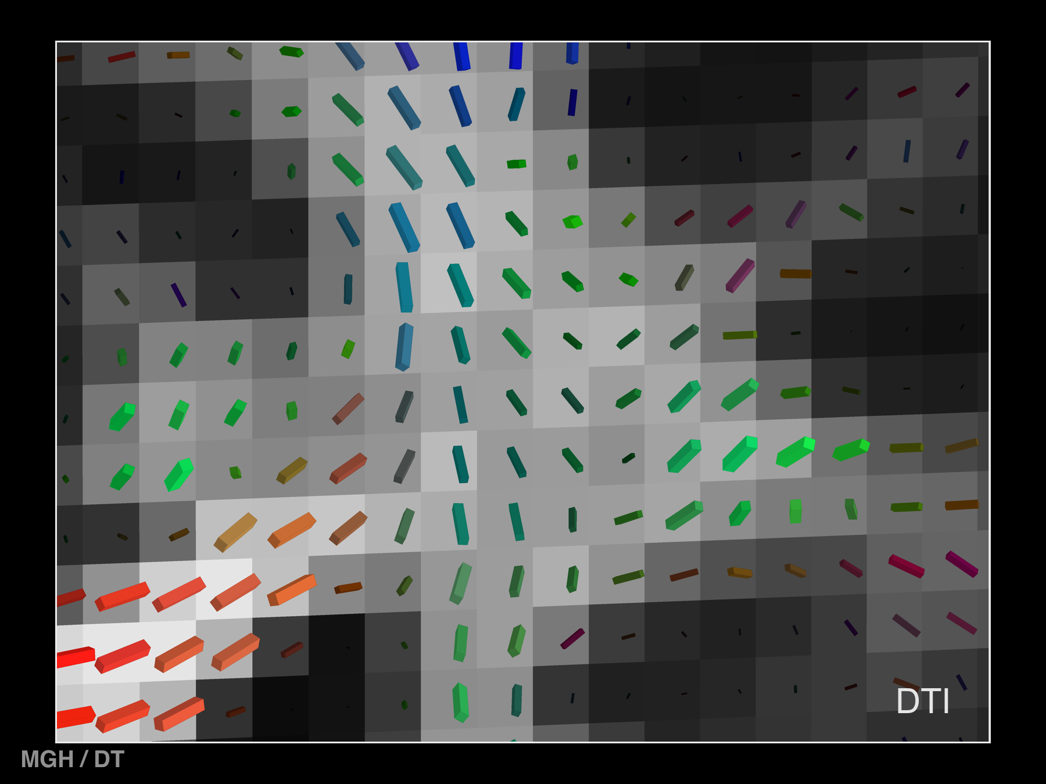
DTI
MGH / DT

Slide 6
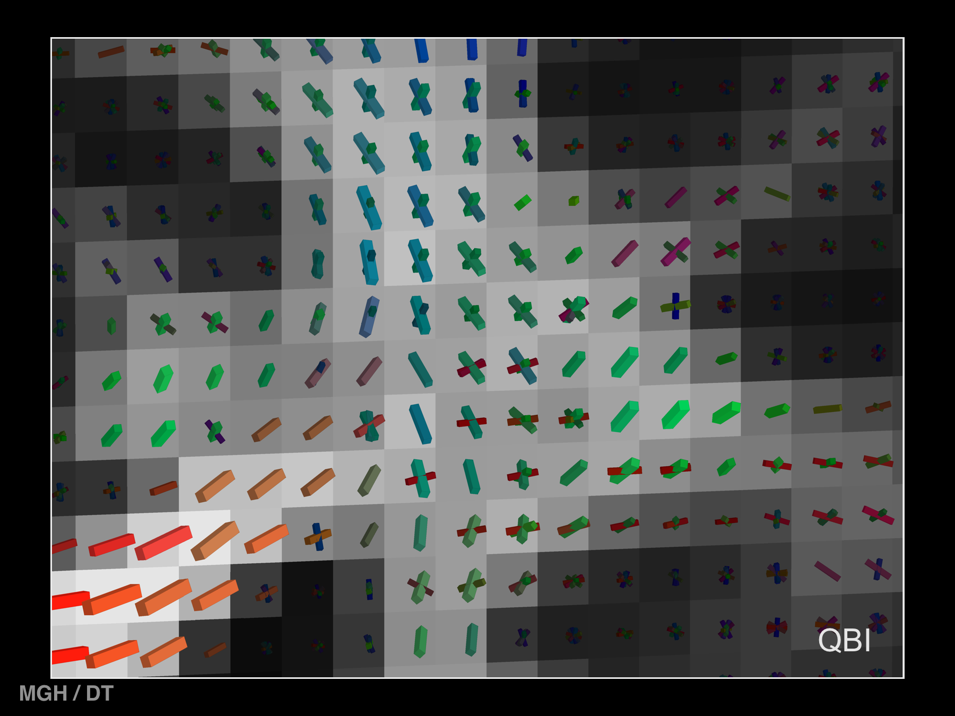
QBI
MGH / DT

Slide 7
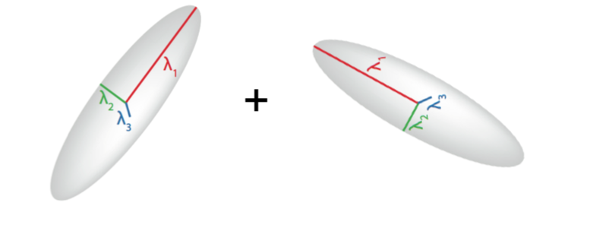
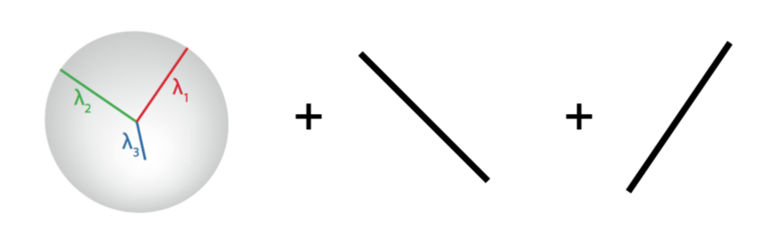
Higher Order Models
Fit multiple components to diffusion data
HARDI / single shell
Multi-tensor
Ball & Stick (FSL)

Slide 8
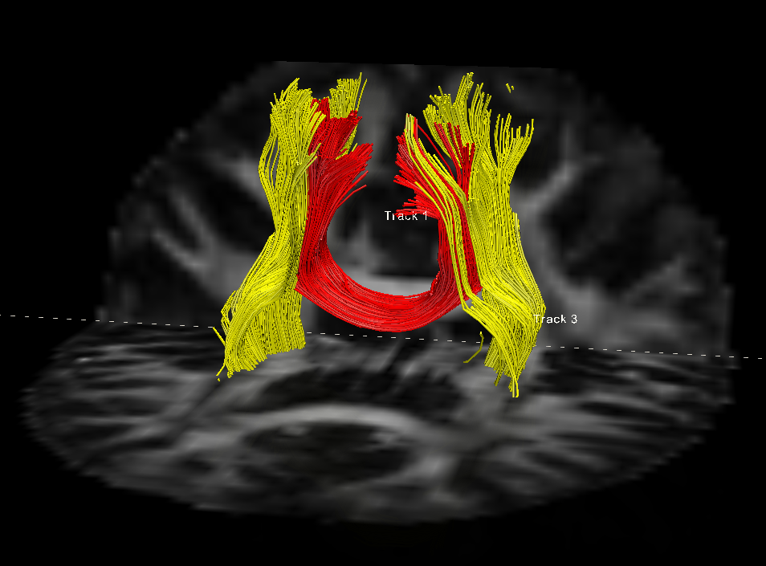
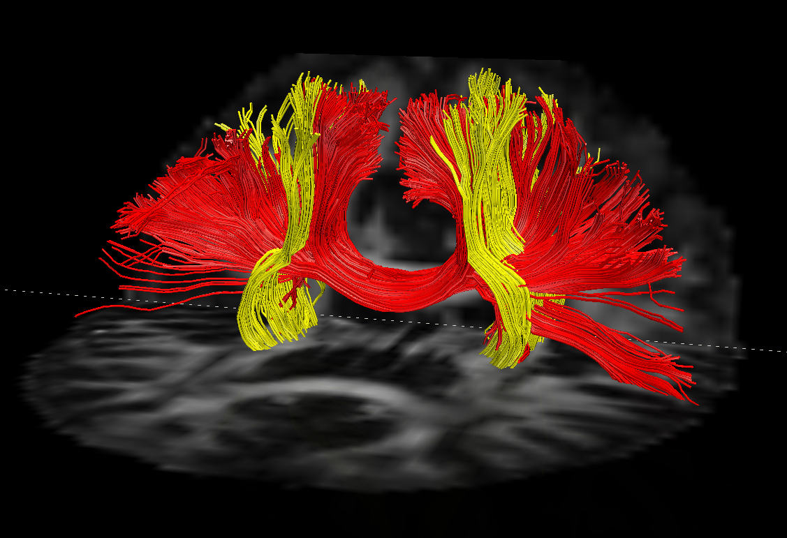
Spherical Deconvolution
DTI Tractography
Spherical Deconvolution Tractography
Spherical deconvolution: Fit a model of diffusion via spherical harmonics
ODF = Orientation Distribution Function

Slide 9
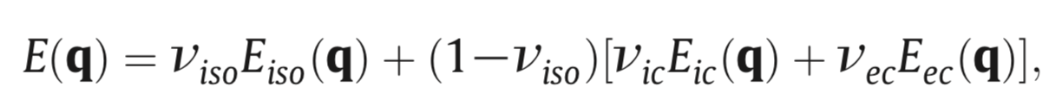
Higher Order Models
Tissue property focused
  Model intra and extra cellular diffusion
  Axon diameter: AxCaliber (and others)
    Issues with model overfitting
  Fiber density & orientations: NODDI
    Intracellular & extracellular & CSF compartments
      v_{ec} = 1 - v_{ic} , E_{ec} and E_{ic} coupled
    Orientation dispersion (OD), angular variance based on Watson distribution

Slide 10
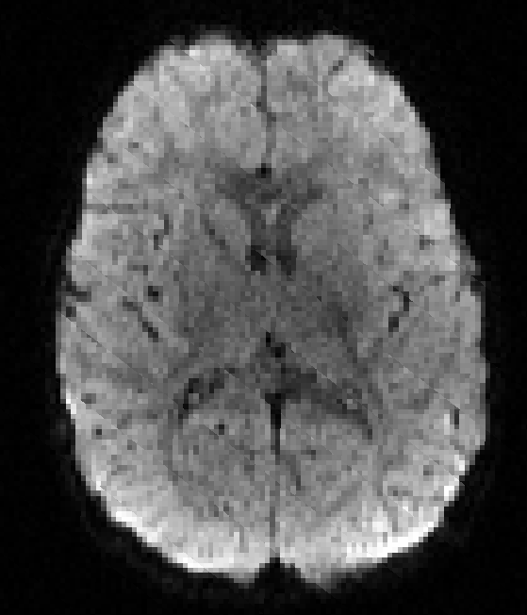
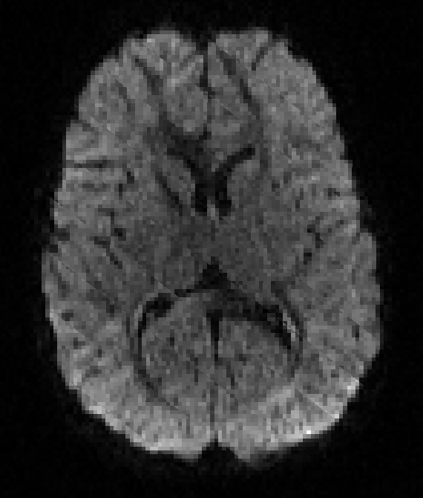
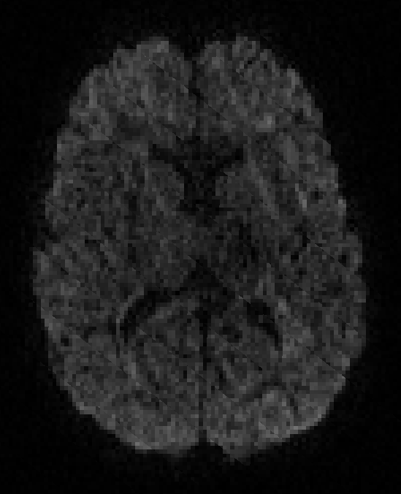
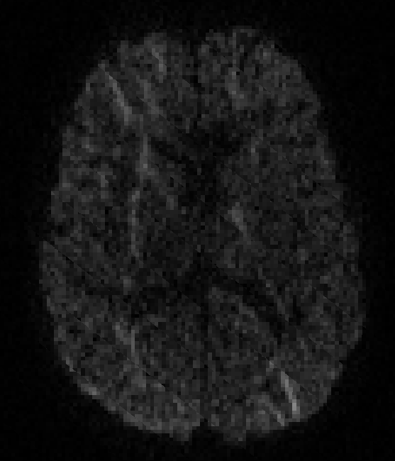
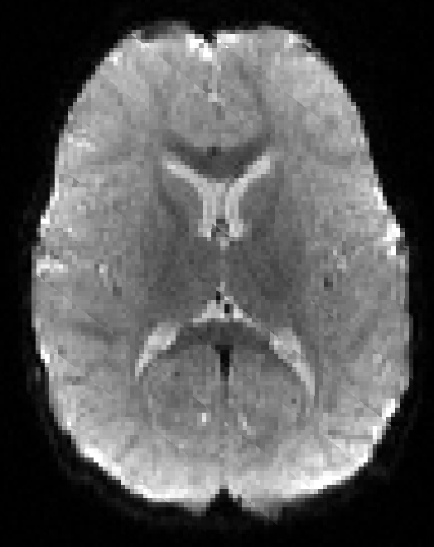
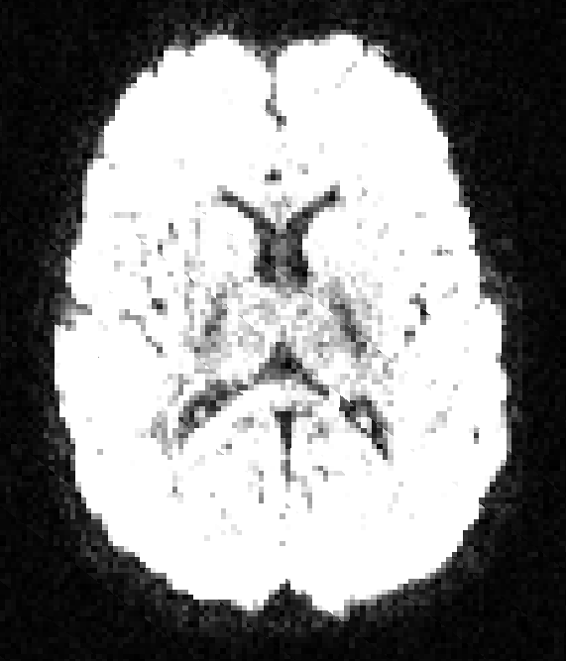
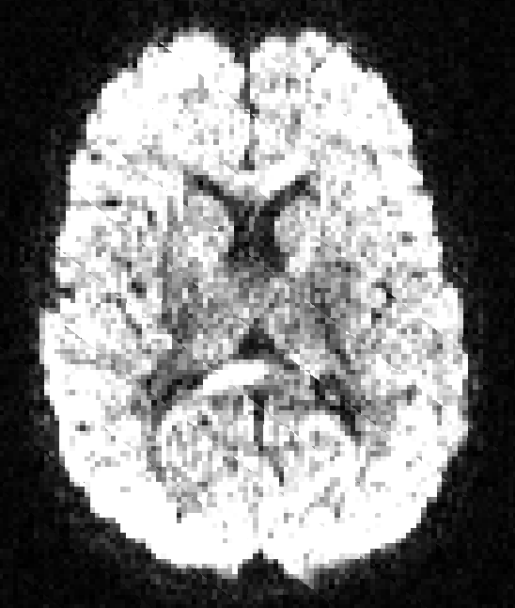
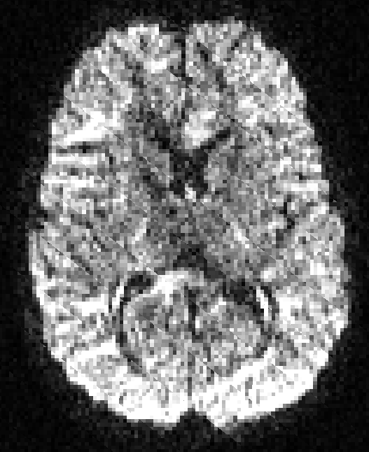
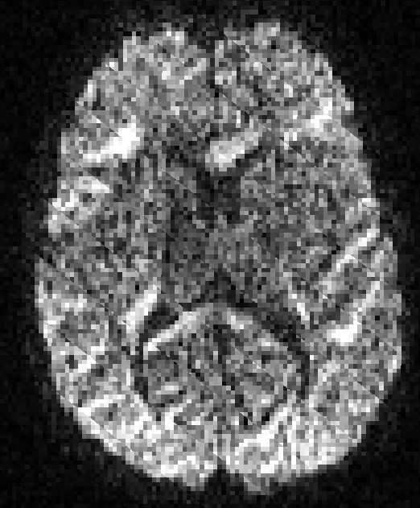
Multiple Shells
Recall: what’s a b-value?
  Amplitude G, duration δ and interval Δ: b = γ² G² δ² (Δ−δ/3)
Shell = acquisitions at a given b-value
  Higher shells => longer duration/interval
    Lower SNR, higher directional sensitivity
BCP on
Siemens Prisma
b=500
b=1000
b=2000
b=3000
b=0

Slide 11
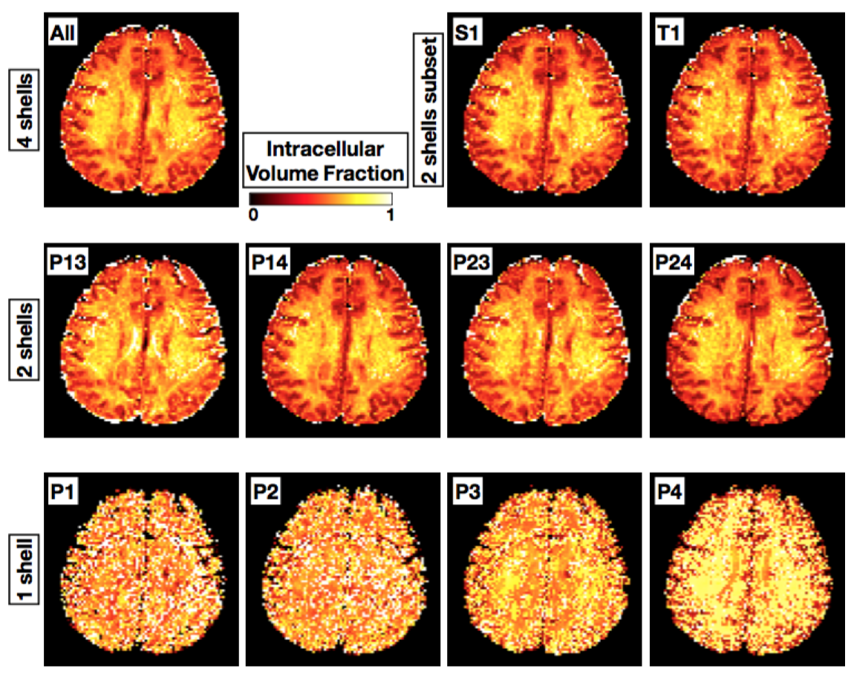
NODDI
At least 2 shells, better 3 or 4
Robust with 3

Slide 12
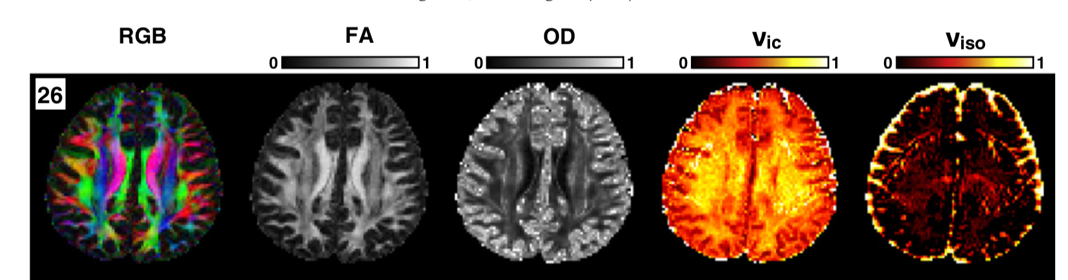
NODDI continued
AMICO implementation (Daducci et al 2015)
  Significant speedup, good stability
Widely used in recent years

Slide 13
NODDI continued
NODDI meaningful in GM
Naming ambiguity:
  ODI=OD
  ND=NDI=v_{ic}=f_{ic}
  FW=Iso_{vf}=v_{iso}=f_{iso}
  (FW=Free Water)

Slide 14
Conclusion – higher models
Properties:
  DTI scalars limited in interpretation
  Higher order: added interpretation
  Higher order: robust vs CSF
Tractography:
  DTI: Stops at major fiber crossings
  DTI: only main fiber reconstruction
  Higher order: resolves crossing fibers
  Higher order: reconstructs both major and minor fiber bundles
Disadvantage:
  Needs lots more diffusion DWI volumes, possible multiple shells

Slide 15
Structural Connectivity
Old structural connectivity:
  Volume correlations
  Are the volumes of different structural regions correlated?
New structural connectivity
  Is it likely that structural regions physically connected via WM tracts?
    Streamline counting based => Not actual fibers
    No true statistical probability of connectivity
  Sometimes, but NOT connectivity: What is WM microstructure (FA) along tracts connecting regions?

Slide 16
Connectivity Matrices
Extract connectivity matrices
  Akin to resting state functional connectivity
    Diffusion matrixes significantly sparser
  n regions => nxn matrix of fiber counts
Example Pipeline from literature:
Lot of processing choices, lots of bad choices in current literature
Lo et al, JNeurosci 2010

Slide 17
Processing Choices!
Region definition matters!
  Several different cortical, cerebellar and even subcortical parcellations
Tractography
  DTI vs higher order
  Deterministic vs probabilistic tractography
  Voxel vs surface based seed/target regions
  Region or whole brain tractography
Matrix normalization

Slide 18
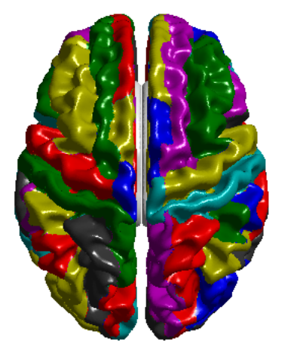
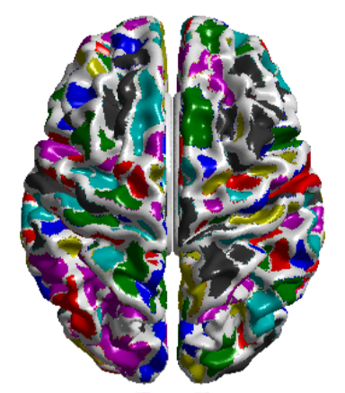
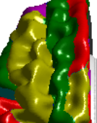
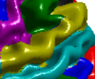
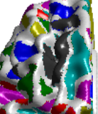
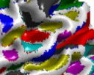
Which Parcellation?
Structural: AAL (2001) (90/78)
  Imperfect parcellation, yet most common
  Regions separate at sulcal base
  Sulci often functionally coherent
  FS: Desikan parcellation quite similar to AAL
Structural: Destrieux (2010) (148)
  Region separate at wall
  Our experiments: Better performance
Functional parcellation (2016) (333)
  Gordon/Petersen (2016)
  Prefers consistent sulcal regions
  Adult functional pattern based
  Our experiments: Best performance
AAL
Functional

Slide 19
Tractography I
All tractography: lots of biases!
DTI tractography:
  Do not use, high variance, noise sensitive
Higher order models:
  Single vs multi shell: multi-shell slightly improves tractography, but single shell ok
  Number of gradients (rule of thumb):
    40+ gradients: modeling of 2 fibers per voxel
    60+ gradients: modeling of 3 fibers per voxel
    Do not model more than 3 fibers…

Slide 20
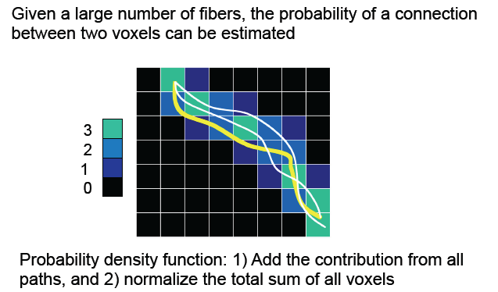
Tractography II
Probabilistic vs deterministic
  Connectivity ~ likelihood of being connected
  Best captured by stochastic method. If possible do not use deterministic tractography.

Slide 21
Tractography III
Region wise: Start/end tracking at regions
  + Each region starts proportional amount of fibers
  + Memory per region, only store visitation maps
  Slow, restart tracking for every region
  Start tracking at GM/WM interface
  Asymmetric matrices
Whole brain: start tracking everywhere in WM
  + Efficient, single set of streamlines
  + Start tracking where diffusion signal is high
  + Symmetric metrices
  - High memory requirement, all tracts stored
  Region close to center over-represented

Slide 22
Tractography IV
Surface regions: Start/end tracking at surface
  + Regions have consistent number of streamlines, independent of inter-subject size differences
  + Sub-voxel accuracy for seeding
  - Needs WM surfaces (additional structural processing)
Voxel regions: Start/end tracking in voxels
  + Most tractography methods are voxel seed based
  + Efficient processing via template registration
  Voxel-level accuracy
  Uneven number of streamlines per regions across subjects, connectivity highly sensitive to size variability

Slide 23
Example Processing?
Lo et al, JNeurosci 2010
Very common processing
AAL subdivision: not optimal
Whole brain tractography: not optimal
DTI deterministic tractography: Bad / NoNo
Voxel based: not optimal
=> Simplest pipeline, highest error/variance

Slide 24
Matrix Normalization
Region wise tractography: asymmetric matrices
  To symmetrize or not to symmetrize?
  Symmetrize via “average” or “max”
All matrices need normalization
  Streamline counting is noisy/sensitive, one cannot use raw counts
  Ratio to whole brain tracts: Percent over all brain tracts
  Ratio to tract between regions: Percent over tracts for that region

Slide 25
CIVILITY
Our connectivity tool
Probabilistic tractography with 2-3 fibers (ball & stick)
  Surface region based
  Any parcellation
Computation on cluster (longleaf)
Javascript based visualization of metrices

Slide 26
Visualization
Need for an interactive and customizable visualization
  CPE intern Wieke

Slide 27
Conclusions
Higher order models of diffusion needed
  For improved interpretation
    NODDI is in heavy use
  For improved tractography
    Smaller tracts, U-fibers, Tumors/Lesions
  For connectivity processing
    To get structural brain connectivity matrices

