Slide 1
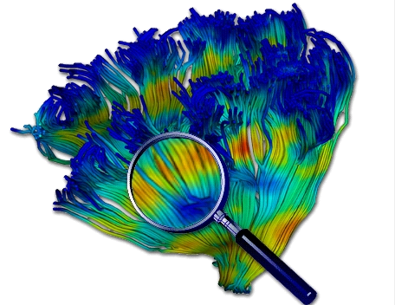
Diffusion MRI - Lesson 4
Atlases, Fibers and Profiles
Martin Styner UNC
Thanks to Guido Gerig, NYU
And many, many folks

Slide 2
Content
The UNC-NAMIC Atlas Fiber Analysis
Unbiased DTI atlas building via DTIAtlasBuilder
Tracking fibers via AutoTract
  Editing tracts in Slicer and FiberViewerLight
Extracting fiber profiles via DTIAtlasFiberAnalyzer
Statistical Analysis via FADTTSter

Slide 3
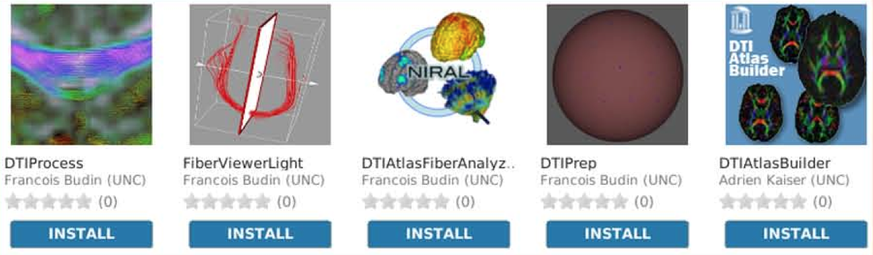
UNC dMRI Slicer Extensions
DTI QC: Vibration artifacts, Error estimation
Fibers: Post-processing, clustering
Statistical analysis methods
Main tool development, Slicer extensions, batch and grid processing

Slide 4
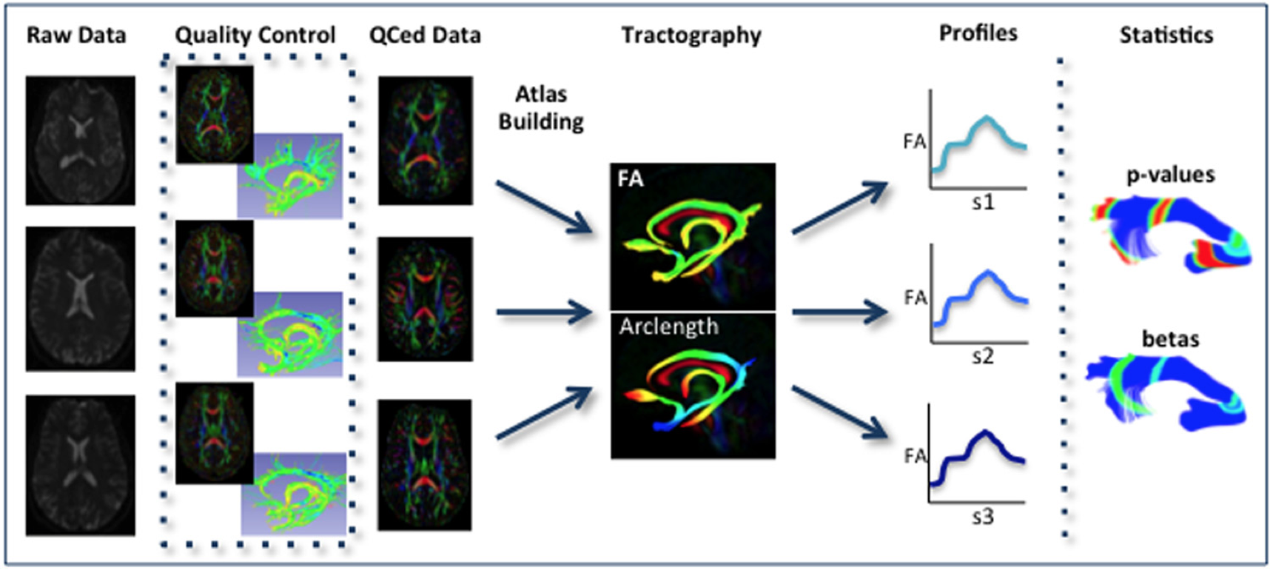
UNC-NAMIC DTI Fiber Analysis
Analysis of DTI properties along the fiber
Many years of methods & tool development
Allows for localized analysis with high sensitivity
Verde AR, Budin F, Berger J-B, Gupta A, Farzinfar M, Kaiser A, Ahn M, Johnson H, Matsui J, Hazlett HC, Sharma A, Goodlett CB, Shi Y, Gouttard S, Vachet C, Piven J, ZHU H, Gerig G, Styner M. UNC-Utah NA-MIC framework for DTI fiber tract analysis. Front Neuroinform. 2014;7:51. PMCID: PMC3885811

Slide 5
AutoTract/Slicer/FiberViewerLight
FADTTSter/Slicer
DTIPrep/Topup/Eddy
DTIAtlasBuilder
DTIAtlasFiberAnalyzer

Slide 6


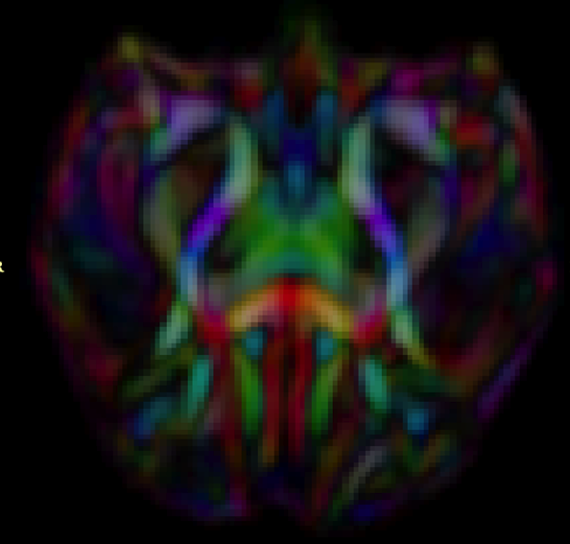
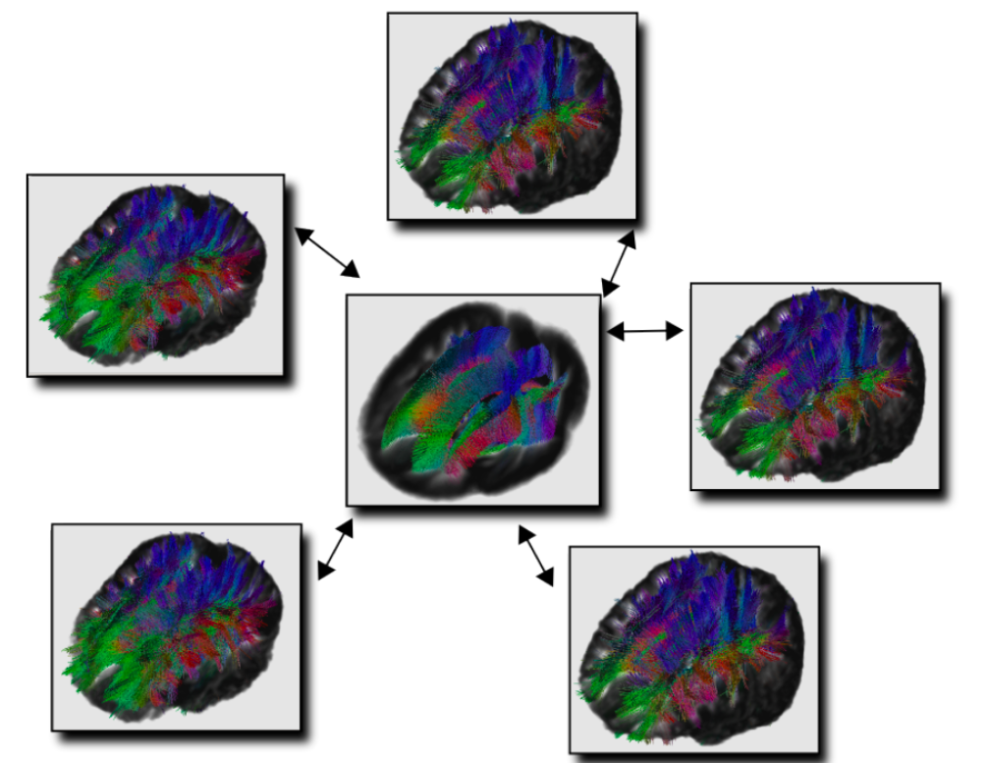

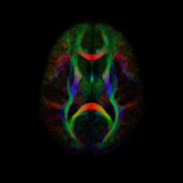
DTI Population Atlases
Definition of standard space
SNR increase
Better tractography
Neonate
1 year
Rhesus (15mo)
2 year
Adult

Slide 7
4 Main Steps

Slide 8
1. Affine Atlas
Optional initial template
  Allows for atlas to be aligned with prior reference space
  Otherwise first image is initial template
First loop: align to initial template
First affine average atlas after first loop alignment
Second loop: align to first affine atlas
Final affine average atlas after second loop

Slide 9
2. Diffeo atlas
Unbiased average atlas
  Diffeomorphic registration
  Iteratively sharpening atlas
    Deformable average that minimizes deformation over all input datasets
  Unbiased to order of presentation
Employs ”GreedyAtlas” tool
Sensitive to outlier intensities in data
  Ensure good brain masking
Separate folder for conversion of data formats

Slide 10
3. Symmetric Diffeo Atlas
2 runs of symmetric diffeomorphic registration
Employs DTI-Reg/”ANTS” tool
  Make sure to change default
  Default is an older tool (Demons) that does not perform as well
1 loop: Computes final atlas
2 loop: Maps data into final atlas

Slide 11


Data Organization
DTIAtlas
1_Affine_
Registration
2_NonLinear_
Registration
3_Diffeomorphic
_Atlas
4_Final_
Resampling
Dataset
.csv
Parameters
.txt
Results
.csv
Script
Loop0
LoopN
First Resampling
Second Resampling
…

Slide 12
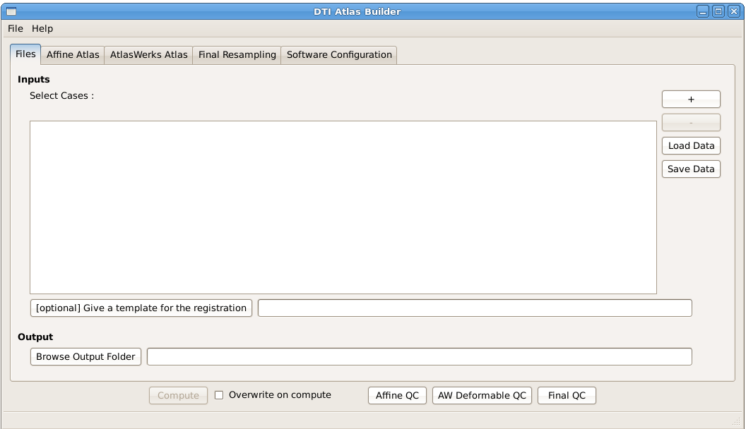
GUI

Slide 13
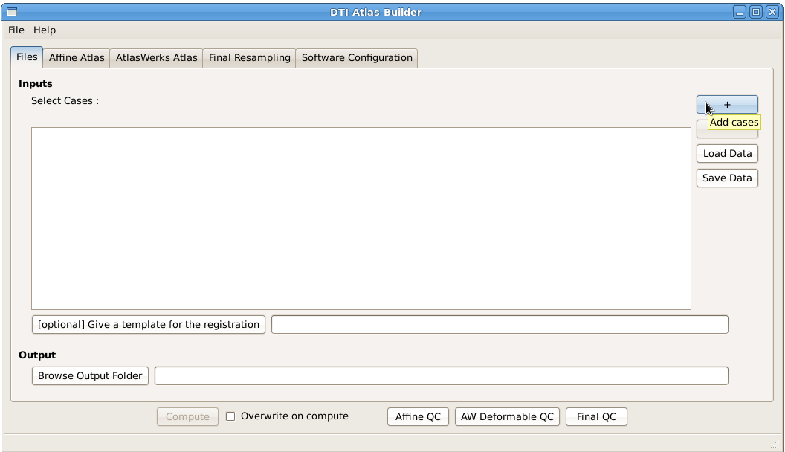
Add DTI Images
Clicking the '+' button will allow you to select several DTI images, and adding them to the central Cases box

Slide 14
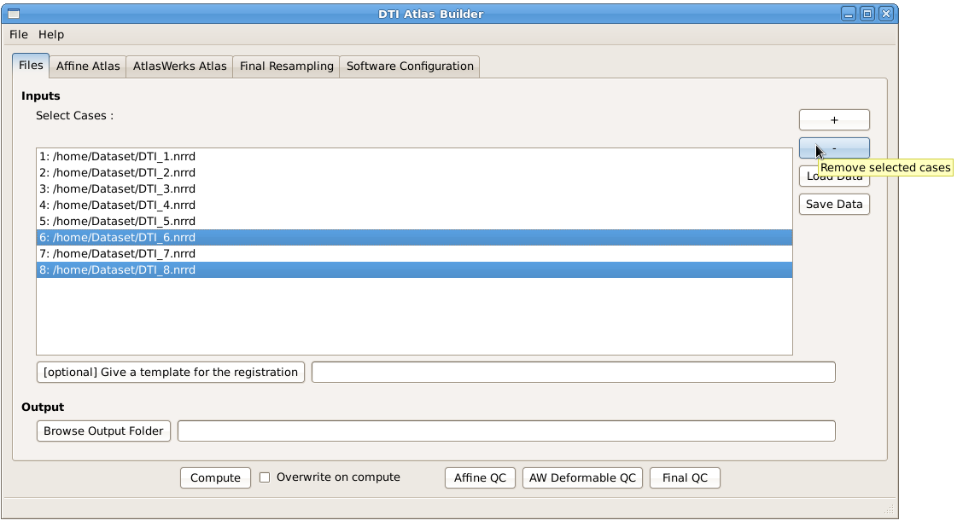
Remove DTI Images
After having selected some images, you can remove them from the central Cases box by clicking the '-' button

Slide 15
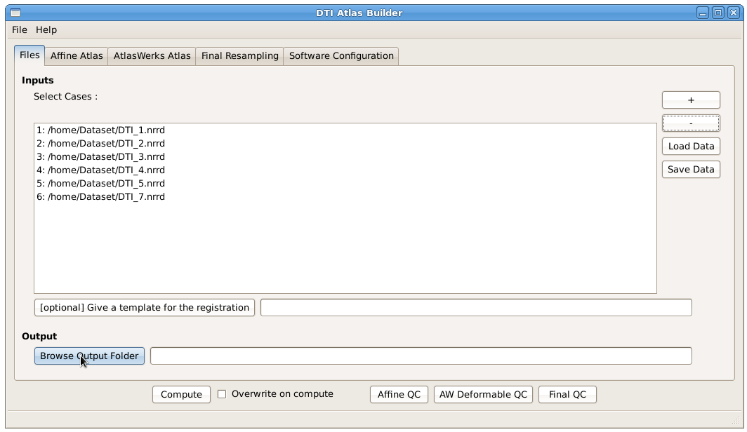
Give an output folder
You need to give an output folder: A folder named "DTIAtlas" will be created in your output folder, and all the files generated by the program will be put in it (Data organization on slide 33)

Slide 16
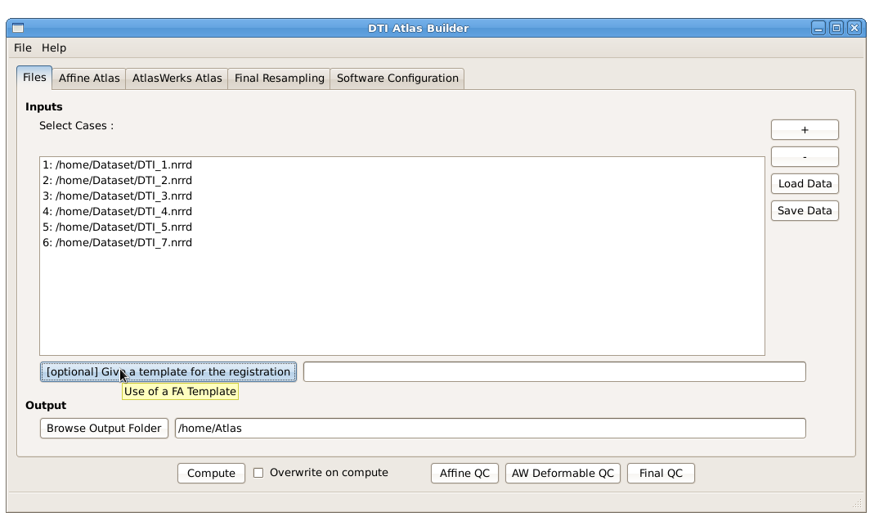
Optional : Give a FA Template

Slide 17
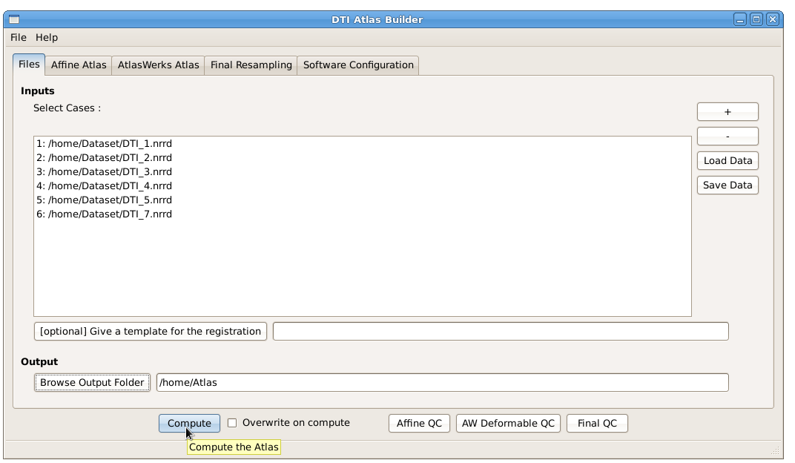
Compute the Atlas
When you added cases and gave an output folder, you can compute the Atlas by clicking the "Compute" button. It will test the existence and type of the files and the folders and tell you if some files are not images or DTIs.

Slide 18
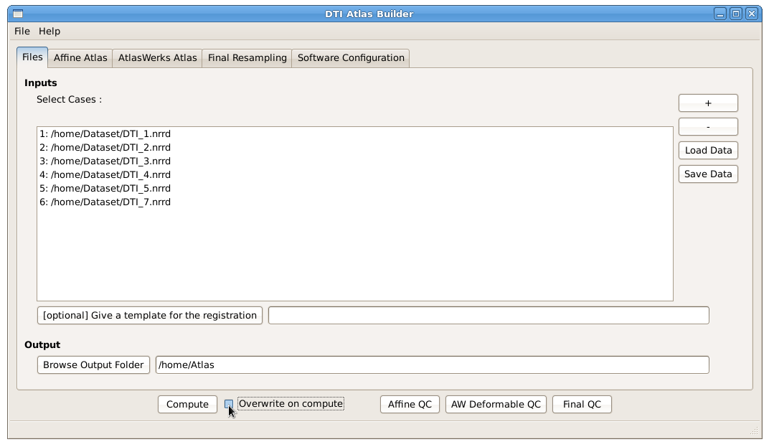
Overwriting
The "Overwrite" option will allow you write the images anyway, over existing images if they were computed already.

Slide 19
Correcting Affine Registration
If affine registration is bad
Add an initial affine transform :
  CaseX_InitLinearTrans.nrrd in folder [OutputFolder]/DTIAtlas/1_Affine_Registration/
  It will be used as an input for the Affine registration (with BRAINSFit)
  Generate initial transform in Slicer visually/manually and save as .txt transform file

Slide 20
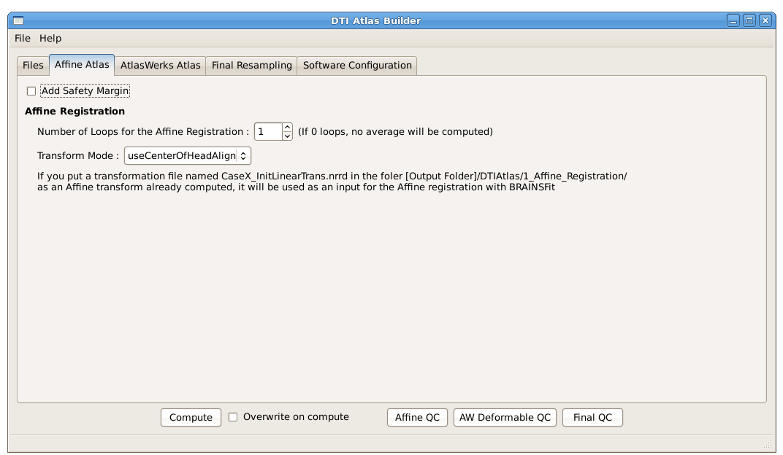
Affine Atlas
Safety margin => deformable registration has issues with images touching margins

Slide 21
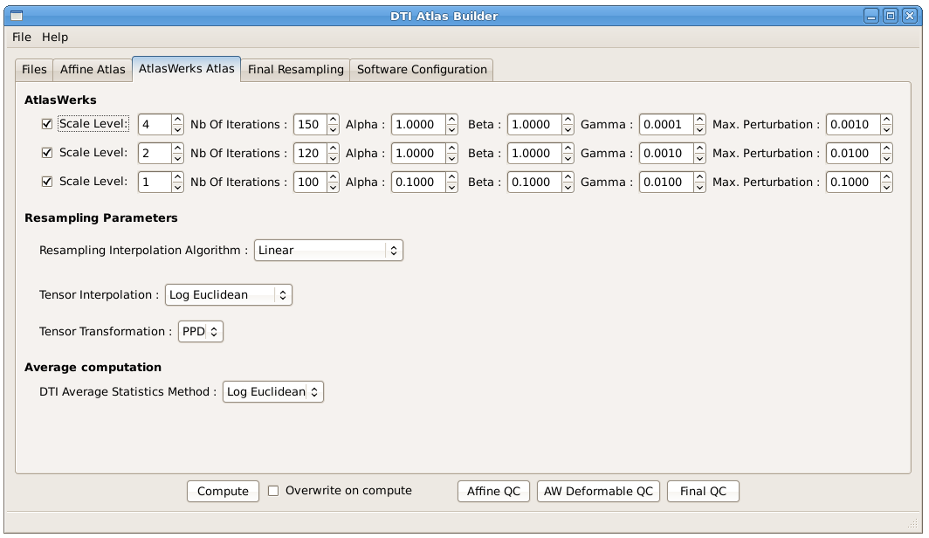
Diffeomorphic Atlas
Don’t touch…

Slide 22
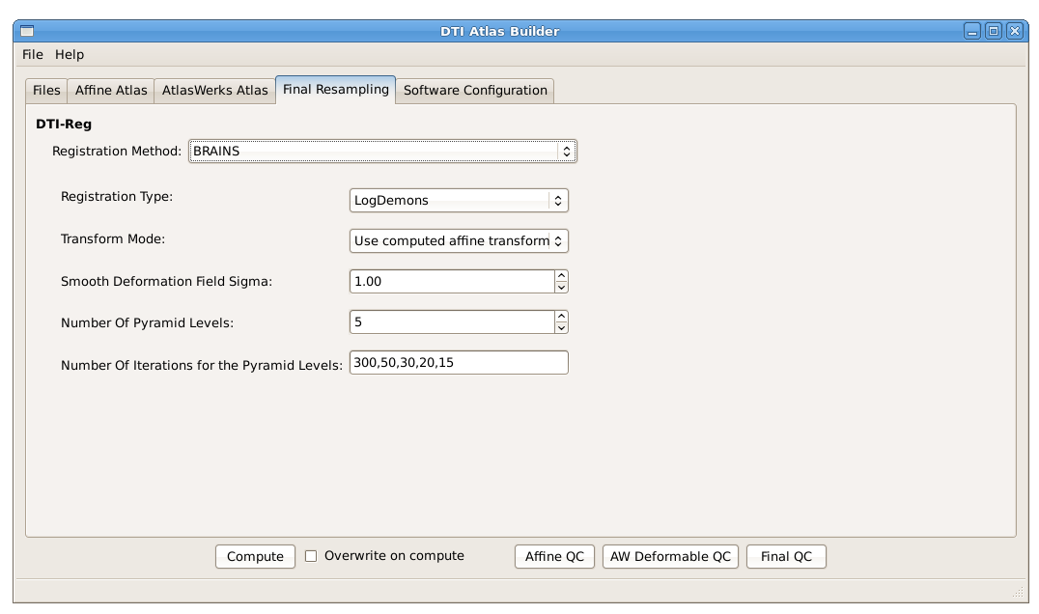
Final Resampling
Will be performed via DTI-Reg
Creates deformation fields from original to atlas space
Use ANTS! Change the default

Slide 23

Final Resampling
Will be performed via DTI-Reg
Creates deformation fields from original to atlas space
Use ANTS! Change the default

Slide 24
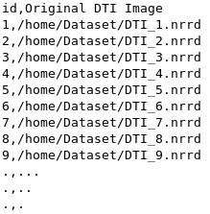
Load and Save
Save your parameters: In the « File » Menu, you can Save or Load a parameter file.
When you save the parameters, a .csv file with the dataset will automatically be created in the same directory than the parameter file.
Auto save: When you push the « Compute » button, the program will automatically save a parameter file (DTIAtlasBuilderParameters.txt) and a .csv dataset file (DTIAtlasBuilderDataset.csv) in [OutputFolder]/DTIAtlas.
It will also save a .csv file with the paths to all the interesting files generated, in this same folder (DTIAtlasBuilderResults.csv).
Save your Dataset into a CSV file so you can load it and use it again later.

Slide 25
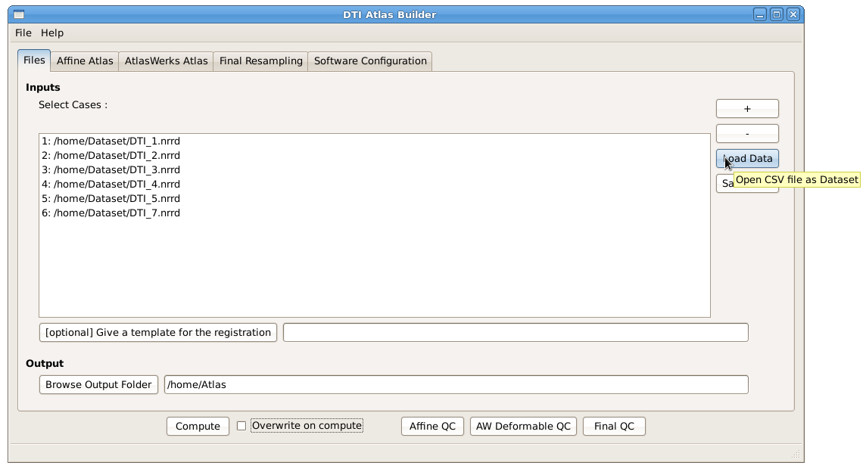
Load and Save

Slide 26
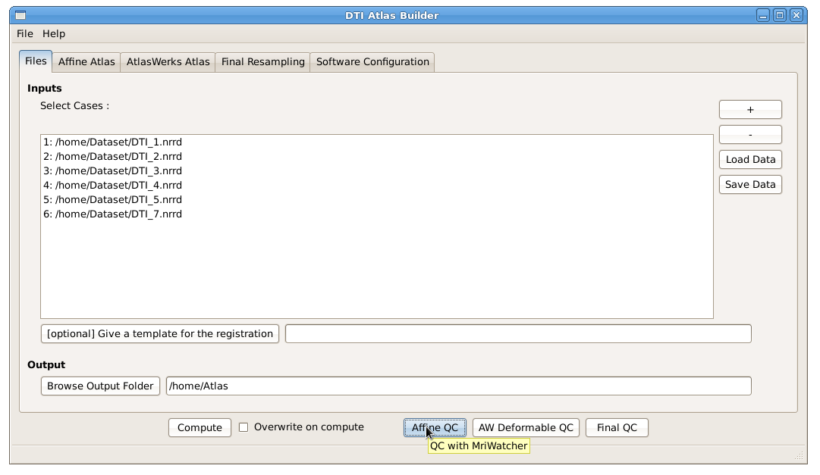
Quality Control
By pushing one of the QC buttons, you will run MriWatcher to see the images at different steps of the compute, and check if the results are good.

Slide 27
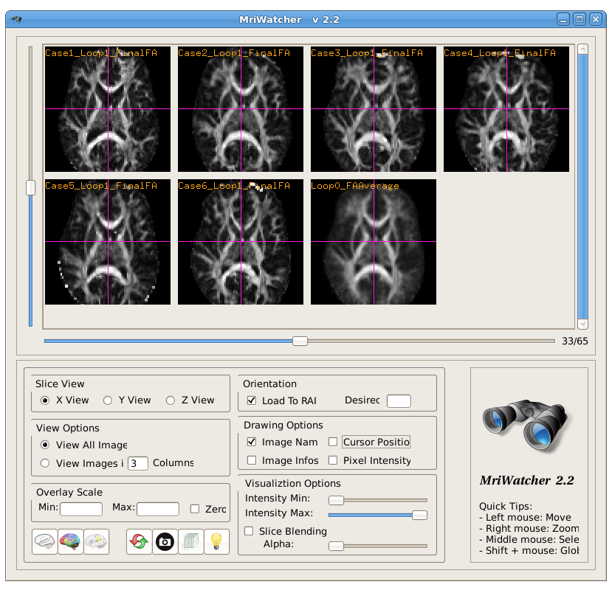
Quality Control
Affine QC:
Affine registered FAs and last affine average computed
Deformable QC:
Deformably registered FAs and Diffeomorphic Atlas
Final QC:
Final DTI-Reg resampled FAs and final Atlas

Slide 28
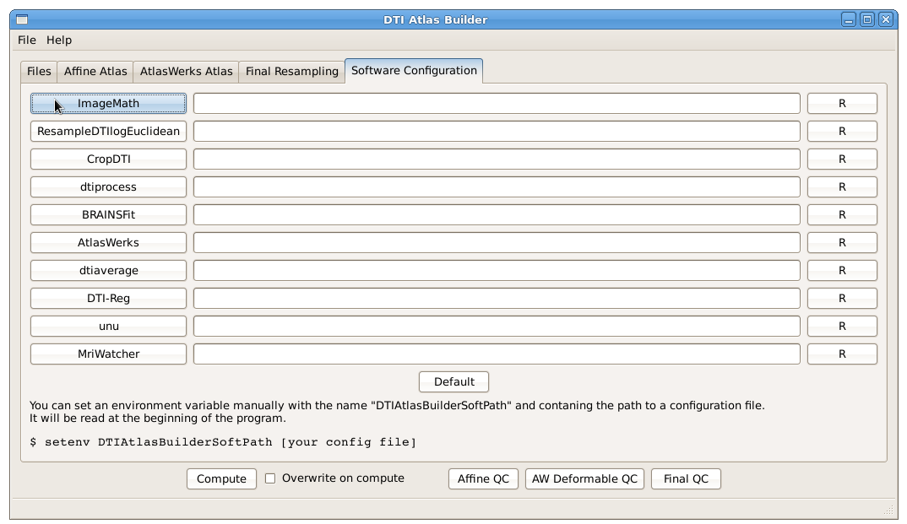
Manual Configuration
If you have your own version of the programs or if you need to use a particular version of it, you can write the path manually or click the button to search it.

Slide 29
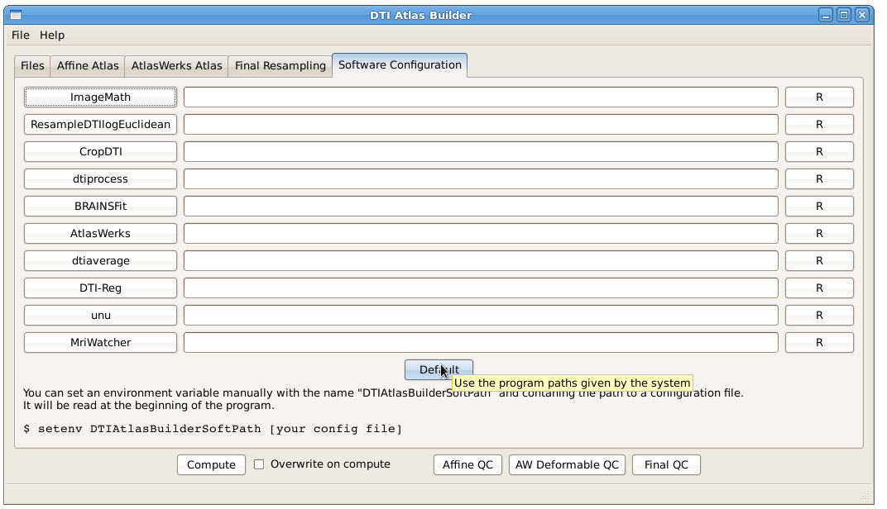
Automatic Configuration
Software Configuration
By clicking the "Default" button, the program will automatically search all the programs in the PATH, and tell you if some of them are missing.

Slide 30
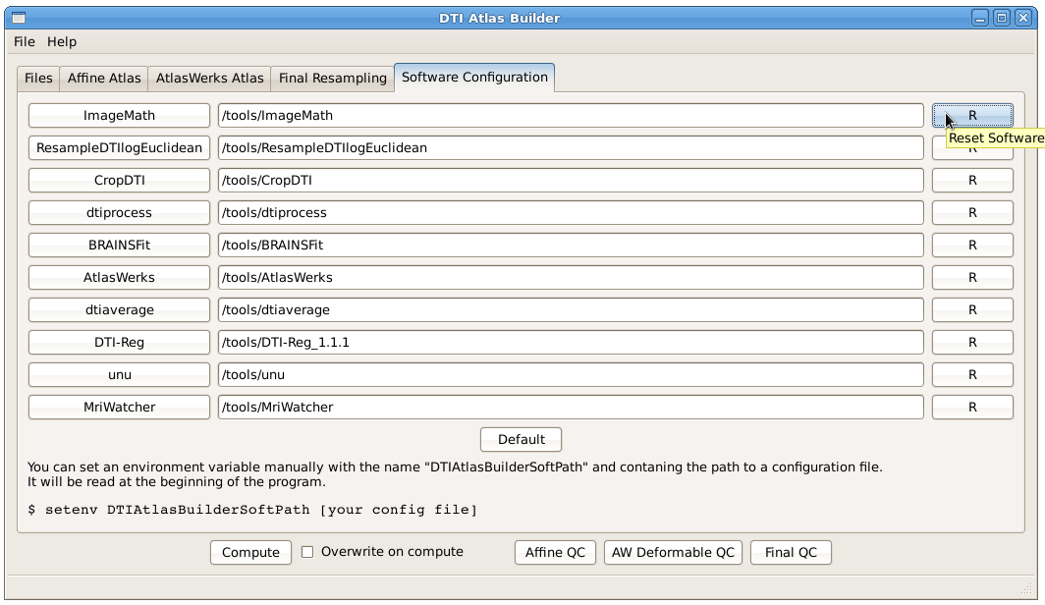
Automatic Configuration
If you want to reset the path for one or more programs, just push the "R" button and it will search the corresponding program in the PATH.

Slide 31
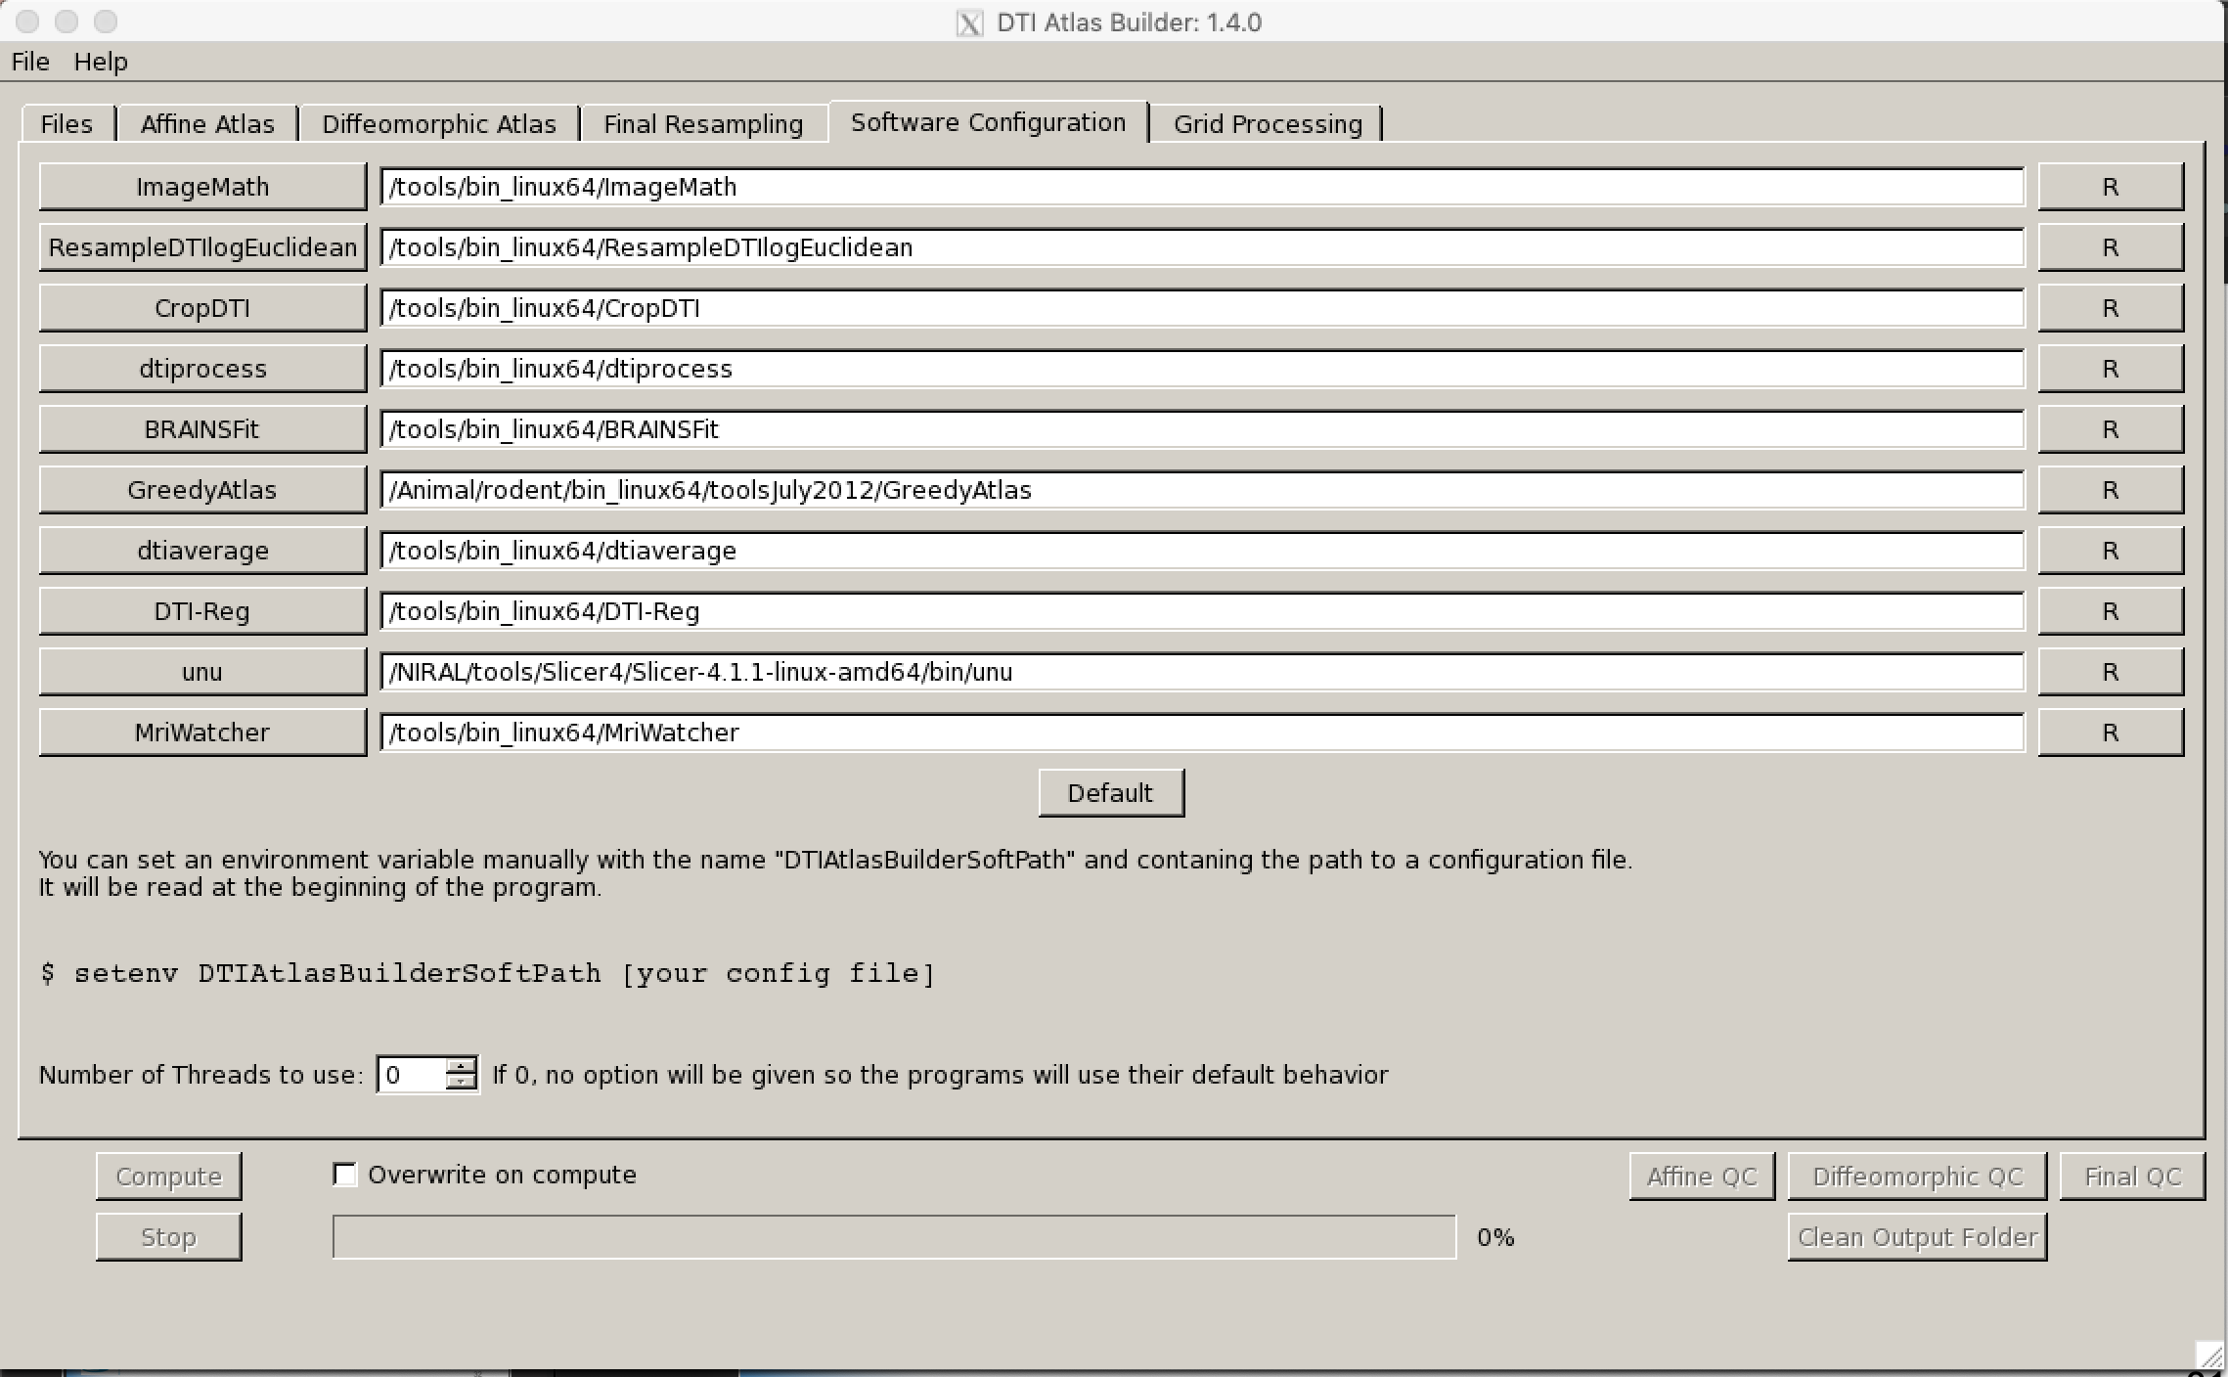
Newest Version (change)
Number of threads for a given tool (no parallelization)

Slide 32

Load and Save
Save your configuration: In the « File » Menu, you can Save or Load a configuration file generated by the program.
You can set an environment variable manually with the name “DTIAtlasBuilderSoftPath” and contaning the path to a configuration file. It will be read at the beginning of the program to configure the softwares.
When opening the program, it will automatically search and load any file called “DTIAtlasBuilderSoftConfig.txt” in the directory where the executable is and in the current work directory.
So you can put this file in any of these folders and you will not have to set an environment variable to have to software automatically configured.

Slide 33
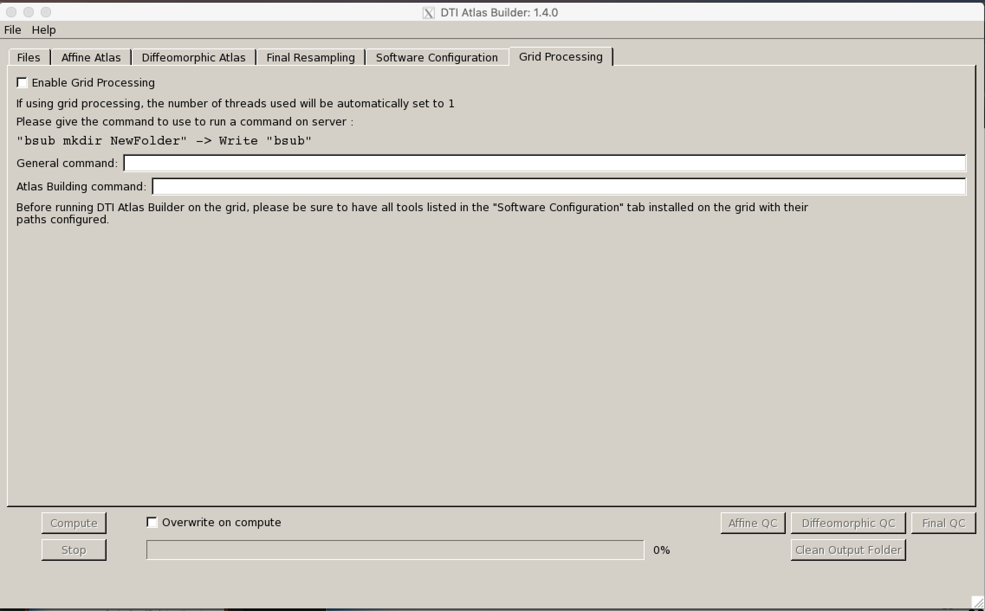
Grid Processing
Grid processing: provide the submit command for your grid for parallelization of the registrations. For each step of the pipeline, commands for all the cases are submitted and the program will wait until all cases have been processed.
Additional setting for unbiased diffeo step as that one needs much more memory

