Slide 1
Science and Security:
The Impact to Other Support (NIH), Foreign Components (NIH), and Current and Pending Support (NSF)
Brian Collier
Assistant Director of Research Administration, OSR
Sherry Whitaker
Director of Sponsored Programs Office, SoM
4/9/2020 Version

Slide 2
Summary
Recently, concerns have been raised by the Federal Government that the integrity of the U.S. research enterprise is being threatened and they are taking steps to ensure more transparency and better security of confidential information and scientific data. This broad reaching issue is commonly referred to as “Science and Security” or “Foreign Influence”.
The impact to the University covers many areas, however this presentation will focus solely on new Federal guidelines for the research areas of Other Support (NIH), Foreign Components (NIH), and Current and Pending Support (NSF).

Slide 3
What Changes Affect the NIH Other Support?
Your NIH Other Support document now needs to include ALL resources made available to you in support of and/or related to ALL your research efforts. This includes:
  Financial resources provided to you by non-UNC Chapel Hill entities and provided by UNC Chapel Hill. This includes service agreements. Do NOT include UNC startup funds.
  IN-KIND resources provided to you by non-UNC Chapel Hill entities.
  Resources provided to another party in support of your research or research project(s).
  NOTE: The responsibility for the accuracy of your Other Support lies with YOU and you alone.

Slide 4
Recap of Types of NIH Other Support
Financial Resources:
Your externally funded active and pending awards, including those made direct to UNC Chapel Hill by a Federal agency or made by another entity using Federal funds (e.g. active and pending direct awards, incoming subcontracts, pilot project funding provided by NC TraCS Institute, etc). Be sure to include both domestic and foreign awards and use TOTAL budget.
Funded service agreements to the University that involve you, because the funding organization must report these to the federal government through Open Payment disclosures.
Your funded external activities that directly impact your research or are research-related. Federal guidance in this area continues to change so we recommend including research-related funding, even if the funds aren’t used to directly support your research, to be fully transparent.
Financial resources provided to another party in support of your research or research project (e.g. a grant to another University who donates some of the funds to you for specific use in your project).
Your startup funds provided by an entity other than UNC-Chapel Hill.
NOTE: NIH no longer requires gifts to be reported but you MAY report them if you want, especially if the gift directly subsidizes your research in some way. NIH also no longer requires you to report training grants or prizes.

Slide 5
Recap of Types of NIH Other Support
In-Kind Resources:
Lab or office space that you use outside of UNC-Chapel Hill to conduct research (e.g. a lab at a pharmaceutical company or other University). UNC-Chapel Hill resources should be placed in the Facilities and Other Resources section of your application.
High value scientific materials that are not publicly available and are given to you or your project for use in your research (e.g. drugs, mouse lines, assays, etc.). NIH has not defined “high value” so err on the side of caution. This includes materials provided to another party in support of your research or research project (e.g. free drugs provided to one of your collaborators who then provides them to you).
Collaborators whose efforts support your research in some way. If you have many collaborators, you may use a summary statement to describe them. See the example in the FAQ section on the OSR Science and Security webpage noted in the links section of this presentation.
Visiting Faculty/Scholars/Scientists/Post-Docs whose efforts support your research, regardless of funding sources, and undergraduate and graduate students whose efforts directly support your research but whose salary isn’t paid by your projects or who aren’t paid at all.
NOTE: Any domestic or international position you hold, including honorary, adjunct, or others should be placed in your biosketch, including those related to external activities.

Slide 6
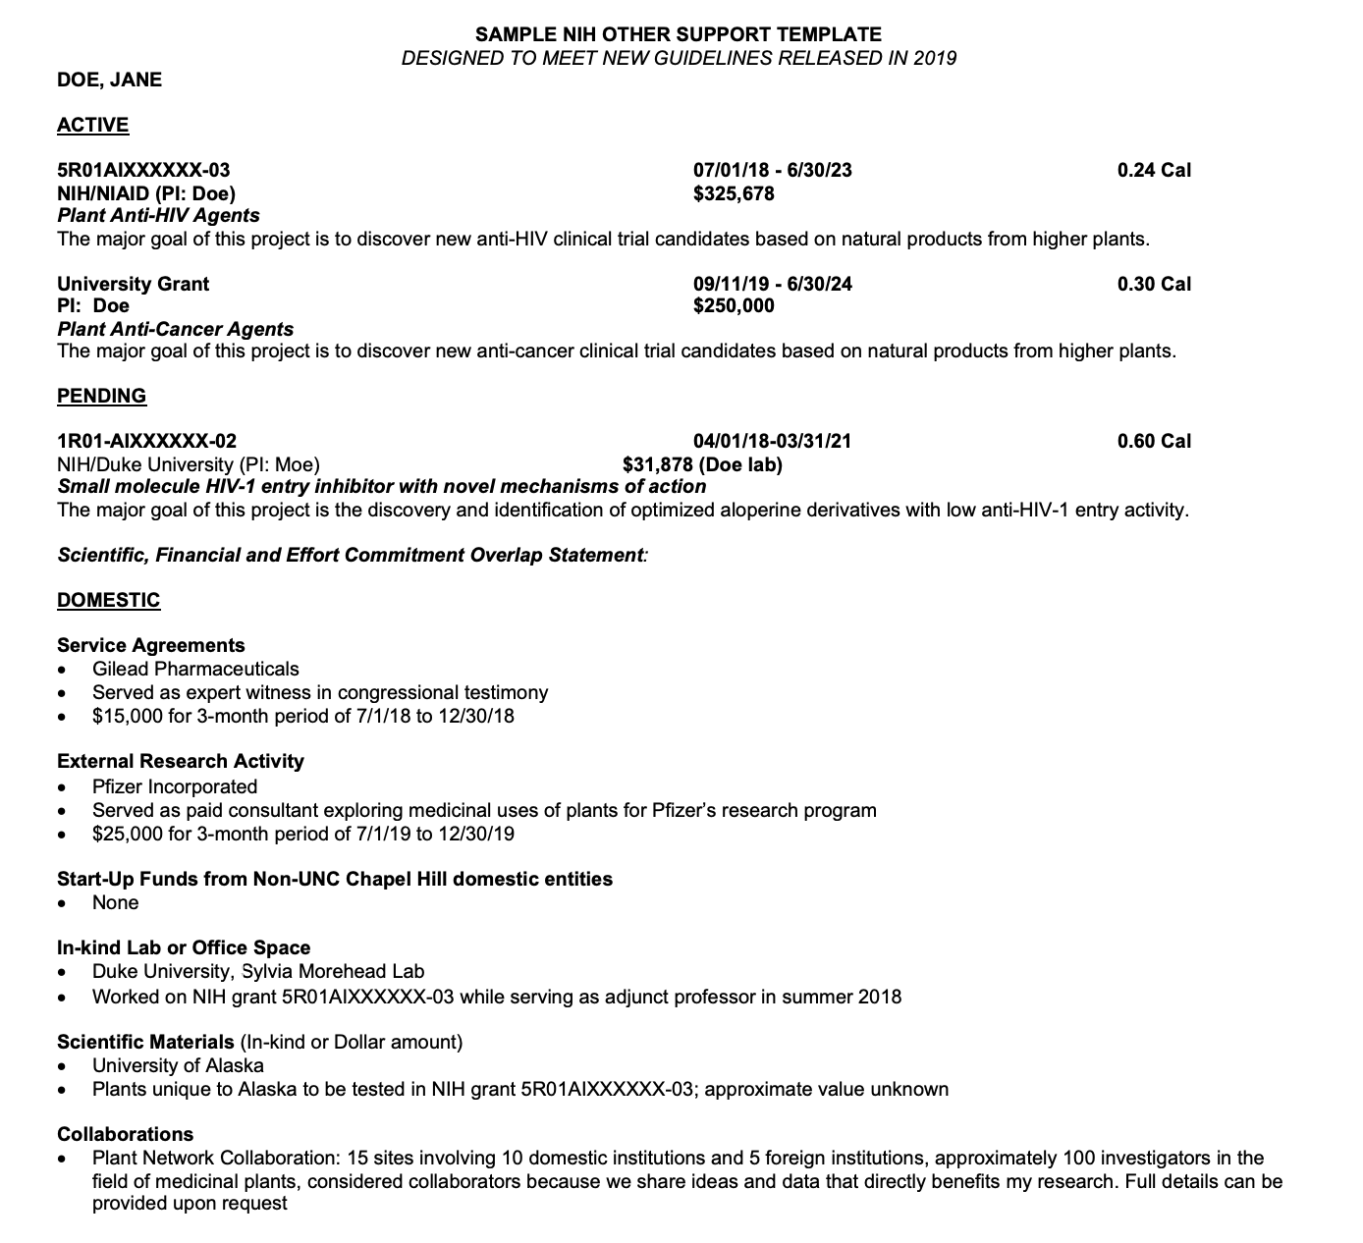

Slide 7
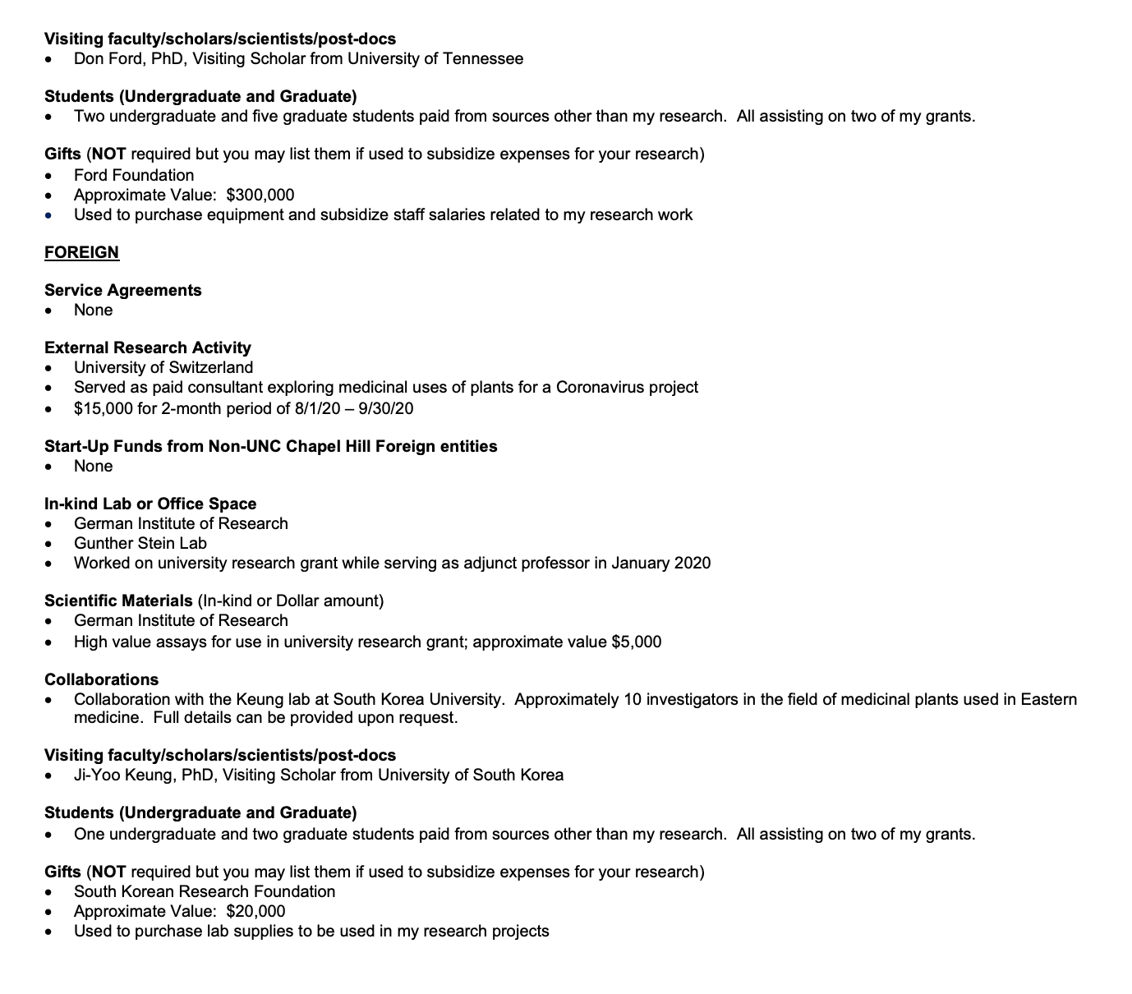

Slide 8
Changes to NSF Current & Pending Support
Effective 6/1/2020
Your NSF Current and Pending Support document now needs to include ALL resources made available to you in support of and/or related to ALL your research efforts. Responsibility for the accuracy of your Current and Pending Support lies with you and you alone.
Financial Resources:
Your externally funded active and pending awards, including those made direct to UNC Chapel Hill by a Federal agency or made by another entity using Federal funds (e.g. incoming subcontracts). Be sure to include both domestic and foreign awards and use TOTAL budget.
Funded service agreements to the University that involve you, because the funding organization must report these to the federal government through Open Payment disclosures.
Your funded external activities that directly impact your research or are research-related. Federal guidance in this area continues to change so we recommend including research-related funding, even if the funds aren’t used to directly support your research, to be fully transparent.
Your startup funds provided by an entity other than UNC-Chapel Hill.
Gifts given to you or UNC Chapel Hill that are used to support your research and require specific obligations and staff time commitments.

Slide 9
Changes to NSF Current & Pending Support Effective 6/1/2020
In-Kind Resources:
The same types of in-kind resources listed in your NIH Other Support should also be used in your NSF Current and Pending Support though where they are placed in the NSF Current and Pending Support differs depending on how the resource is used. See below:
  If the In-Kind contribution is NOT specifically related to the proposed project AND has associated staff time commitment, you must report it in the Current and Pending Support section.
  If the In-Kind contribution IS specifically related to the proposed project, regardless of staff time commitment, you must report it in the Facilities, Equipment & Other Resources section.
NOTE: Any domestic or international position you hold, including honorary, adjunct, or others should be placed in your biosketch.

Slide 10
Templates and FAQ Links
Sample NIH Other Support Template (focus on content instead of format)
https://research.unc.edu/sponsored-research/forms/#
NSF Current and Pending Support Template
https://www.nsf.gov/bfa/dias/policy/cps.jsp
NIH Biosketch Information
https://grants.nih.gov/grants/forms/biosketch.htm
NSF Biosketch Information
https://www.nsf.gov/bfa/dias/policy/biosketch.jsp
FAQs
https://research.unc.edu/sponsored-research/resources/science-security/
https://grants.nih.gov/faqs#/other-support-and-foreign-components.htm

Slide 11
What is a Foreign Component to NIH?
NIH currently defines a foreign component as the existence of any significant scientific element or segment of your NIH-supported project performed outside the United States.
In other words, it means:
  The performance of work on your project by you or a project team member in a foreign location, whether NIH funds are expended or not expended; and/or
  The performance of work on your project by a researcher who is not on your official project team in a foreign location employed or paid for by a foreign organization, whether NIH funds are expended or not expended (e.g. a foreign collaborator you’re working with, etc.).

Slide 12
What does Significant Scientific Element Mean?
NIH has not provided a hard definition because it differs project to project. Some examples of project-specific activities that might be considered significant:
  Collaborations with individuals at a foreign site anticipated to result in them being named co-authors on publications attributed to the project;
  Use of facilities or equipment at a foreign site;
  Receipt of financial support or resources from a foreign entity.
NOTE: The University, with your help, will make the initial determination of significance, but NIH will make the final determination

Slide 13
What Could Happen if My Other Support, Foreign Component, or Current and Pending Support Information Isn’t Accurate?
The Federal Government may remove you from the project, impose specific award conditions, disallow costs, withhold future awards to the university, or terminate your award. In extreme cases, it may also result in your arrest for violating the False Claims Act or penalizing the university financially for the same reason. Below are links to specific cases where that has happened:
Harvard Professor Arrested
https://www.nbcnews.com/news/us-news/harvard-s-chemistry-chair-charged-allegedly-lying-about-china-contract-n1124646
University of Tennessee Professor Arrested
https://www.justice.gov/usao-edtn/pr/researcher-university-tennessee-arrested-wire-fraud-and-making-false-statements-about
Former Emory Professor Charged with Fraud
https://www.sciencemag.org/news/2020/02/ex-emory-scientist-ties-china-charged-fraud
Van Andel Research Institute Fined $5.5M
https://www.justice.gov/usao-wdmi/pr/2019_1219_VARI

Slide 14
Other Useful Information Links
UNC Research Foreign Influence:
https://research.unc.edu/compliance/foreign-influence/
OSR Guidance on Science & Security:
https://research.unc.edu/sponsored-research/resources/science-security/
SOM SPO Contact Information:
https://www.med.unc.edu/spo/spo-knows/
Reminders of NIH Policies on Other Support and on Policies related to Financial Conflicts of Interest and Foreign Components:
https://grants.nih.gov/grants/guide/notice-files/NOT-OD-19-114.html
NIH FAQs on Other Support and Foreign Components:
https://grants.nih.gov/grants/faq-other-support-foreign-components.htm
Clarifying Long-Standing NIH Policies on Disclosing Other Support:
https://nexus.od.nih.gov/all/2019/07/11/clarifying-long-standing-nih-policies-on-disclosing-other-support/
Maintaining Integrity in NIH Peer Review: Responsibilities and Consequences:
https://grants.nih.gov/grants/guide/notice-files/NOT-OD-18-115.html
ASPPH Presents Webinar: Managing Compliance Challenges Involving Global Collaborators: https://www.aspph.org/event/aspph-presents-webinar-managing-compliance-challenges-involving-global-collaborators/

Slide 15
Q & A

