Slide 1
Tackling Obstacles to Development of Strategies to Prevent Poor Outcomes in Knee Osteoarthritis
UNC CCCR Speaker Series
June 17, 2020
Leena Sharma, MD

Slide 2
Collaborators
Biostatistics
  Joan Chmiel
  Julia Lee
  Orit Almagor
  Jing Song
Imaging
  Ali Guermazi
  Frank Roemer
  Michel Crema
  Felix Eckstein
  Pottumarthi Prasad
Physical activity, human movement science
  Alison Chang
  Dorothy Dunlop
  Kirsten Moisio
Osteoarthritis Initiative
  Joan Bathon
  Jane Cauley
  Charles Eaton
  Marc Hochberg
  Rebecca Jackson
  Kent Kwoh
  Michael Nevitt

Slide 3
Theme
Long-term cohort studies of persons at high risk for knee osteoarthritis (OA) have improved our understanding of disease and disability development.
We can use these rich datasets to tackle obstacles to prevention strategy development.
  Disability
  Disease development and progression

Slide 4
The Problem
Knee OA is a major cause of disability
  The risk of needing help to walk a mile and climb stairs attributable to knee OA was higher than all other conditions examined.
  Estimating that OA accounts for 2.4% of all years lived with disability (YLD), the World Health Organization ranked OA 10th among contributors to 1990-2013 global YLDs.

Slide 5
Obstacle 1 and Potential Solution
Obstacle 1
  Beneficial approaches – e.g., physical activity, exercise – are difficult for persons with diseased joints
    Pain, deformity, deconditioning, and reduced aerobic capacity limit activity and exercise
    Maladaptation to avoid activity-related pain may be entrenched
  Managing knee OA disability is costly, due to morbidity, loss of mobility, and effect on work
Potential solution – prevention during earlier stages
  Early prevention strategies may be more effective and less costly than managing established disability
  Prevention strategies could delay, reduce ultimate severity of, and/or prevent knee OA disability

Slide 6
Obstacle 2 and Potential Solution
Obstacle 2
  Uncertainty regarding whom to target – persons with established knee OA? Early knee OA? Pre-OA (at high risk but not yet with radiographic disease)?
    In established knee OA, risk factors for functional decline have been identified; disease, disease-exacerbated factors, disease consequences play a big role.
      Knee pain, stiffness, swelling, functional instability, malalignment, muscle weakness, proprioceptive inaccuracy
      Worse BMI, comorbidity, falls, depressive symptoms, worse self-efficacy, sleep disturbance; less physical activity, more sedentary time
    Joint structural changes and symptoms complicate efforts to prevent decline, especially since interventions targeting them are inadequate.
Potential solution – focus on pre-OA
  Persons with pre-OA are at a stage when behavioral/lifestyle modification is more likely realizable and effective.

Slide 7
Obstacle 3 and Potential Solution
Obstacle 3
  Prevention trials optimally target persons at high risk for the outcome, but a method to stratify risk of functional impairment or disability has not been reported either for pre-OA or existing knee OA.
  Risk stratification methods are critical to identify high-risk groups, for trial eligibility and dissemination of prevention strategies.
Potential solution
  Develop risk stratification method
  Sharma L, et al. Development and Validation of Risk Stratification Trees for Incident Slow Gait Speed in Persons at High Risk for Knee OA. Ann Rheum Dis. 2019;78:1412-9

Slide 8
Objective
Develop and validate a practical, user-friendly method of risk stratification for subsequent development of functional impairment in persons at high risk for knee OA, applicable to community and clinical settings
Gait speed
  Established measure of functional impairment
  Associated with disability, increased morbidity, excess mortality
Osteoarthritis Initiative (OAI)
  Provided opportunity to follow the course of individuals at high risk for knee OA
  We leveraged OAI to study this group by extending their follow-up to 10 years
Multicenter Osteoarthritis Study (MOST)
  Includes a large cohort of persons at high risk for knee OA
  Best current opportunity to validate risk stratification method

Slide 9
Methods – Derivation and Validation Cohorts
Prospective, observational, longitudinal cohort studies of individuals with knee OA or at high risk to develop it
OAI
4796 persons
ages 45-70 years
MOST
3026 persons
ages 50-79 years
We additionally required baseline absence of OA in both knees (KL < 2)
and excluded persons with slow gait speed at baseline
Derivation Cohort
1870 persons
Validation Cohort
1279 persons

Slide 10
Methods – Inclusion/Exclusion Criteria and Recruitment, OAI & MOST
 | Osteoarthritis Initiative (derivation cohort) | Multicenter Osteoarthritis Study (validation cohort)
Age and sex distribution | Proportional to U.S. population | Proportional to U.S. population
Ethnic minorities | Per representation in respective area | Per representation in respective area
Enrollment sites | Baltimore MD, Columbus OH, Pittsburgh PA, or Pawtucket RI | Birmingham AL or Iowa City IA
Eligibility criteria for a participant at higher risk for knee OA | One or more of following, in absence of symptomatic knee OA: frequent knee symptoms (most days of 1m in past 12m) excess body weight (above median for each age‐ and sex‐specific group based on data from Framingham OA Study) prior knee injury causing difficulty walking for ≥ 1 week previous knee surgery family history of knee replacement Heberden’s nodes repetitive knee bending age 70-79 years | One or more of following, in absence of symptomatic knee OA: frequent knee symptoms (most days of past 1m) excess body weight (above median for each age‐ and sex‐specific group based on data from Framingham OA Study) prior knee injury previous knee surgery
Exclusion criteria (for OAI or MOST as a whole) | inflammatory arthritis severe bilateral joint space narrowing knee replacement and severe contralateral narrowing bilateral knee replacement or plan for it within 3 years MRI contraindications use of aids >50% of ambulation (except 1 cane) severe comorbidity double-blind clinical trial participation | inflammatory arthritis dialysis history of cancer (except for non-melanoma skin cancer) bilateral knee replacement unable to walk without another person or walker planning to move out of area in the next 3 years
Recruitment | Recruited community-dwelling individuals using population lists, mass mailing of study materials, and media and community outreach | Recruited community-dwelling individuals using population lists, mass mailing of study materials, and media and community outreach

Slide 11
Methods – Outcomes
Incident slow gait speed (< 1 meter/second)¹⁻³ at any follow-up
Persons with slow gait speed at baseline excluded
Measured using timed 20-meter walk
  In OAI, at baseline, 12m, 24m, 36m, 48m, 72m, 96m, 120m
  In MOST, at baseline, 30m, 60m, 84m
  1) Studenski S, et al. Physical performance measures in the clinical setting. J Am Geriatr Soc 2003
  2) Cesari M, et al. Prognostic value of usual gait speed in well-functioning older people – results from the Health, Aging, and Body Composition Study. J Am Geriatr Soc 2005
  3) Middleton A, et al. Walking speed: the functional vital sign. J Aging Phys Act 2015

Slide 12
Walking Speed and Associated Outcomes
Middleton A, et al. Walking speed: the functional vital sign. J Aging Phys Act 2015;23:314-22
*Able to climb several flights of stairs
**More likely to require long term care than discharge home or nursing home

Slide 13
Methods – 40 Baseline Variables Considered in the Derivation Cohort
Demographic: age, sex, race, ethnicity, education, income, health care coverage
Social support: marital status, living alone
Physical activity: PASE subscales – sitting, walking, light sport/recreation, moderate sport/recreation, strenuous sport recreation, muscle strength/endurance
Knee symptoms/function: frequent knee symptoms, frequent med use for knees, WOMAC pain, WOMAC stiffness, WOMAC function, KOOS pain, KOOS symptoms, KOOS QOL, KOOS QOL items, limit activities due to knee symptoms
Other joint symptoms or OA: hand OA (observation of obvious hard bumps on joints closest to fingertips), back pain, hip pain, ankle pain, foot pain
Comorbid conditions: overweight, obese, depressive symptoms, comorbidity, falls
Others: knee injury, knee surgery, family history of knee replacement, smoking

Slide 14
Methods – Statistical Analysis
Classification and regression tree (CART) methods were used in OAI derivation cohort to identify best set of predictors.
  CART segregates different values of predictors (classification) through decision tree composed of progressive binary splits based on recursive partitioning analysis.
  Every value of each predictor is considered as a potential split and optimal split is based on impurity criterion (reduction in residual sum of squares due to binary split of data at that tree node).
  Each parent node in decision tree produces two child notes, which in turn can become parent nodes.
  Process continues with tree building and pruning until statistical criterion indicates that tree fits without overfitting.
  Terminal nodes are mutually exclusive and exhaustive subgroups of sample.
Nodes constrained to minimum size of 60 in parent nodes and 30 in child nodes.
To avoid overfitting, tree models were evaluated for predictive ability using 10-fold cross-validation

Slide 15
Methods – Statistical Analysis (continued)
Outcome rates for each terminal node were used to create risk stratification groups in derivation cohort.
  Predictive value of risk stratification models was assessed by odds ratios (ORs) and 95% confidence intervals (CIs) comparing risk groups.
Derived trees were then prospectively applied to validation cohort to independently test their ability to identify participants in different risk groups.
  Outcome rates for these risk groups and ORs and 95% CIs comparing risk groups were calculated.
Discrimination ability of prediction models was compared using area under receiver operating characteristic curves (AUCs) in derivation and validation cohorts.
Salford Predictive Modeler’s CART v8.0 was used for CART and SAS v9.4 for logistic regression and AUC analyses

Slide 16
Results
Incident slow gait speed
  206/1870 (11.0%) in derivation cohort (10-year follow-up)
  143/1279 (11.2%) in validation cohort (7-year follow-up)
Outcome rates for each terminal node were used to create risk stratification groups in derivation cohort.
In derivation cohort, most parsimonious model was 3-risk-group tree including age and WOMAC Function.
7-, 9-, 11- and larger risk-group trees were within 1 SE of measured performance of most parsimonious tree, but trees with 11 or more risk groups were highly complex and difficult to interpret.
7-risk-group tree include age, WOMAC Function, education, strenuous sport/recreational activity, obesity, and high depressive symptoms as discriminators.
9-risk-group tree additionally included overweight or obesity.

Slide 17
1870 Eligible Persons (Derivation Cohort)
Age ≤ 66.5
Age > 66.5
7.1 %
High Risk-1
slow gait speed
23.1%
slow gait speed
(100/1411)
(106/459)
Comparison | OR | 95% CI
High Risk-1 vs. Low Risk | 5.24 | 3.80-7.24
High Risk-2 vs. Low Risk | 7.13 | 4.35-11.69
High Risk-2 vs. High Risk-1 | 1.36 | 0.84-2.21
1,411 Persons
WOMAC Function ≤ 23.7
WOMAC Function > 23.7
Low Risk
High Risk-2
5.4%
29.0%
FIGURE 1. Predictors of Incident Slow Gait Speed and Risk Stratification, Derivation Cohort. The figure depicts the optimal (most parsimonious) tree and frequency of outcome for each terminal node (risk group):
age >66.5 years (High Risk-1)
age ≤66.5 and WOMAC Function >23.7 (High Risk-2)
age ≤66.5 and WOMAC Function ≤23.7 (Low Risk)
slow gait speed
slow gait speed
(71/1311)
(29/100)

Slide 18
1870 persons
7.1%
(100/1411)
Age ≤ 66.5
Age > 66.5
High Risk-3
23.1% (106/459)
1411 persons
5.4% (71/1311)
WOMAC Function
≤ 23.7
High Risk-4
29.0%
(29/100)
WOMAC Function
> 23.7
1311 persons
9.9% (38/382)
≤ some college
> some college
Low Risk-2
3.6%
(33/929)
382 persons
11.5% (38/330)
strenuous sport/rec, ≤ 2d
strenuous sport/rec, > 2d
Low Risk-1
0%
(0/52)
330 persons
8.1%
(18/223)
not obese
obese
High Risk-1
18.7 % (20/107)
223 persons
FIGURE 2. Predictors of Incident Slow Gait Speed and Risk Stratification, Derivation Cohort.
The figure depicts the 7-risk-group tree and frequency of outcome for each risk group:
age >66.5 (High Risk-3)
age ≤66.5, WOMAC Function >23.7 (High Risk-4)
age ≤66.5, WOMAC Function ≤23.7, education >some college (Low Risk-2)
age ≤66.5, WOMAC Function ≤23.7, education ≤some college, strenuous activities >2 days (Low Risk-1)
age ≤66.5, WOMAC Function ≤23.7, education ≤some college, strenuous activities ≤2 days, obese (High Risk-1)
age ≤66.5, WOMAC Function ≤23.7, education ≤some college, strenuous activities ≤2 days, nonobese, with high depressive symptoms (High Risk-2)
age ≤66.5, WOMAC Function ≤23.7, education ≤some college, strenuous activities ≤2 days, nonobese, without high depressive symptoms (Low Risk-3)
without high
depressive symptoms
high depressive
symptoms
Low Risk-3
5.8%
(11/191)
High Risk-2
21.9%
(7/32)

Slide 19
1279 Eligible Persons (Validation Cohort)
Age ≤ 66.5
Age > 66.5
7.3 %
High Risk-1
slow gait speed
23.2%
slow gait speed
(71/968)
(72/311)
Comparison | OR | 95% CI
High Risk-1 vs. Low Risk | 4.28 | 2.94-6.24
High Risk-2 vs. Low Risk | 2.29 | 1.22-4.27
High Risk-2 vs. High Risk-1 | 0.53 | 0.29-1.00
968 Persons
WOMAC Function ≤ 23.7
WOMAC Function > 23.7
Low Risk
High Risk-2
6.6%
13.9%
FIGURE 3. Predictors of Incident Slow Gait Speed and Risk Stratification, Validation Cohort. The figure depicts the findings when the most parsimonious tree generated by analysis of the derivation cohort was tested for its ability to risk stratify persons in the validation cohort.
slow gait speed
slow gait speed
(57/867)
(14/101)

Slide 20
1279 persons
7.3% (71/968)
Age ≤ 66.5
Age > 66.5
High Risk-3
23.2%
(72/311)
968 persons
6.6%
(57/867)
WOMAC Function
≤ 23.7
WOMAC Function
> 23.7
High Risk-4
13.9%
(14/101)
867 persons
10.3% (41/400)
≤ some college
Low Risk-2
3.4%
(16/467)
> some college
400 persons
11.7% (40/341)
strenuous sport/rec, ≤ 2d
strenuous sport/rec, > 2d
Low Risk-1
1.7%
(1/59)
342 persons
10.3%
(19/185)
not obese
obese
High Risk-1
13.5%
(21/156)
185 persons
FIGURE 4. Predictors of Incident Slow Gait Speed and Risk Stratification, Validation Cohort.
The figure depicts the findings when the 7-risk-group tree generated by analysis of the derivation cohort was tested for its ability to risk stratify persons in the validation cohort.
without high
depressive symptoms
high depressive symptoms
Low Risk-3
9.8%
(16/164)
High Risk-2
14.3%
(3/21)

Slide 21
Results – Discrimination
Incident slow gait speed ROC models | Derivation cohort AUC | Validation cohort AUC
3-risk-group tree | 0.70 | 0.67
7-risk-group tree | 0.75 | 0.72
9-risk-group tree | 0.77 | 0.73
For both derivation and validation cohorts
  AUCs for 7-risk-group tree were significantly better than for 3-risk-group tree (each p < 0.0001)
  AUCs for 9-risk-group tree were significantly better than for 7-risk-group tree (p < 0.0001 and p = 0.02)

Slide 22
Summary
Considering 40 baseline variables, a 3-risk-group tree was identified as most parsimonious
A 7-risk-group tree and a 9-risk-group tree performed comparably to 3-risk-group tree; AUCs were best for 9-risk-group but were not substantially different from 7-risk-group tree
Overall, incident slow gait speed developed in 11%, but risk varied greatly, depending on risk group membership using 7-risk-group tree, between
  0 and 29% in derivation cohort
  2 and 23% in validation cohort
AUCs to summarize discrimination ability were comparable in the two cohorts

Slide 23
Discussion
Findings in validation cohort provided some, albeit not perfect, validation.
Possible reasons for difference in findings between the two cohorts
  Different number of follow-up visits and follow-up duration
  Differences (in full sample and in certain risk groups) in baseline prevalence of no frequent pain in both knees
  Differences (in certain risk groups) in distribution of KL 0/0, 0/1, and 1/1
Outcome frequency in low risk groups was similar in both cohorts, reinforcing concept of resilient phenotype.
  Risk of incident slow gait speed was low in persons < 66.5 years, with WOMAC function ≤ 23.7, > some college
  If younger and with better WOMAC function score but below education threshold, could overcome that by
    Any strenuous sport/recreational activity ≥ 2 days/week, or
    Not being obese and not having high level of depressive symptoms
Findings illustrate importance of validation – comparable performance cannot be assumed even when studies are similarly designed.
AUC comparability provides further evidence of validation and generalizability.

Slide 24
Discussion
This prognostic stratification could be applied in community and clinical settings to promote awareness of risk and motivate efforts to prevent poor outcome.
  Identify persons at high risk for knee OA
    Carefully developed and very similar in OAI and MOST, is translatable into a short paper or electronic form
  Among them, identify persons at high risk for functional impairment
    Findings suggest 3-risk-group and 7-risk-group trees are reasonable alternatives.
      If simplicity is required, smaller tree may suffice.
      7-risk-group tree is slightly more burdensome but had better AUCs.
      In theory, the modifiable factors – strenuous activity, high depressive symptoms, obesity – in the 7-risk-group tree could serve to motivate.
Easily completed, simple, and inexpensive tool – implementation study needed

Slide 25
Discussion
For a sense of magnitude, among 1000 with pre-OA
  299 classified high risk (High Risk-1 or -2 using the 3-risk-group tree)
    72 – nearly 1 in 4 – would be expected to experience incident slow gait speed over the coming 7-10 years
  701 classified low risk, 38 – just over 1 in 20 – would be expected to experience this outcome.

Slide 26
Discussion
Potential impact
  Tool to enhance awareness of risk of impaired function and its potential downstream consequences which may motivate steps to prevent decline
  Help to define eligibility for prevention trials that seek to delay functional decline
Awareness of risk at an early stage, before affliction by knee OA, would be information at a point when these individuals are well enough to
  Take action
  Perceive action as a preservation of wellness

Slide 27
Limitations
Differences between cohorts in duration and frequency of follow-up
Only used easily assessed variables, deliberately, to maximize applicability of the trees; however, other variables may influence risk discrimination
Both OAI and MOST were designed to study community-dwelling individuals at high risk for knee OA and recruited from population lists but did not use random sampling.
We included persons without knee OA by radiographic criteria; these findings should be validated in a high-risk population without knee OA by self-report.
Threshold of gait speed as an outcome aids interpretability, but inherent limitation of thresholds is that persons closer may be more likely to cross.

Slide 28
Conclusion
In persons at high risk for knee OA, easily acquired data can be used to identify those at high risk of incident slow gait speed.
Outcome risk varied greatly depending on risk group identified using the trees.
These trees can inform an individual’s awareness, at an early stage, of risk for impaired function, as well as define eligibility for prevention trials.

Slide 29


Slide 30
The Problem
Current treatments for knee OA may help symptoms but do not affect disease progression.

Slide 31
Obstacles and Potential Solution
Obstacle 1
  Disease modification requires tackling the multi-faceted, downward spiral of joint tissue events that is progressive knee OA.
Potential solution
  Efforts to delay disease development and early-stage intervention may be more cost-effective than attempting to modify disease course starting at a later stage.
Obstacle 2
  What stage is appropriate for ‘early-stage intervention’?

Slide 32
What stage is appropriate for early-stage intervention?
Widely established definition of knee OA (radiographic KL ≥ 2) hinges on unequivocal osteophyte presence.
However, in knees graded KL 0 (normal) or KL 1 (possible osteophyte), knee tissue lesions are not infrequent in MRI studies.
Evidence is accumulating to support the hypothesis that these lesions are not incidental.
These lesions occur in tissues typically involved by the whole-organ disease of OA – cartilage, subchondral bone, and menisci – given this, they may not be risk factors per se but signs of disease.
Whether they represent early OA is a challenging question to address at a study population level.
Risk prediction modeling in this context enables evaluation of whether tissue lesion status improves the prediction of incident knee OA using the established definition, after considering known predictors, as would be expected if these lesions represent early disease.

Slide 33
Accumulating Evidence That These Lesions are Not Incidental, Especially When They Occur in High Risk Populations
Javaid MK, et al. Pre-radiographic MRI findings are associated with onset of knee symptoms: the MOST study. Osteoarthritis Cartilage 2010
Sharma L, et al. Significance of preradiographic MRI lesions in persons at increased risk of knee OA. Arthritis Rheumatol 2014
Davies-Tuck ML, et al. The natural history of bone marrow lesions in community-based adults with no clinical knee OA. Ann Rheum Dis 2009
Dore D, et al. Natural history and clinical significance of MRI-detected bone marrow lesions at the knee: a prospective study in community dwelling older adults. Arthritis Res Ther 2010
Roemer FW, et al. Presence of MRI-detected joint effusion and synovitis increases the risk of cartilage loss in knees without OA at 30-month follow-up: the MOST study. Ann Rheum Dis 2011
Sharma L, et al. Clinical significance of worsening versus stable preradiographic MRI lesions in a cohort study of persons at higher risk for knee OA. Ann Rheum Dis 2015
Roemer FW, et al. What Comes First? Multitissue involvement leading to radiographic osteoarthritis: MRI-based trajectory analysis over four years in the OAI. Arthritis Rheumatol 2015
Niu J, et al. Patterns of coexisting lesions detected on MRI and relationship to incident knee OA: MOST. Arthritis Rheumatol 2015
Felson DT, et al. Synovitis and the risk of knee OA: the MOST Study. Osteoarthritis Cartilage 2016

Slide 34
What stage is appropriate for early-stage intervention?
If they represent early disease, would expect tissue lesion status to improve prediction of incident knee OA, after considering known predictors
Having different goals, some previous risk prediction studies did not include tissue lesions
  Zhang et al developed risk prediction model for incident KL ≥ 2
    Age, gender, BMI, occupational kneeling/lifting, injury, and OA family history
    Validation using OAI and Genetics of Osteoarthritis and Lifestyle (GOAL) data

Slide 35
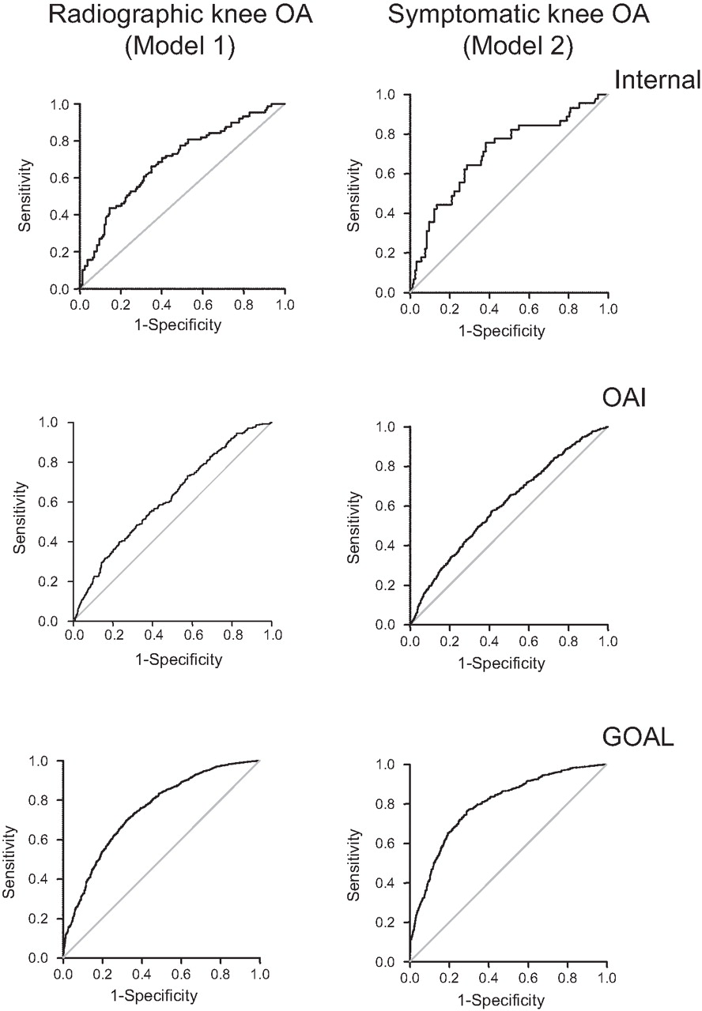
Zhang W, et al. Nottingham knee osteoarthritis risk prediction models.
Ann Rheum Dis 2011;70:1599-1604

Slide 36
What stage is appropriate for early-stage intervention?
Having different goals, some previous studies did not include tissue lesions and were not limited to normal (KL 0) knees
  Kerkhof et al, Rotterdam Study (RS)-I, risk prediction model for incident KL ≥ 2
    Base model: age, gender, BMI – AUC 0.66
    AUC not improved by adding: knee pain, disability index, general health, smoking, educational level, heavy work, genetic score, or urinary C-terminal cross-linked telopeptide of type II collagen
    AUC improved by adding: radiographic hand OA, radiographic hip OA, and baseline KL 1 (possible osteophytes)
    validation using RS-II and the Chingford Study

Slide 37
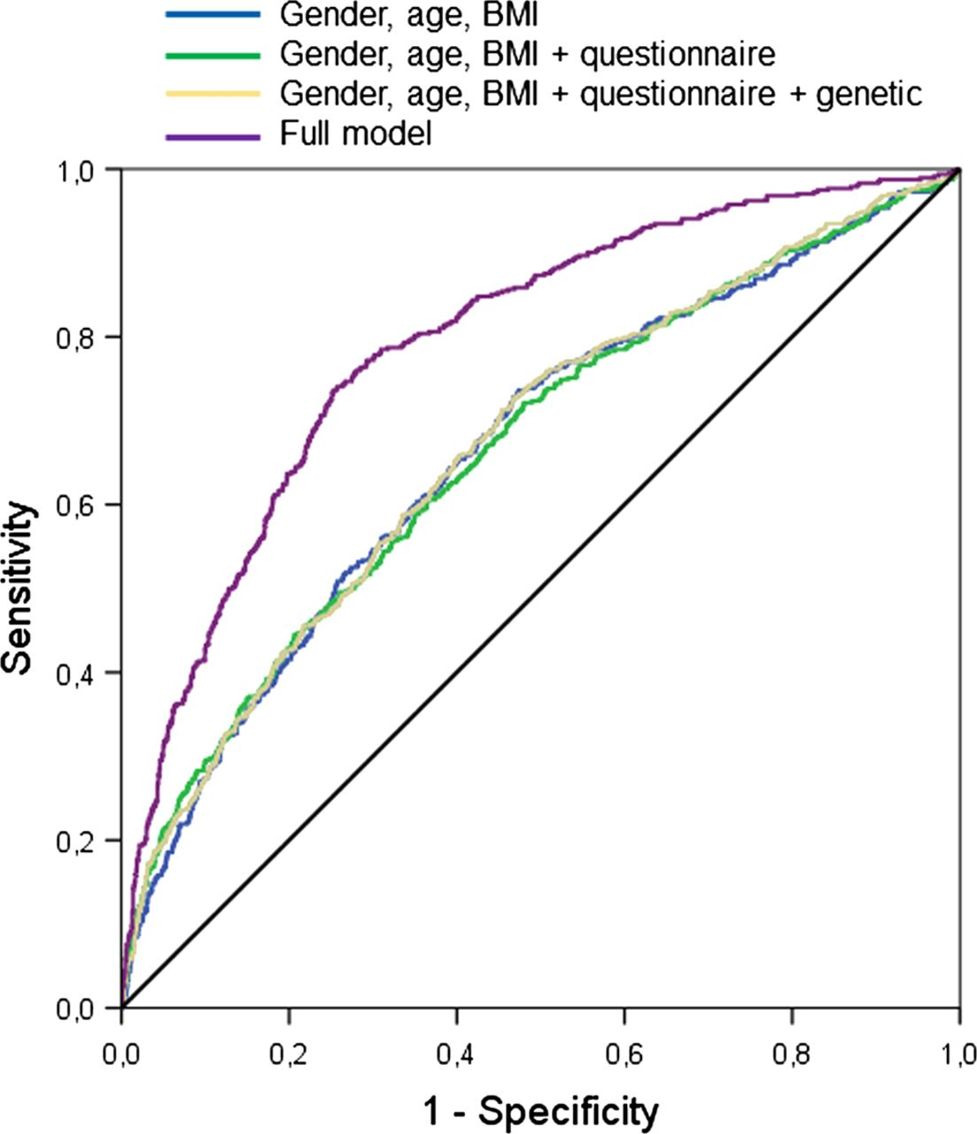
Kerkhof HJM, et al. Prediction model for knee osteoarthritis incidence, including clinical, genetic and biochemical risk factors. Ann Rheum Dis 2014;73:2116-21

Slide 38
What stage is appropriate for early-stage intervention?
Joseph et al included MRI, but included KL 0, 1, and 2 knees and excluded knees with baseline pain or “deformity”
  Risk prediction model for incident KL 3-4 or TKR or WOMAC pain >/= 5 over 8 years
  Models
    1 KL score, previous knee injury last 12 months, age, gender, BMI
    2 as in 1 + cartilage defects lateral femur and patella and presence of meniscal tear
    3 as in 2 + T2 in medial tibia and femur (earliest stages of cartilage ECM degeneration prior to irreversible cartilage defects)
  No external validation

Slide 39
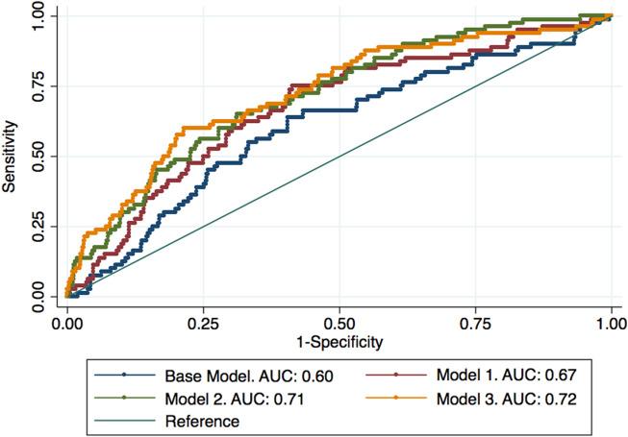
Joseph GB, et al. Tool for osteoarthritis risk prediction (TOARP) over 8 years using baseline clinical data, x‐ray, and MRI: Data from the OAI. J Magn Reson Imaging 2018;47: 1517-26

Slide 40
What stage is appropriate for early-stage intervention?
Sharma L, et al. Knee tissue lesions and prediction of incident knee osteoarthritis over 7 years in a cohort of persons at higher risk. Osteoarthritis Cartilage 2017;25:1068-75.
Hypothesis:
In persons KL 0 in both knees, models for prediction of
1) incident KL ≥ 2 and
2) incident KL ≥ 2 and joint space narrowing
can be improved by including baseline symptoms or function,
and further improved by inclusion of knee lesion status,
as would be expected if these lesions represented an early stage of disease.
Widely established KL ≥ 2 definition of knee OA is the basis of a large literature documenting impact and burden of knee OA. However, because KL 2 knees may or may not progress beyond a mild stage, we included the secondary outcome, corresponding with moderate disease.

Slide 41
Methods
OAI: prospective, observational cohort study of 4796 men and women, 45-79 years
Inclusion criteria for OAI
  Age 45-79 years
  With, or at high risk for, symptomatic knee OA
  “with” = frequent knee symptoms (most days of ≥ 1m in past 12m) and KL ≥ 2 in at least 1 knee
  “at risk” = frequent symptoms or high risk (e.g., injury causing walking difficulty ≥ 1 week and/or knee surgery and/or overweight by gender/age-specific cutpoints)
  Additional inclusion criterion for this study: bilateral KL 0 at baseline
Exclusion criteria for OAI
  Systemic, inflammatory arthritis
  Bilateral end-stage knee OA or TKR
  Ambulatory aid other than straight cane, >50% of the time
  MRI exclusions

Slide 42
Methods – Imaging
Knee x-ray
  PA fixed-flexion protocol, SynaFlexer frame
  Centralized readings
  Primary outcome: KL ≥ 2
  Secondary outcome: KL ≥ 2 and joint space narrowing
Knee MRI
  Acquisition utilized 3.0T Siemens Trio scanners at each site
  Sequences published and at website
  MOAKS readings of 12m and 48m MR images (right knee; if right knee image quality poor, left knee)

Slide 43
Methods – Statistical analysis
1 knee/person (right; left, if image quality of right unacceptable)
Baseline predictors were analyzed (12-month for lesions)
Follow-up time for persons without an outcome occurrence was censored at the last visit where the outcome was assessed. Persons with an outcome contributed follow-up time until the outcome was first documented.
Cox proportional hazards (PH) regression models were used to model risk (expressed as a hazard function) for developing each outcome.

Slide 44
Methods – Statistical Analysis
We constructed a base model using baseline predictors from univariate analyses of plausible predictors; to be selected, each predictor had to have a p-value ≤ 0.10 for the univariate hazard ratio (HR). Since findings were similar in univariate analyses for each outcome, we used the same base model for both outcomes.
We then added pain or function variables and finally lesion variables (meeting the p-value threshold).
Results summarized using adjusted HRs and 95% confidence intervals (CIs)

Slide 45
Methods – Statistical analysis
Nested PH models (with increasingly larger covariable sets) were compared using a likelihood ratio chi-square test (LR) with appropriate degrees of freedom (df) and Schwarz Bayesian Information Criterion (SBC).
  The LR test statistically compares the lesion model to the model without the lesion.
  More global measures of fit based on the log likelihood function, such as the SBC value, can be used as summary measures to compare the predictive value of the models vs. the base model.
    Lower SBC values suggest model improvement compared to a model with a larger SBC.

Slide 46
Methods – Statistical analysis
Although insensitive for the purpose of assessing the impact of adding a new predictor to a model, the AUC is useful to assess discrimination – probability that an individual with outcome will be assigned a higher risk than an individual without outcome.
We calculated the AUC of the ROC for logistic regression models that included as predictors variable sets that significantly improved prediction in the corresponding PH model.
To assess calibration (comparison of observed and predicted risks), we used Hosmer-Lemeshow Χ2 statistics for goodness-of-fit; large p-values indicate good calibration.

Slide 47
Results
The PH model that included age, gender, overweight, obesity, hand OA, injury, surgery, LIFT, SQUAT (Model A) predicted risk of KL ≥ 2 significantly better than age, gender, overweight, obesity (LR test 13.31, 5 df, p = 0.02).
Vs. Model A, prediction was not further improved by KOOS Symptoms, QOL, or QOL items, but was improved by WOMAC Pain (LR test 5.30, 1 df, p = 0.02) and WOMAC Function (LR test 6.09, 1 df, p = 0.01).
Several lesion variables improved prediction vs. Model A+WOMAC Pain and vs. Model A+WOMAC Function.

Slide 48
Tissue lesion contributions to prediction of knee OA, Cox proportional hazards models using the LR Test and SBC (n=841, 1 knee/person)
 |  | K/L≥2 (outcome)
Lesion status | Number (%) with outcome 53/841 (6.3%) | Adjusted HR (95% CI) | LR test (p-value) | SBC for base model¹ + lesion
Any cartilage damage (TF or PF) | 48/634 (7.6) | 2.51 (0.99, 6.38) | 4.76 (0.29) | 702.77
Cartilage damage, TF and PF | 29/262 (11.1) | 2.68 (1.54, 4.68) | 11.96 (0.0005) | 695.57
Any BML (TF or PF) | 40/508 (7.9) | 1.70 (0.90, 3.21) | 2.87 (0.90) | 704.66
BML, TF and PF | 20/145 (13.8) | 2.77 (1.58, 4.86) | 11.37 (0.0007) | 696.16
Meniscal tear | 26/177 (14.7) | 4.31 (2.43, 7.64) | 23.56 (<0.0001) | 683.96
Meniscal extrusion | 17/115 (14.8) | 2.94 (1.61, 5.39) | 10.66 (0.001) | 696.86
Base model included age, gender, overweight, obesity, hand OA, knee injury, knee surgery, LIFT, SQUAT, and WOMAC Pain (SBC for base model = 703.56)

Slide 49
Tissue lesion contributions to prediction of knee OA, Cox proportional hazards models using the LR Test and SBC (n=841, 1 knee/person)
 | K/L≥2 (outcome)
Lesion status | Adjusted HR (95% CI) | LR test (p-value) | SBC for base model¹ + lesion
Sum of lesion types (adj. HR/additional lesion type) | 1.97 (1.49, 2.59) | 23.78 (<0.0001) | 683.75
# regions with cartilage damage (TF+PF) (adj. HR/additional region) | 1.56 (1.36, 1.79) | 32.30 (<0.0001) | 675.23
Max cartilage damage severity – surface area (TF+PF regions) (adj. HR/additional grade) | 1.87 (1.23, 2.85) | 9.98 (0.002) | 697.55
Max cartilage damage severity – full thickness score (TF+PF regions) (adj. HR/additional grade) | 1.45 (1.11, 1.90) | 7.12 (0.008) | 700.40
# regions with BML (TF+PF) (adj. HR/additional region) | 1.45 (1.20, 1.76) | 12.94 (0.0003) | 694.58
Max BML severity (TF+PF regions) (adj. HR/additional grade) | 1.45 (1.04, 2.04) | 4.42 (0.04) | 703.10
Sum of lesion types (adj. HR/additional lesion type) | — | 47.05 (<0.0001) | 668.42
Base model included age, gender, overweight, obesity, hand OA, knee injury, knee surgery, LIFT, SQUAT, and WOMAC Pain (SBC for base model = 703.56)

Slide 50
Results
The greatest improvement (lowest SBC) was seen for
  # subregions with cartilage damage
  sum of lesion types
  meniscal tear
  # subregions with cartilage damage, # subregions with BMLs, and meniscal tear (“combined model”)

Slide 51
Results
Model A predicted risk of KL ≥ 2 and joint space narrowing significantly better than age, gender, overweight, and obesity (LR test 12.98, 5 df, p = 0.02).
Vs. Model A, prediction was improved by WOMAC Pain (LR test 5.39, 1 df, p = 0.02) or WOMAC Function (LR test 5.80, 1 df, p = 0.02).
Several lesion variables improved prediction vs. Model A+WOMAC Pain and vs. Model A+WOMAC Function.
The greatest improvement was seen with
  # subregions with cartilage damage
  meniscal tear
  combined model

Slide 52
Risk prediction models: discrimination and calibration – KL≥2 outcome
Predictors | Discrimination: AUC (95% CI) | Calibration: Hosmer-Lemeshow p-value
Age, gender, BMI | 0.66 (0.58, 0.74) | 0.66
Model A (age, gender, overweight, obesity, hand OA, knee injury, knee surgery, LIFT, SQUAT) | 0.71 (0.63, 0.79) | 0.80
Model A + WOMAC Pain | 0.73 (0.65, 0.80) | 0.13
Model A, WOMAC Pain + Cartilage damage (TF+PF) | 0.77 (0.71, 0.84) | 0.16
Model A, WOMAC Pain + BML (TF+PF) | 0.76 (0.69, 0.83) | 0.16
Model A, WOMAC Pain + Meniscal tear | 0.79 (0.73, 0.86) | 0.63
Model A, WOMAC Pain + Meniscal extrusion | 0.77 (0.71, 0.83) | 0.14
Model A, WOMAC Pain + Sum of lesion types | 0.80 (0.74, 0.86) | 0.79
Model A, WOMAC Pain + # subregions with cartilage damage (TF+PF) | 0.82 (0.76, 0.87) | 0.35
Model A, WOMAC Pain + Maximum cartilage damage (surface area, TF+PF) | 0.77 (0.71, 0.83) | 0.69
Model A, WOMAC Pain + Maximum cartilage damage (full thickness, TF+PF) | 0.76 (0.70, 0.83) | 0.58
Model A, WOMAC Pain + # subregions with BML (TF+PF) | 0.76 (0.70, 0.83) | 0.59
Model A, WOMAC Pain + Maximum BML severity (TF+PF) | 0.74 (0.67, 0.81) | 0.95
Model A, WOMAC Pain + # subregions with cartilage damage, # subregions with BML, meniscal tear concurrently included in model | 0.84 (0.78, 0.89) | 0.95

Slide 53
Risk prediction models: discrimination and calibration – KL≥2 and joint space narrowing outcome
Predictors | Discrimination: AUC (95% CI) | Calibration: Hosmer-Lemeshow p-value
Age, gender, BMI | 0.64 (0.54, 0.74) | 0.58
Model A (age, gender, overweight, obesity, hand OA, knee injury, knee surgery, LIFT, SQUAT) | 0.73 (0.65, 0.81) | 0.79
Model A + WOMAC Pain | 0.74 (0.65, 0.82) | 0.50
Model A, WOMAC Pain + Cartilage damage (TF+PF) | 0.77 (0.69, 0.84) | 0.81
Model A, WOMAC Pain + BML (TF+PF) | 0.78 (0.70, 0.85) | 0.74
Model A, WOMAC Pain + Meniscal tear | 0.80 (0.73, 0.87) | 0.60
Model A, WOMAC Pain + Meniscal extrusion | 0.76 (0.69, 0.83) | 0.11
Model A, WOMAC Pain + Sum of lesion types | 0.78 (0.72, 0.85) | 0.04
Model A, WOMAC Pain + # subregions with cartilage damage (TF+PF) | 0.81 (0.73, 0.88) | 0.09
Model A, WOMAC Pain + # subregions with BML (TF+PF) | 0.77 (0.69, 0.85) | 0.68
Model A, WOMAC Pain + # subregions with cartilage damage, # subregions with BML, meniscal tear concurrently included in model | 0.83 (0.75, 0.90) | 0.70

Slide 54
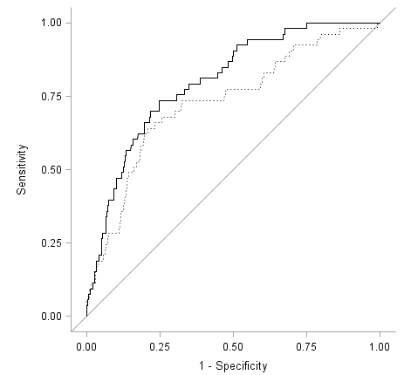
Receiver Operating Characteristic Curves for Models to Predict Radiographic Knee OA Defined as KL≥2 – Addition of Number of Subregions with Cartilage Damage
_____ AUC: 0.82 (95% CI: 0.76-0.87)
…...... AUC: 0.73 (95% CI: 0.65-0.80)

Slide 55
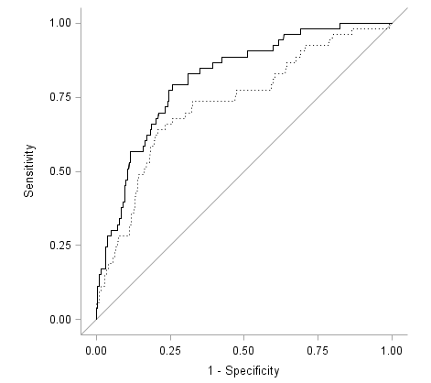
Receiver Operating Characteristic Curves for Models to Predict Radiographic Knee OA Defined as KL≥2 – Addition of Sum of Lesion Types
_____ AUC: 0.80 (95% CI: 0.74-0.86)
…...... AUC: 0.73 (95% CI: 0.65-0.80)

Slide 56
Summary
Among persons at higher risk for knee OA and KL 0/0, lesions in tissues known to be involved in OA improved prediction of development of mild and moderate OA disease, defined as incident KL ≥ 2 and as KL ≥ 2 and joint space narrowing, over up to 7 years of follow-up when added to models including age, gender, BMI, hand OA, injury, surgery, occupational activity, and knee symptoms or function.
For both outcomes, prediction was further improved by including TF and PF cartilage damage, TF and PF BMLs, meniscal tear, meniscal extrusion, sum of lesion types, number of subregions with cartilage damage, number of subregions with BMLs, and for the combined model.
For both outcomes, number of subregions with cartilage damage, sum of lesion types, meniscal tear, and the combined model most strongly improved prediction based on proportional hazards models.
AUCs ≥ 0.80 were found for both outcomes for number of subregions with cartilage damage and the combined model.

Slide 57
Discussion
Notably, building on pain or function models, cartilage damage characterized in different ways, in both compartments, number of subregions, and maximum severity – both surface area and full-thickness, separately examined – all improved prediction of risk of KL ≥ 2.
BMLs in both compartments, number of subregions, and maximum severity improved prediction of risk of KL ≥ 2.
The severity variables did not improve prediction of the secondary outcome, perhaps signifying lower power.
Borderline or non-significant findings for any cartilage damage and any BML may reflect too low a threshold of lesion status.
Meniscal tear and extrusion improved prediction of risk of KL ≥ 2. Meniscal tear improved prediction of the secondary outcome; extrusion findings were significant for the pain model and borderline for the function model.

Slide 58
Strengths
To our knowledge, the predictive value of tissue lesions for development of knee OA has not been evaluated.
Also, previously reported risk models have not been focused on persons at higher risk for knee OA but KL 0 in both knees.
A strength of our analyses is use of proportional hazards regression models that incorporate time to first documentation of outcome or time to final study visit if no outcome, rather than simply dichotomizing outcomes as present or not at end of variable lengths of follow-up.

Slide 59
Limitations and Caveats
Our MRI readings did not include effusion/synovitis, which has also been associated with OA development.
Number of outcomes insufficient for computationally complex approaches such as net reclassification improvement or integrated discrimination improvement to further assess improvement in model performance.
Need validation; to date, we have not been able to identify a bilateral KL 0 sample with comparable MRI assessment
  less sensitive 1.0T MRI acquisition protocol
  too few participants KL 0 in both knees at baseline
  no response from the lead investigators
It was not among our objectives to evaluate the clinical utility of MRI in persons at higher risk. The role of MRI in patients at this stage is uncertain, particularly since there are no established treatments for such lesions.

Slide 60
Previous Work in Persons at High Risk and KL 0/0
Arthritis Rheumatol 2014;66:1811-9 Ann Rheum Dis 2016;75:1630-6
Tissue lesions by MRI were frequent
  76% had cartilage damage
  61% bone marrow lesions
  21% meniscal tears
Cartilage damage (isolated PF; TF and PF), BMLs (any; isolated PF; TF and PF), and meniscal tears were associated with incident persistent symptoms.
Dose‐response association of
  severity of cartilage damage and BMLs with incident persistent symptoms
  BMLs with incident TF and PF cartilage damage
More concomitant lesion types associated with a greater risk of incident persistent symptoms and incident TF cartilage damage
Worsening MRI lesion status associated with concurrent incident radiographic OA and subsequent persistent symptoms

Slide 61
Do we need a reorientation in how we approach knee OA?
Current knee OA care emphasizes symptom management until TKR.
Action is rarely taken in persons at high risk for knee OA, who are at a stage when it may have greatest impact.
These findings offer a window into events in high-risk knees over years before the established clinical definition of OA is reached, suggesting a potentially long pre-radiographic period of disease development.
Disease is likely developing during the “high-risk” period.
Health-promoting behavior may be more achievable and effective in preventing fully developed OA and its consequences on quality of life vs. customary intervention initiated after OA is established in the knee.

Slide 62
Questions
Could pharmacologic or non-pharmacologic therapy in this period help to prevent full-blown knee OA development?
How do we identify who in the high-risk population to treat?
  Disease risk score development
    Grant in development in collaboration with UNC, PI Julia Lee

Slide 63



Acknowledgement
Funding Source: NIH/NIAMS R01-AR-065473, R01-AR-066601, P30-AR-072579
The Osteoarthritis Initiative is a public-private partnership comprised of five NIH contracts (N01-AR-2-2258; N01-AR-2-2259; N01-AR-2-2260; N01-AR-2-2261; N01-AR-2-2262) funded by the NIH and conducted by the OAI Study Investigators. Private sector funding for the OAI is managed by the Foundation for the NIH.
The Multicenter Osteoarthritis Study is supported by NIH grants U01-AG-18820, U01-AG-18832, U01-AG-18947, and U01-AG-19079.

Slide 64
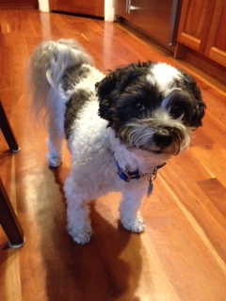
Thank You

