Slide 1
Quality improvement for beginners
Karina Whelan, MD
Amy Shaheen, MD, MSc

Slide 2
Revisiting the Overview from the last session:
Weeks 1 - 2
Complete IHI QI Modules 101-105
Weeks 3-6
Weeks 7-10
Wrap up PDSAs and think about sustainability
Write an AIM statement
On track for 3 or more PDSA cycles
Think about follow-up projects
Plan and implement PDSA #1
Update A3
Complete A3
Make a poster
Weeks 11-14
Make a driver diagram
Review PDSA progress, plan/start PDSA #2
Start your A3 Document (helps track progress)

Slide 3
Revisiting the Overview from the last session:
Weeks 1 - 2
Complete IHI QI Modules 101-105
Weeks 3-6
Plan and implement PDSA #1
Weeks 7-10
Wrap up PDSAs and think about sustainability
Write an AIM statement
On track for 3 or more PDSA cycles
Think about follow-up projects
Update A3
Complete A3
Make a poster
Weeks 11-14
Make a driver diagram
Review PDSA progress, plan/start PDSA #2
Start your A3 Document (helps track progress)

Slide 4
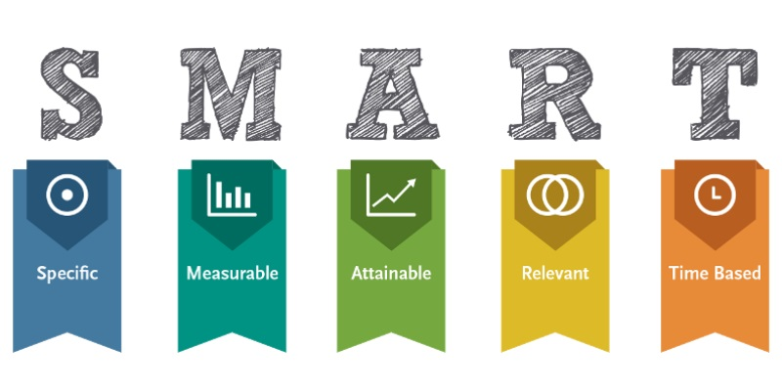





AIM statement: Choosing a SMART Aim
S M A R T
SPECIFIC
MEASURABLE
ACHIEVABLE
RELEVANT
TIMELY

Slide 5
Model For Improvement:
Going from Aim to PDSA
What are we trying to accomplish?
What changes can we make that will result in improvement?
How do we quantify that a change as an improvement?
DO
STUDY
ACT
PLAN

Slide 6


Model For Improvement: How to plan a PDSA
What are we trying to accomplish?
What changes can we make that will result in improvement?
How do we quantify that a change as an improvement?
DO
STUDY
ACT
PLAN
Define the system
Assess the current situation
Analyze causes

Slide 7
ORGANIZING YOUR DATA: Brief review of a Driver Diagram
SMART Aim (Specific, Measurable, Achievable, Relevant, Timely) | KEY Drivers (BIG categories, too broad to target) | Secondary Drivers (Specific, well-defined targets) | TARGETS (Ideas for change – Each could yield a SINGLE Project or PDSA)
Increase Pneumococcal vaccination rate by 5% for patients of Dr X and Dr Z who are >/=65 years over a 6 week period | PATIENT | Received elsewhere | Obtain records
 |  | Not interested | Educational hand-out/poster
 |  | No recent appointment | Schedule for RN visit
 | PROVIDER | Forgot to order | “Reminder” in visit notes
 |  | Other priorities | Delegate to RN/MA
 | NURSE/MA | Did not discuss | Incentivize ?competition
 |  | Forgot to give | Flagging/Alert system
 |  | Did not document prior (patient brought record) | Improve RN/MA documentation
 | CLINIC | Room availability (during visit) | Give during triage process/ vitals
 |  | Staffing for RN visit | Dedicated staffing 1 day a week

Slide 8

Model For Improvement: How to plan a PDSA
What are we trying to accomplish?
What changes can we make that will result in improvement?
How do we quantify that a change as an improvement?
DO
STUDY
ACT
PLAN
Try out your improvement theory

Slide 9

Model For Improvement: How to plan a PDSA
What are we trying to accomplish?
What changes can we make that will result in improvement?
How do we quantify that a change as an improvement?
DO
STUDY
ACT
PLAN
Study the results

Slide 10

Model For Improvement: How to plan a PDSA
What are we trying to accomplish?
What changes can we make that will result in improvement?
How do we quantify that a change as an improvement?
DO
STUDY
ACT
PLAN
REPEAT!
Standardize improvement
Plan continuous improvement

Slide 11
IF YOU HIT A ROADBLOCK… Return to the Driver Diagram
SMART Aim (Specific, Measurable, Achievable, Relevant, Timely) | KEY Drivers (BIG categories, too broad to target) | Secondary Drivers (Specific, well-defined targets) | TARGETS (Ideas for change – Each could yield a SINGLE Project or PDSA)
Increase Pneumococcal vaccination rate by 5% for patients of Dr X and Dr Z who are >/=65 years over a 6 week period | PATIENT | Received elsewhere | Obtain records
 |  | Not interested | Educational hand-out/poster
 |  | No recent appointment | Schedule for RN visit
 | PROVIDER | Forgot to order | “Reminder” in visit notes
 |  | Other priorities | Delegate to RN/MA
 | NURSE/MA | Did not discuss | Incentivize ?competition
 |  | Forgot to give | Flagging/Alert system
 |  | Did not document prior (patient brought record) | Improve RN/MA documentation
 | CLINIC | Room availability (during visit) | Give during triage process/ vitals
 |  | Staffing for RN visit | Dedicated staffing 1 day a week

Slide 12
Lets practice this using a real example
Notes:
Work in pairs. If you have a topic/aim statement, work on that. If not, practice using a plan to implement colon cancer FIT tests in your adult clinic. Start by refining your aim further if needed.

Slide 13
PDSA worksheet
You should already have your AIM Statement Prepared
Your completed Driver Diagram will help you pick an intervention for your PDSA
This worksheet will help you document what you are learning
Get feedback from your peers and all practice members affected then rework it repeat
Start with small changes

Slide 14
Look at your AIM statement and Driver diagram and pick ONE specific target for improvement to achieve your QI goal

Slide 15
If you don’t have one:
I want to implement FIT testing in the ACC clinic
I will send out 10 FIT tests to patients in the next one week

Slide 16
Identify youR leaders and Stakeholders:
Leaders: Practice manager, care manager, or a physician leader.
These individuals either get stuff done or are able to get others to do things
Stakeholders: ANYONE affected by your cycle of change, including:
Co-workers: front desk staff, nurses, phlebotomy, medical students, physicians and everyone the project could touch
Explain why you think your intervention is important, do it face to face
Ask whomever you are talking to: Is there anything else I should talk to about this?
Clinic/Leadership
Discuss why this project is relevant to the clinic, are we
Obtain insight on existing practices and prior projects
Patients
One of the greatest assets a practice can have – Ultimately your changes affect them, patient investment and input is KEY
Notes:
LEADERS: These individuals have social capital – They can help you get other team members to do things or get things done for you
STAKEHOLDERS: , when you approach them explain:
Coworkers:
Get names and commitments and get feedback on your proposal
If needed use a process map (diagram with arrows) to show them their role in the change and their responsibility in the change
Why do you want to let them know what you are doing?
Patients: Identify patients with the practice leader and get feedback
How do they perceive things now?
How do they think things could be better?
Have them review anything that involves reading or educating. Try out phone calls on volunteers and consider that as you plan your first cycle.

Slide 17
Other Stakeholders: likely NOT involved at this stage
Institution: Usually better to have some preliminary data before reaching this high.
Electronic health record or IT: Best to engage them after you have proof of concept and have tried out processes independent of the health record first.
Notes:
Good example: We wanted to build an electronic health record alert that came up when a doctor ordered a urinary catheter to ensure that all catheters are put in for the right reason. Who would we want to talk to? What would be important before we built that alert?
We looked at the order and realized that you could only put in order if you checked off an approved reason.

Slide 18

What are you going to improve?

Slide 19
Types of change in healthcare and quality/Effort yield
Hierarchy of change-
  Some are effective/expensive
  Some are cheap/effective
Avoid expensive (or tons of work) with marginal benefit
Always start small… If it works, THEN expand
Notes:
Effort/yield-

Slide 20
Types of change
PROVIDER LEVEL
Audit and feedback
Education
Financial incentives.
PATIENT LEVEL
Education
Reminders and promotion of self management
Financial incentives
CLINIC LEVEL
Chronic disease management
Increased staffing,
Skill mix
Case management
ORGANIZATIONAL/
SYSTEM LEVEL
Reimbursement
Accreditation
EMR changes
Notes:
Audit and feedback
Quality indicators and reports,
Publicly released performance data
Benchmarking (comparing to top performers)
Provider Education:
workshops conferences
Academic detailing with an expert
educational materials
Organizational change:
case management,
disease management,
increased staffing,
skill mix change (think about using nurses or other providers for things doctors usually do)

Slide 21
Types of change
PROVIDER LEVEL
Audit and feedback
Education
Financial incentives.
PATIENT LEVEL
Education
Reminders and promotion of self management
Financial incentives
CLINIC LEVEL
Chronic disease management
Increased staffing,
Skill mix
Case management
ORGANIZATIONAL/
SYSTEM LEVEL
Reimbursement
Accreditation
EMR changes
This list is EXHAUSTIVE and OVERWHELMING
– A process map can help you identify who is doing what and highlight bottlenecks and where we can do things differently
Notes:
Audit and feedback
Quality indicators and reports,
Publicly released performance data
Benchmarking (comparing to top performers)
Provider Education:
workshops conferences
Academic detailing with an expert
educational materials
Organizational change:
case management,
disease management,
increased staffing,
skill mix change (think about using nurses or other providers for things doctors usually do)

Slide 22
Plan your intervention… What factors do you need to consider?
Who
What
Where
When
How

Slide 23
factors to consider for FIT testing:
Availability of FIT kits
  How many; Where do we get them; How much do they cost; Where are they stored; How long does it take for them to be received
Electronic Health Record
  Order Availability in EPIC; Preference List; Billing; Update on Health maintenance
ACC Staff Confidence
  Training for nurses/physicians; Physician use; Decision Aids
Patient Factors
  Eligible population; Issues with mailing/postage; Insurance/cost; Picture in AVS to increase return; Experience survey/Follow up call
Logistics of FIT kits
  Family Medicine to discuss issues they have had
Follow up results
  What to do with positive results; Tracking progress

Slide 24

Plan your Data collection: how will you quantify improvement

Slide 25
Again with outcomes, think about:
Who
What
Where
When
How

Slide 26
Process measures
These are the building blocks to the ultimate outcome measure you are trying to improve
Ex: You propose mailing patients FIT cards to achieve your ultimate goal of improving colon cancer screening rates
First you measure the number of patients due for screening with FIT kits mailed
Then you make reminder phone calls to patients to follow-up
How many calls made
How many kits received
Quantify:
How calls answered
Notes:
Another example, you want to institute depression screening in your clinic. You may diagram how it is going to work but each step should be measured and those are process measures. i.e. how often did the nurse hand the patient the depression screener, how often did the patient fill it out, how often did the provider respond/acknowledge the score, and where was it documented

Slide 27
Process Measure pitfalls
You get excited about the data you have collected and forget the ultimate outcome you were trying to change
You tried to change too many things/people at once and can’t keep track of what actually helped your outcome
Notes:
Start small with one front desk person/one nurse, etc
Use these in very small cycles of change (1-2 days) to build momentum and learn
Once one measure is working, quickly implement the next step.
Group education, one on one education and multiple times may be needed.
Feed back data as soon as possible.

Slide 28

Outcomes measures
IN PRIMARY CARE:
These are the ultimate desired patient outcome, vs what you need to do to get here
  Ex: number of mammograms scheduled vs number of mammograms completed and UTD
Outcomes in primary care are usually things like screening rates, percent of panel vaccinated, etc.
Try looking at dashboards, practice run charts, etc to track these
Find something that might help efficiency or profitability
Notes:
Not the same as outcomes in research - Death and events are not the usual outcomes in primary care

Slide 29
Run charts: How we track improvement

Slide 30
Sometimes it takes a few interventions to sustain change

Slide 31
Perhaps something else was going on instead?

Slide 32
Wisdom on Your PDSA cycles
The more you now about your system, the more likely you are to pick a change that will be successful.
So know the players (stakeholders)
Keep changes very small and build momentum
Use process measures to make sure that changes can be done and are adopted (i.e. how many of something happened TODAY) Easy and you don’t need data pulls.
The needle moves slowly. You are nudging it.

Slide 33
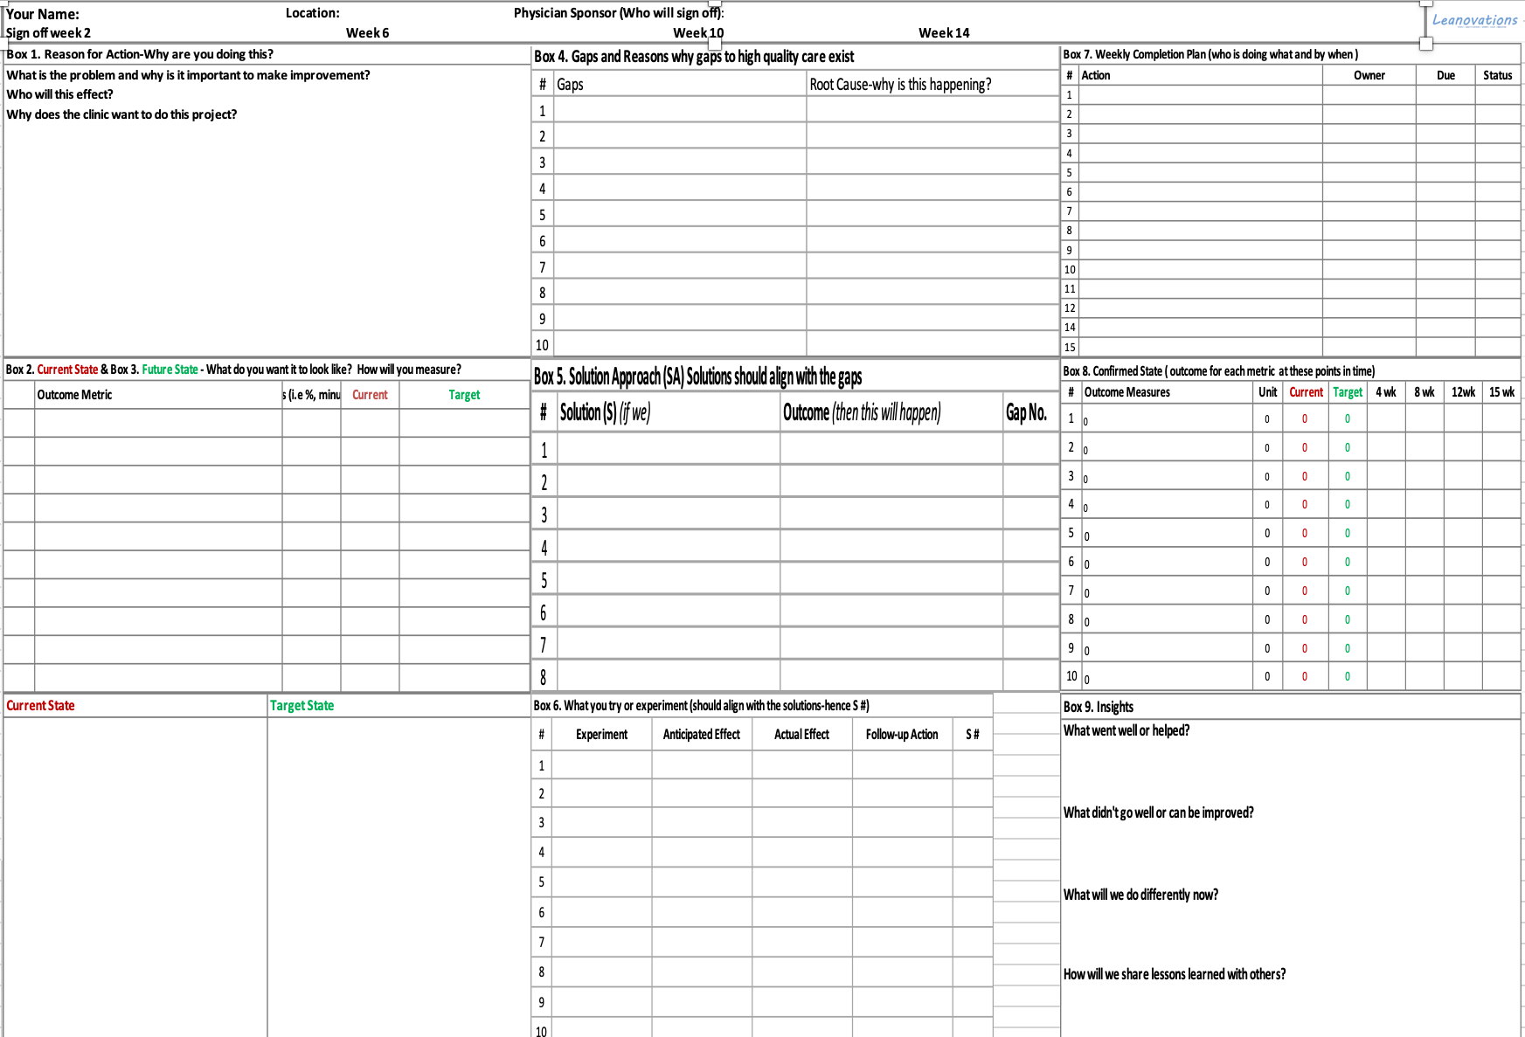
Quick intro to the a3 document – there is a detailed guide on sakai

Slide 34

Examples of prior student projects:
What they delivered…
Improve Cervical Cancer Screening rates by 10% in two months (78% to 85.8%)
> Two practices
> Pulled reports, for patients for for pap smear
> Scheduled paps, updated EMR for those s/p benign TAH, changed intervals if HPV testing done
Improve statin use in diabetic patients by 10% in 8 weeks
> Called patients not on statins, suggested starting one and if they agreed, had provider call in statin
Decrease time to routine vaccinations during pediatric well child visits by 5 minutes over one week
> Used process map and pre-visit planning to determine who was due for what
> Developed educational material for patients
> Had vaccines ready from start of visit
> Obtained time studies from parent and patient perspective

Slide 35
Lets see a real Qi project in action…
FIT Testing Project Video

