Slide 1
MRI Ultrasound Fusion Targeted Prostate Biopsy In Prostate Cancer Localization, Risk Assessment, And Focal Therapy
Marc A. Bjurlin, DO, MSc Associate Professor
Department of Urology
Lineberger Comprehensive Cancer Center

Slide 2
Problems with Current Detection Paradigm
PSA sensitivity is set by threshold, but specificity is poor at all threshold
No ability of PSA to distinguish aggressive disease
Huge number of biopsies
Repeat biopsies for men with cancer
Repeat biopsies for men without cancer
Resulting over-detection leading to over-treatment leading to criticism of our field

Slide 3
What is the problem?
The biomarker
The response to the biomarker
The biopsy
The response to the biopsy
We can probably do better with all of the above.

Slide 4
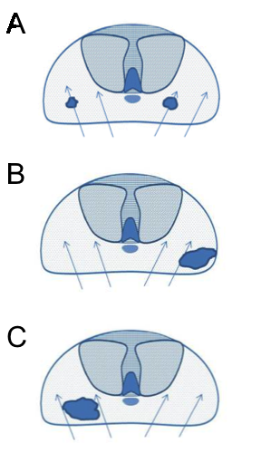
Current Limitations of Prostate Biopsy
Clinically insignificant cancers are identified by chance
Important cancers are incorrectly risk stratified
Clinically significant tumors are missed
(Bjurlin, et al, J Urol, 2014; adapted from H Ahmed, UCL)
Notes:
4

Slide 5
Definition of Biopsy Optimization
Detection of potentially lethal prostate cancer
Avoidance of “over-detection” of clinically insignificant cancer
Generation of clinically useful data
accurate depiction of risk and cancer location
Maintenance of cost effectiveness
Avoidance of repetitive biopsy
Cost effective specimen handling
Taneja, et al, AUA White Paper: Optimization of Prostate Biopsy and Specimen Handling, 2013
Bjurlin, et al, J Urol, 2013

Slide 6
Options for Improving The Biopsy Paradigm
Better candidate selection
Biomarkers: PCA3, PHI, 4k score
Nomograms: PCPT calculator, Vienna nomogram
Saturation techniques
Overcome sampling error through excessive sampling
Targeted biopsy/Imaging
Use of imaging to guide biopsy
Use of imaging to stratify risk

Slide 7
MRI Could Correct All the Limitations of Systematic Biopsy
Targeting of patients with MR detected abnormality
fewer false negatives
fewer repeat biopsies
more accurate cancer classification
greater cancer core length
better grade concordance
better patient selection for AS/therapy
No biopsy for MRI normal patients
avoidance of over-detection of indolent tumors

Slide 8
MRI Targeted Biopsy Approach
MRI Targeted Biopsy
MRI-Guided Biopsy
(in gantry)
Transrectal Ultrasound-Guided
Visual Estimation
(cognitive registration)
MRI/US Fusion
(software registration)
Transperineal
Transrectal
Transrectal
Transrectal
Transperineal
Transperineal

Slide 9
Multiparametric MRI of the Prostate
Pre-biopsy 3T multi-parametric MRI
Identify areas of suspicion for sampling
Predicts likelihood of prostate cancer through MRI suspicion score (PI-RADS)
Selection of patients for biopsy
T2WI
ADC
DWI
DCE
Perfusion
Map
Bjurlin, et al, J Urol, 2013

Slide 10
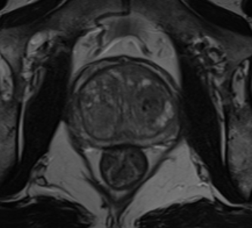
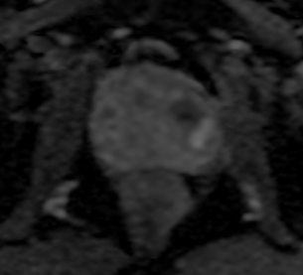
MRI-targeted fusion biopsy
(a)
(b)
(c)
(d)
(e)
(f)

Slide 11
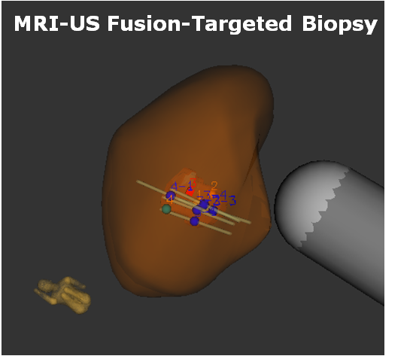

Slide 12
Clinical Applications of Pre-biopsy MRI Prior to Targeted Biopsy
Previous negative biopsy
Finding missed disease
Active surveillance/ known cancer
Localizing dominant disease
Accurate classification of disease risk
No previous biopsy
Goal of finding lethal disease while missing non-lethal disease
Reduction of over-detection

Slide 13
2017: Purpose of this paper is to evaluate the available evidence and make practical recommendations

Slide 14
Evaluation of Biopsy Naïve Patients Utilizing mpMRI (2017)
Keypoint: The clinical impact of mpMRI-targeted biopsy in men with no previous history of prostate biopsy remains controversial, due to an unclear magnitude of clinical impact relative to cost. In considering its use, quality of mpMRI, experience of interpreting radiologist, cost of mpMRI, and availability of alternate biomarkers should be considered.

Slide 15
Evaluation of Biopsy Naïve Patients Utilizing mpMRI (2017)
Keypoint: There is insufficient data to recommend routine MRI in every biopsy naïve patient under consideration for prostate biopsy. Its use may be considered in men for whom clinical indications for biopsy are uncertain (minimal PSA increase, abnormal DRE with normal PSA, or very young or old patients).

Slide 16
Changing the Biopsy-Naïve Paradigm
PROMIS - Diagnostic accuracy of multi-parametric MRI and TRUS biopsy in prostate cancer (PROMIS): a paired validating confirmatory study – Lancet 2017
PRECISION - MRI-Targeted or Standard Biopsy for Prostate-Cancer Diagnosis – NEJM 2018
MRI-FIRST - Use of prostate systematic and targeted biopsy on the basis of multiparametric MRI in biopsy-naive patients (MRI-FIRST): a prospective, multicentre, paired diagnostic study – Lancet 2019

Slide 17
PROMIS
Multicenter, paired-cohort, confirmatory study to compare the diagnostic accuracy of MRI and TRUS-guided systematic biopsy against a reference template prostate mapping biopsy
MRI: more sensitive for clinically significant cancer (defined as GS ≥4+3) than TRUS biopsy (93% vs 48%) and less specific (41% vs 96%
MRI triage: allow 27% to avoid a biopsy, 5% fewer clinically insignificant cancers detected
NPV of 89% for low suspicion MRI, (using 4+3) but for 3+4, the NPV decreased to 74%

Slide 18
PRECISON
Multicenter randomized, noninferiority trial, assigning men with a clinical suspicion of prostate cancer who had not undergone biopsy previously to undergo MRI, with or without targeted biopsy, or standard TRUS biopsy
71 of 252 men (28%) had PI-RADS 1-2 = No biopsy
≥Gleason 3+4: 95 men (38%) in the MRI-targeted group, 64 of 248 (26%) in the standard-biopsy group (P=0.005)
MRI: not only non-inferior, but superior to standard TRUS-biopsy for the detection of clinically significant cancer
Fewer men undergoing MRI-targeted biopsy were found to have indolent (Gleason 3+3) cancers

Slide 19
MRI-FIRST
Prospective, multicenter, paired diagnostic study, conducted at 16 centers in France to address whether MRI before biopsy would improve detection of clinically significant prostate cancer in biopsy-naive patients
All - TRUS systematic and hypoechoic directed biopsies, +2 cores of MRI targets if ROI 3,4,5.
N= 275 patients were enrolled, 53 (21%) had ROI≤ 2 = excluded
Detection of clinically significant disease by systematic biopsy (30%) and targeted biopsy (32%) did not differ significantly (P=0.38),
87.5% of non-significant cancer was found on systematic biopsy and only 25% on targeted sampling =75% of indolent cancers were identified by systematic biopsy alone

Slide 20
2019 – Updated SOP MRI Prostate
UNOFFICIAL
Keypoint: Two randomized clinical trials have provided level 1 data to support the recommendation of mpMRI prior to biopsy for all men

Slide 21
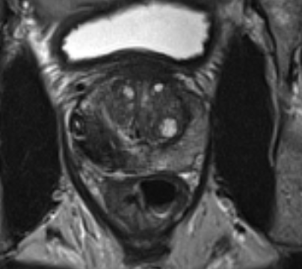
Prostate Cancer Localization
Risk Assessment
Focal Therapy

Slide 22
Challenges of the Focal Therapy Paradigm
Candidate Selection
Method of Delivery
Image guided
Biopsy guided
Treatment Planning
Extent
Adequacy of Margin
Outcome Measures
How do we prove benefit
Cost
QOL
Survival

Slide 23
Key Concepts
Balance of focal treatment vs. adequacy of treatment
Confluence of tissue destruction
Inaccuracy of localization
Can be overcome by increasing tissue treated
Dispersion of thermal energy
Contributes to toxicity

Slide 24
Potential Reasons for Focal Therapy Failure
Poor localization by imaging
Inadequate detection
Incomplete demonstration of tumor
Poor staging biopsy
Implies disease missed by MRI and biopsy
Under-sampling at baseline
Inadequate treatment
Under-treatment of target zone
Inadequate margin

Slide 26
Non-confluent Undertreatment

Slide 27
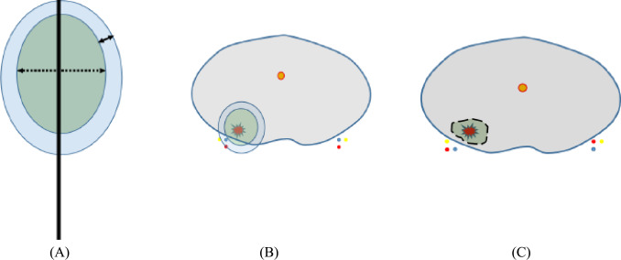
Cryotherapy vs HIFU
Graphical representation of the ablation volume with for cryotherapy and high-intensity focused ultrasound. (A) A cryo probe with an ice ball. The dotted arrows show the kill zone and the solid arrow shows the safety margin. (B) Cryoablation of a posterior lesion for which the safety zone for the ice ball extends beyond the prostatic capsule. (C) More precise control of the ablation zone with high-intensity focused ultrasound.
Focal Therapy for Prostate Cancer: An “À la Carte” Approach European Urology, 2016, Available online 6 January 2016

Slide 28
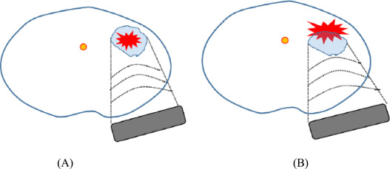
Cryotherapy vs HIFU
Graphical representation of anterior displacement of lesion during high-intensity focused ultrasound (HIFU). (A) Cancer within the HIFU target at the beginning of the treatment. (B) Prostatic edema along the HIFU pathway pushes the lesion anteriorly away from the target region.
Focal Therapy for Prostate Cancer: An “À la Carte” Approach European Urology, 2016, Available online 6 January 2016

Slide 29
Spectrum of Energy Sources
Laser
FOCALITY OF ABLATION
Electroporation
Bipolar RF
VTP (PDT)
CONFLUENCE OF ABLATION
HIFU
THERMAL DISPERSION
Cryosurgery

Slide 30
Factors Affecting Choice of Energy Selection
Extent of ablation
Size of tumor/Extent
Method of tumor detection
Image detected ➔ more focal
Biopsy detected ➔ wider ablation
Ability to achieve confluent destruction
Location of tumor within the prostate
Proximity to nerves
Distance from rectum
Apex

Slide 31
MRI
: Histo Boundaries
: Radius MRI
: Radius Histo
: Hausdorff Distances
: Hausdorff Max
Lenobin et al, J Urology, 2015

Slide 32
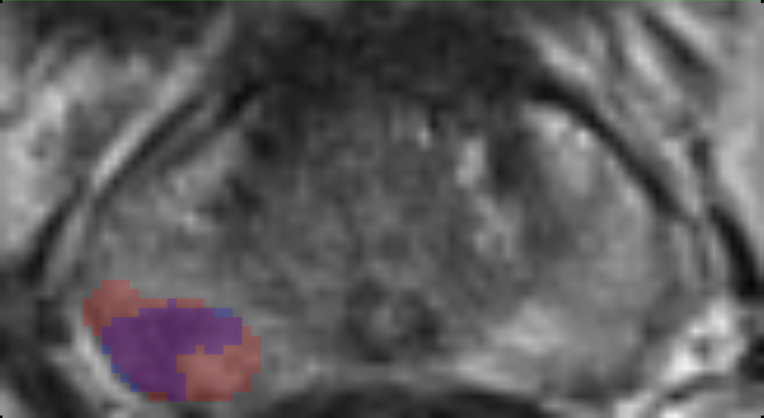
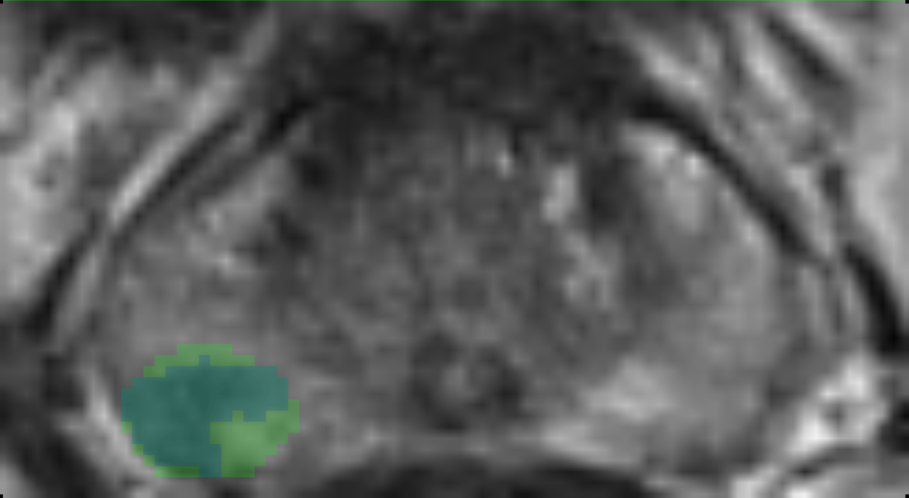
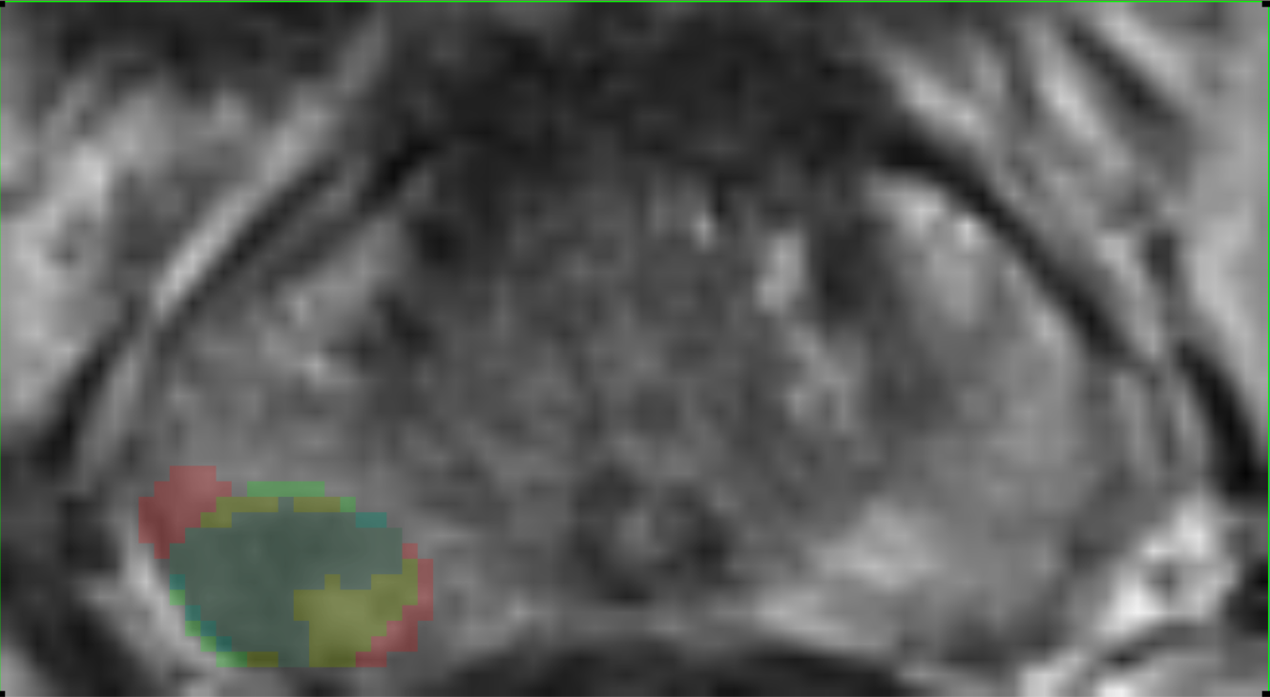
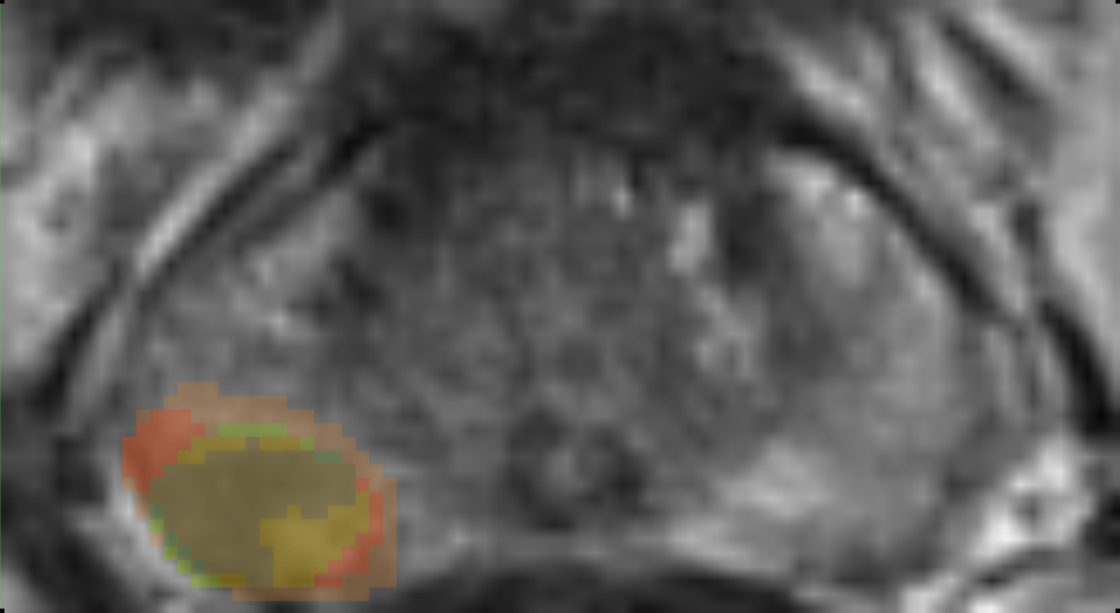
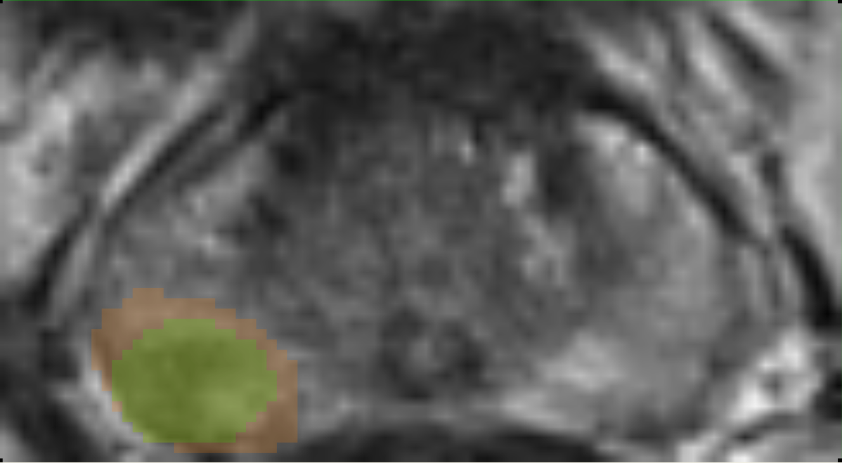
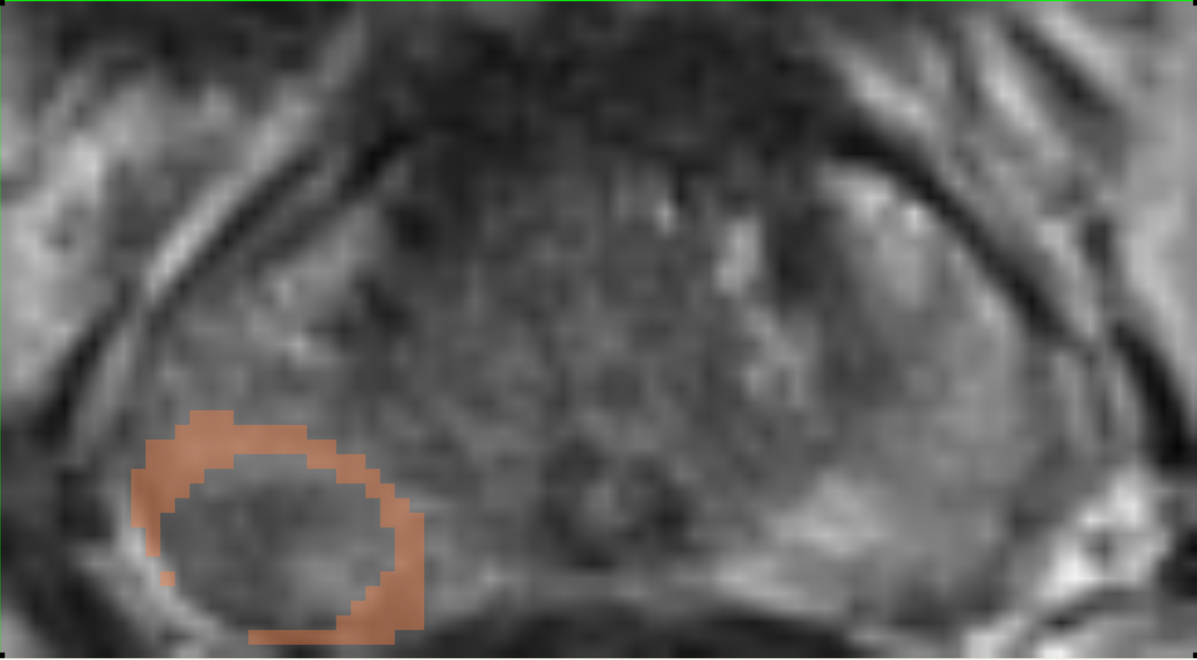
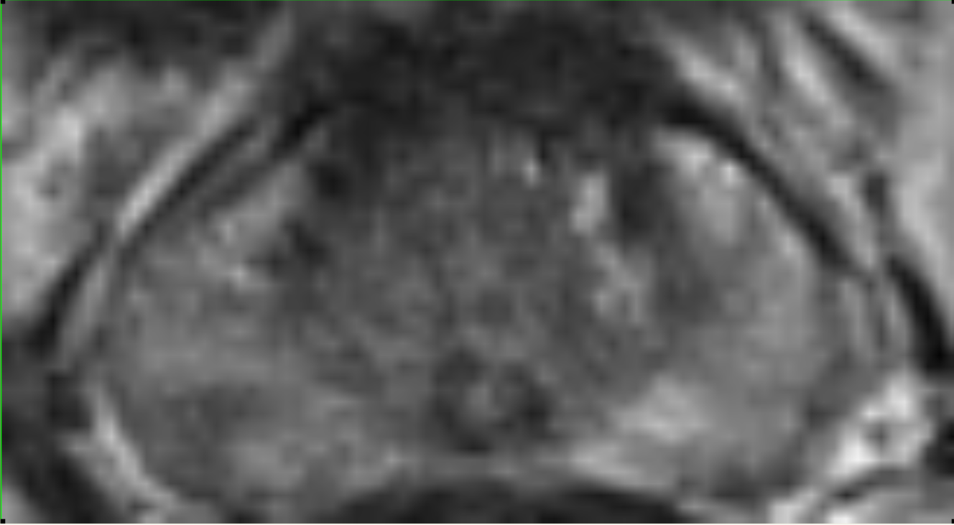
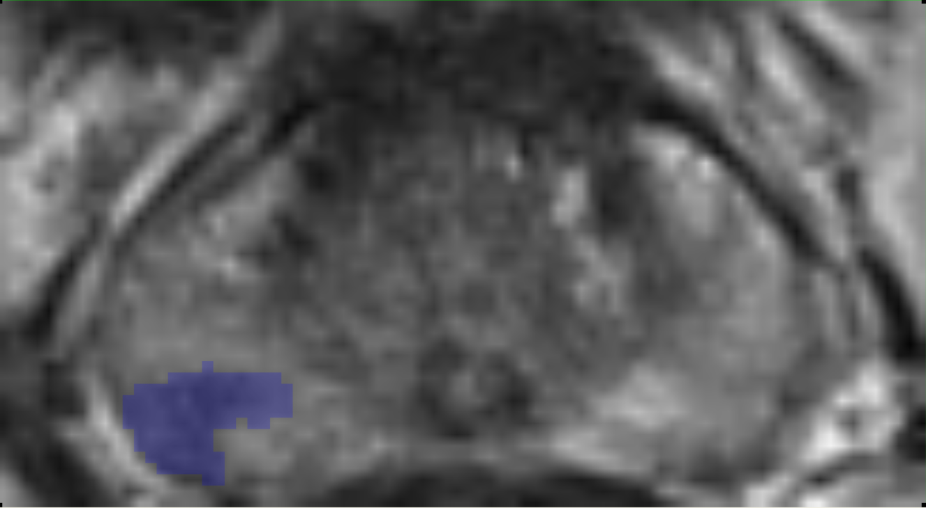
Lenobin et al, J Urology, 2015

Slide 33
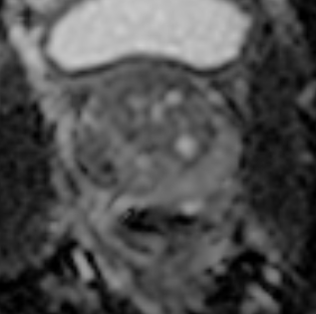
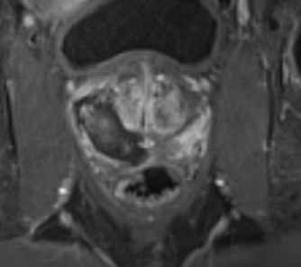
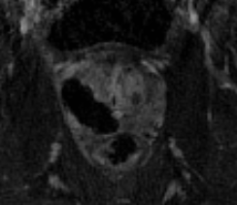
Case Example
T2WI
ADC
Subtraction
DCE
No residual evidence of tumor
Ablation cavity appears to encompass previously noted tumor
No significant extraprostatic necrosis

Slide 34
Conclusions
MR targeted biopsy offers unique benefits in all biopsy indications:
Reduction of Gleason 6 cancer detection without reduction of high grade detection in men with no previous biopsy
Focal therapy is evolving from fiction to fact and driven by appropriate disease detection, localization and risk assessment
Implementation is feasible, but the benefits remain to be validated
Long-term outcomes for validation will remain a challenge for the future

