Slide 1
Future Trends in Erectile Dysfunction and Hypogonadism
R. Matthew Coward, MD FACS
Associate Professor of Urology, UNC Department of Urology
Director of Male Reproductive Medicine and Surgery, UNC Fertility
University of North Carolina School of Medicine, Chapel Hill, NC, USA
Floyd A. Fried Advances in Urology – June 22, 2019

Slide 2
Disclosures
Under Accreditation Council for Continuing Medical Education guidelines disclosure must be made regarding financial relationships with commercial interests within the last 12 months.
I have no relevant financial relationships or affiliations with commercial interests to disclose.

Slide 3
Erectile Dysfunction – Background
Definition: Inability to attain and/or maintain sufficient penile rigidity for sexual satisfaction
Prevalence: Up to 30 million men in the U.S. and 150 million men worldwide
Negatively affects a man's mental health, his relationship, and his general well-being
Provides opportunity to address multiple men's health issues

Slide 4
2018 AUA Guidelines for Erectile Dysfunction
Notes:
The previous version of the Guideline was published in 2005. This Guideline was just published in May 2018, and is representative of the evolution of the field since that time, but it was also more thorough, scientifically rigorous, and evidence-based than previous iterations. It updates the literature, introduces several new and important fundamental concepts which I will discuss, and it provides a helpful algorithm which we will go through.

Slide 5
History, Examination, and Laboratory Testing
1. Men presenting with symptoms of ED should undergo a thorough medical, sexual, and psychosocial history; a physical examination; and selective laboratory testing. (Clinical Principle)
Medical, sexual, psychosocial history:
Age, comorbid medical and psychological conditions, prior surgeries, medications, family history of vascular disease, substance use
Risk factors for ED: vascular disease, tobacco use, neurologic disease, endocrinopathies, medication side effects, and psychosocial issues
History should include partner
Key questions:
Symptom onset / severity / degree of bother
Problem with obtaining and/or maintaining an erection
Presence of nocturnal and/or morning erections
Situational factors (e.g., occurring only in specific contexts)
Masturbatory erections
Prior use of erectogenic therapy
Stable or progressive symptoms (progressive suggests comorbidities)
Information about changes in libido, orgasm, and penile morphology

Slide 6
History, Examination, and Laboratory Testing
1. Men presenting with symptoms of ED should undergo a thorough medical, sexual, and psychosocial history; a physical examination; and selective laboratory testing. (Clinical Principle)
Physical examination:
VS, including BP and waist circumference
Assessment for signs of hypogonadism: gynecomastia, under-developed facial/pubic/axillary hair
Genitourinary examination
Laboratory testing:
Serum BUN/Cr, fasting lipids, Hgb A1c, testosterone, thyroid function, PSA
Consideration of psychological factors:
Depression, anxiety, relationship conflict

Slide 7
General Treatment Principles
6. For men being treated for ED, referral to a mental health professional should be considered to promote treatment adherence, reduce performance anxiety, and integrate treatments into a sexual relationship. (Moderate Recommendation; Evidence Level: Grade C)
7. Clinicians should counsel men with ED who have comorbidities known to negatively affect erectile function, that lifestyle modifications, including changes in diet and increased physical activity, improve overall health and may improve erectile function. (Moderate Recommendation; Evidence Level: Grade C)

Slide 8
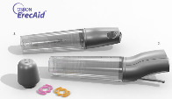
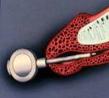
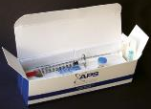
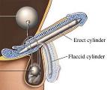
Shared Decision-Making
Old Paradigm – Step-Wise Approach (1st line, 2nd line, 3rd line)
New Paradigm – Shared Decision-Making

Slide 9
PDE-5 Inhibitors
8. Men with ED should be informed regarding the treatment option of an FDA-approved oral PDE5-i, including discussion of benefits and risks/burdens, unless contraindicated. (Strong Recommendation; Evidence Level: Grade B)
9. When men are prescribed an oral PDE5-i for the treatment of ED, instructions should be provided to maximize benefit/efficacy. (Strong Recommendation; Evidence Level: Grade C)
10. For men who are prescribed PDE5-i, the dose should be titrated to provide optimal efficacy. (Strong Recommendation; Evidence Level: Grade B)
Notes:
The new guidelines do include PDE-5 inhibitors, although we have conceptualized the management in a different way. Since the guideline has moved to a shared decision-making model, we understand now that PDE-5 inhibitors may not be effective for all patients. Patients present with varieties of etiologies and severities, and we accept now that patients’ preferences and goals may vary. Regardless, PDE-5 inihibitors remain an important conservative, first-line approach.

Slide 10
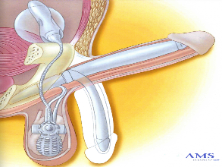
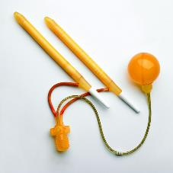
Penile Prosthesis Implantation
18. Men with ED should be informed regarding the treatment option of penile prosthesis implantation, including discussion of benefits and risks/burdens.
RESERVOIR
CYLINDERS
PUMP

Slide 11
2018 AUA Guidelines – ED Treatment Algorithm

Slide 12
Testosterone
4. For men with ED, morning serum total testosterone levels should be measured. (Moderate Recommendation; Evidence Level: Grade C)

Slide 13
What is Hypogonadism/Low T ?
Is it a real condition or marketing genius ?

Slide 14
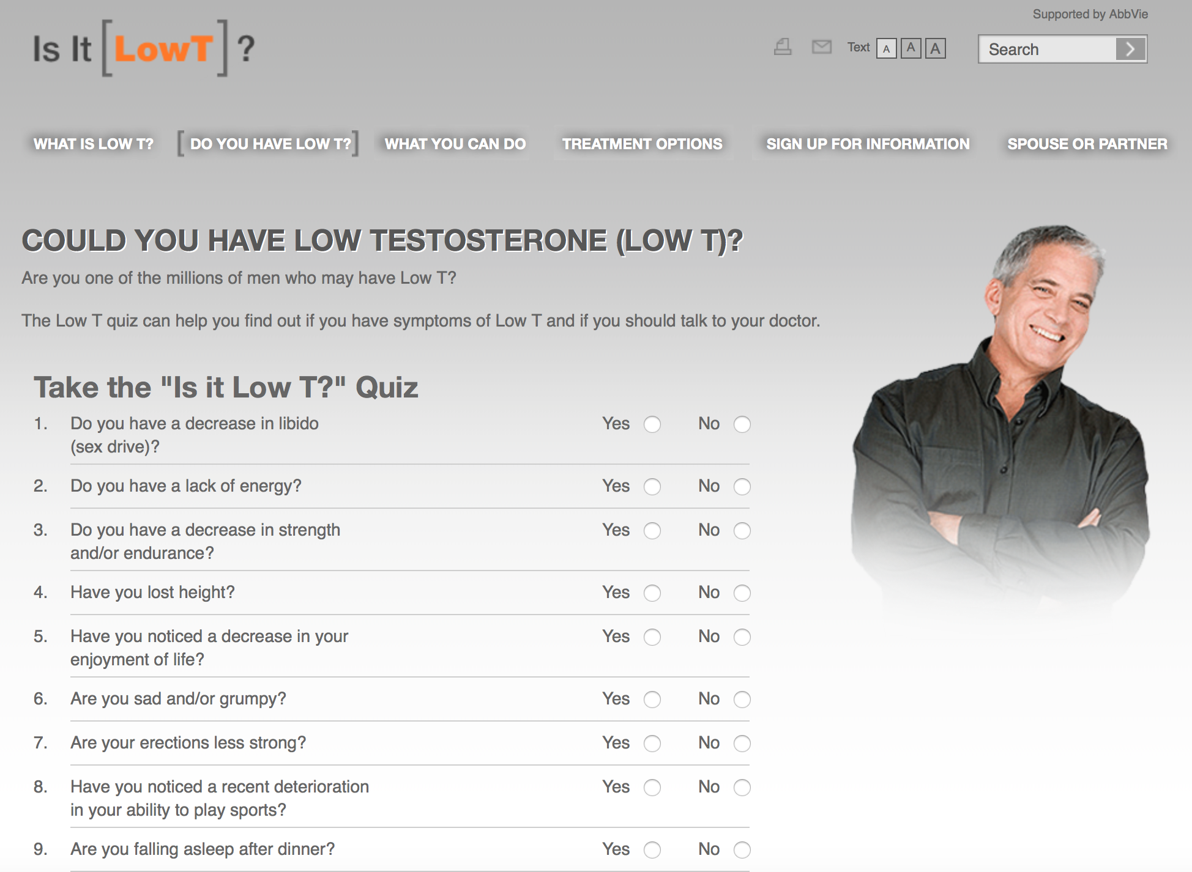

Slide 15
What is Hypogonadism/Low T ?
Is it a real condition or marketing genius ?
Depends if we are talking about primary hypogonadism or secondary hypogonadism
Primary hypogonadism is a real condition
Secondary hypogonadism may be a real condition (rare), or may be temporary, reversible, or related to another medical condition or medication
Age-related hypogonadism is likely mixed primary/secondary

Slide 16
Guidelines for T Level for Diagnosis
Endocrine Society
Low T defined using local, normal assay ranges in the presence of signs or symptoms
Food and Drug Administration (FDA)
Cut-off value of 300 ng/dL to define hypogonadism for clinical trial development and enrollment
Consensus statement from ASA, EAA, EAU and others
TT levels > 350 ng/dL do not require treatment, and levels < 230 ng/dL (with symptoms) may require TRT
For levels 230-350 ng/dL, repeat the TT with SHBG for calculation of FT or direct measurement of FT by equilibrium dialysis
NO CONSENSUS!
THE AUA

Slide 17
Diagnosis of Hypogonadism 2018 AUA Guidelines on Testosterone Deficiency
Published 4/3/18
Unabridged document is 76 pages
COI: Mulhall is consultant/advisor for Pfizer, Lilly, AMS; numerous others

Slide 18
Diagnosis of Hypogonadism 2018 AUA Guidelines on Testosterone Deficiency

Slide 19
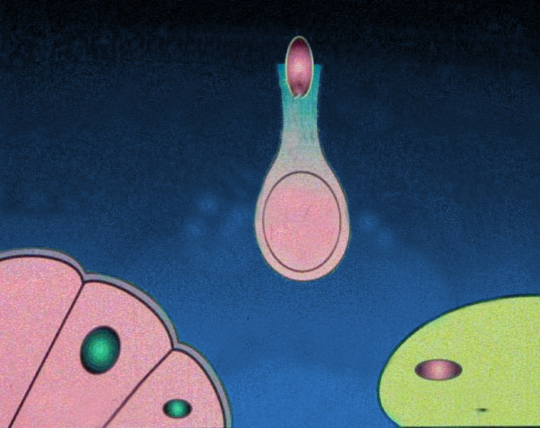
Higher Centers
Normal Physiology of the Hypothalamic Pituitary
Gonadal Axis in the Male
Hypothalamus
GnRH
Germinal
Epithelium
Inhibin
Anterior
Pituitary
-
Testosterone
-
-
+
+
LH
FSH
Sertoli Cells
Leydig Cell

Slide 20
Who Should Receive TRT? FDA Drug Safety Communication (3/3/2015)
TRT is for men with hypogonadism resulting from disorders of the:
Testicles
Pituitary gland
Brain
“…Testosterone is being used extensively in attempts to relieve symptoms in men who have low testosterone for no apparent reason other than aging. The benefits and safety of this use have not been established.”

Slide 21
Contraindications to TRT
Male breast cancer
Known/suspected active prostate cancer (?)
Hematocrit >55%
Known/suspected hypersensitivity to ingredients used in TRT
Men who desire fertility
Untreated sleep apnea
New (??) : prior history of MI, stroke, cardiac disease

Slide 22
“Alternative Agents”
For patients…
Still interested in fertility
With secondary hypogonadism and normal testicular exam who prefer physiologic testosterone normalization
With contraindications to TRT or unable to accept the numerous risks of TRT
Normal LH is ~3 mIU/mL and normal range is ~2-4 mIU/mL
Must use clinical judgement taking into account age, other causes of hypogonadism
Single level does not take into account pulsatility of LH secretion

Slide 23
“Alternative Agents” Physiologic Treatment of Secondary Hypogonadism
SERMs
Clomiphene citrate (Clomid) – (off-label)
Gonadotropins
Human chorionic gonadotropin (hCG) – (off-label)
Aromatase Inhibitors
Anastrozole (Arimidex) – (off-label)

Slide 24
Advantages of “Alternative Agents”
Advantages
No risk of transference
Pills available
No significant pituitary suppression
No fertility impairment
Reliable dosing
CV risk of testosterone supplementation (?)
Established safety and efficacy

Slide 25
Clomiphene Citrate (Clomid) Background
Clomiphene citrate (Clomid) = selective estrogen receptor modulator (SERM)
Off-label for hypogonadism and male infertility
Dosage: 12.5 - 50 mg daily, Typically starting 25 mg daily
Mixture of 2 geometric isomers
Both modulate estrogen receptor → ↑ FSH and ↑ LH → ↑ T
Side effects
Gynecomastia, weight gain, hypertension, cataracts, acne, blood clots, blurred vision

Slide 26
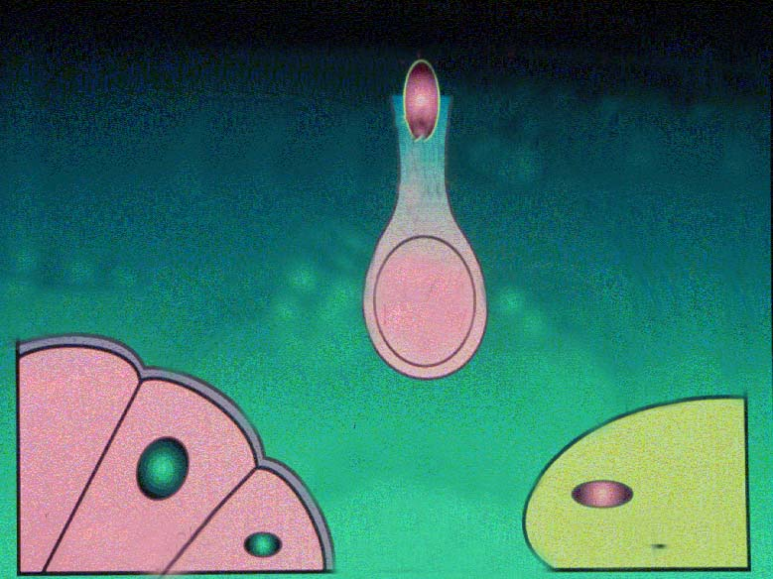
Higher Centers
The Effect of SERMs on the HPG Axis
Clomiphene
Citrate
Hypothalamus
Estrogen
GnRH
Germinal
Epithelium
Inhibin
Anterior
Pituitary
-
Testosterone
-
-
+
+
LH
FSH
Sertoli Cells
Leydig Cell

Slide 27
Clomiphene in the Literature
Outcomes of clomiphene treatment in young hypogonadal men
N=86 men
Duration of CC treatment=19 months
All mean T and gonadotropin measurements significantly increased
ADAM scores improved in all domains (except loss of height)
No major side effects
Clomiphene is safe and effective for long-term management of hypogonadism
N=46 patients
Stable T levels over 3 years
Bone density and ADAM scores improved significantly
No adverse events
Mulhall, et al. BJU Nov 2012; Mulhall, et al. BJU Aug 2012

Slide 28
Comparison of Clomiphene vs. Testosterone
Clomiphene vs. Testosterone for Hypogonadism: Comparison of Satisfaction and Efficacy
N=93 men
T injections (31) or gels (31), or CC (31)
Age-matched
Similar satisfaction on qADAM
No difference in overall hypogonadal symptoms
Conclusion: Clomiphene is safe and efficacious and can be used long-term for treatment of hypogonadism
Ramasamy, et al. J Urol Mar 2014

Slide 29
Anastrozole (Arimidex)
Mechanism
Reversibly binds the aromatase enzyme and blocks aromatization of testosterone to estrogen by adipose tissue
Role of anastrozole (off-label)
Treatment of secondary hypogonadism with hyperestrogenemia
Use when T:E2 < 10:1
Dose
Optimal dose is unknown
Varies from 1mg daily to 1mg weekly

Slide 30
Human Chorionic Gonadotropin (hCG)
Mechanism
LH analog, so used for hypogonadotropic hypogonadism
Stimulates Leydig cell production of T
Role of hCG (off-label)
Treatment of secondary hypogonadism
Maintain spermatogenesis and intratesticular T with TRT
Recovery of T-induced suppression of spermatogenesis
Dose
Optimal dose is unknown
Varies from 500 IU weekly to 3000 IU QOD

Slide 31
Higher Centers
The Effect of hCG on the HPG Axis
Hypothalamus
GnRH
Germinal
Epithelium
Inhibin
Anterior
Pituitary
-
Testosterone
-
-
+
hCG
LH
+
+
FSH
Sertoli Cells
Leydig Cell

Slide 32
Treatment Algorithm for Secondary Hypogonadism
Check morning total testosterone, LH, and E2 levels (minimum)
If both LH and T are low, treat as secondary hypogonadism
Treat underlying issue
Start clomiphene 25mg daily
Add anastrozole 1mg QD or QOD if T:E2 < 10:1
Consider adding hCG if unresponsive or if recovery of fertility is high priority
Add exogenous testosterone only as a secondary option

Slide 33
Hypogonadism - Summary
Diagnose hypogonadism with two morning levels <300 ng/dL coupled with symptoms
Clinicians should measure LH (Strong recommendation; grade A)
In men with low LH (secondary hypogonadism), always consider the underlying cause
Consider TRT primarily for men with primary hypogonadism, and consider “alternative agents” for secondary hypogonadism

Slide 34
Erectile Dysfunction - Summary
Mental health evaluation, involvement of the partner, and advice on lifestyle are standard components of the management of ED
The former step-wise approach has been replaced by shared decision-making
All patients should be informed of all treatment modalities that are not contraindicated, regardless of invasiveness or irreversibility, as potential first-line treatments
Patients should pursue treatments most aligned with their goals and risk tolerance

Slide 35
Thank You!

