Slide 1

wRVUs: Do They Really Measure the Workload and Complexity Of What We Do?
Raj S. Pruthi MD MHA FACS
Rhodes Distinguished Professor and Chair
Department of Urology
The University of North Carolina at Chapel Hill

Slide 2
Productivity-based Compensation
INTRODUCTION
Increasing use of wRVU in employed compensation models
2007 (16%) → 2016 (> 60%)
Use of benchmarked data (MGMA, AMGA, SC) to determine compensation/productivity ($/wRVU)
  e.g. AMGA $441,836 / 7649 = $57.76/wRVU
Notes:
Increasing use of productivity-based compensation models – especially for employed postions.

Slide 3
wRVU
INTRODUCTION
RBRVS - Developed for HCFA by Hsaio et al (1986-92)
Passed in 1989 -- implemented in 1992
Notes:
Congress reformed how physicians were compensated for services under Medicare in the late 1980’s. Show - a Harvrad economist and a group o researchers with input from different specialties developed for Health Care Finance Administration (HCFA) – a part of HHS responsible for administration of Medicare and Medicaid.
Cornerstone of this legislation was the national Mediacare fee schedule based on resource-based relative value scale – intended to reflect the cost required to deliver each service.
Show and his team developed a to measure the relative value of every single one of the thousands of services provided by doctors -- A job later compared to measuring “the exact amount of anger in the world.” For example, Hsiao’s team deemed that a hysterectomy required 3.8 times more mental effort and 4.47 times more technical skill than a psychotherapy session.

Slide 4

INTRODUCTION
Work RVU
x Work GPCI
+
=
x
Conversion
Factor
Practice Expense RVU
x PE GPCI
+
Payment
Rate
Malpractice RVU
x MP GPCI
GPCI = geographic practice cost index
Notes:
The current system includes three components: work, practice expense and professional liability insurance with final payments incorporating a geographic adjustment as well as conversion factor determined annually to accommodate budget constraints

Slide 5
INTRODUCTION
RVUs → metric of physician productivity
RVUs : CPT code
Notes:
Relative value units are a metric of physician productivity and have been used to inform Medicare reimbursement rates for services since the early 90s
RVUs are assigned to each service identified by a CPT code
I’d like to focus on work RVUs specifically, which are often used as measures of physician productivity.

Slide 6





405
urological services
22
383
Notes:
As part of the Harvard study to determine the initial work RVUs for urology were created by a technical consulting group of 3 urologists nominated by the AUA and AMA which looked at 405 urological services with CPT codes and selected the most important 22. They then administered telephone surveys to a national random sample of 115 urologists to rate pre-service, intra-service, and post-service work for these codes. For the remaining 383 codes, work was determined in a similar fashion by surveying 2 panels of 14 urologists 28 nominated by the AUA.

Slide 7




Work = Time x Intensity
Notes:
For these surveys, each component of work was defined by the product of time in minutes and intensity, which was defined by a combination of technical skill and physical effort, mental effort and judgment, and stress due to the potential risk to the patient.

Slide 8
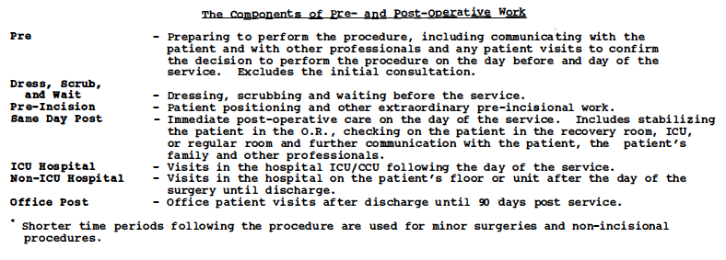
INTRODUCTION

Slide 9
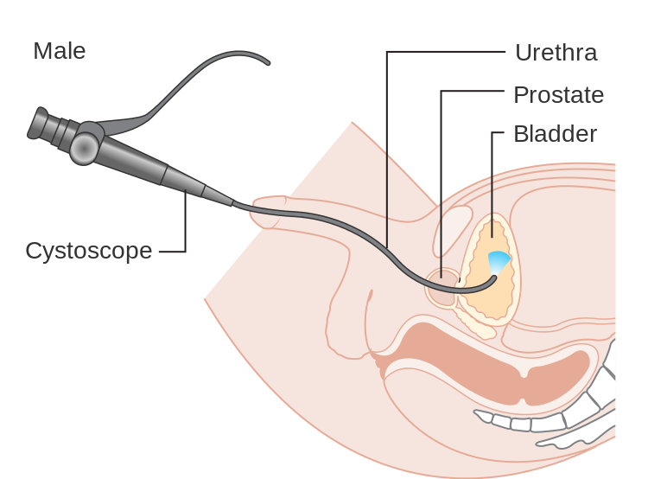
Work
100 units
Notes:
Using this work data for different CPT codes, relative assessments of work were made by starting with a reference service assigned a standard work value of 100 units, which for urology was an ambulatory in-hospital diagnostic cystoscopy in a man with microscopic hematuria, then rating the work of other services compared to that reference service

Slide 10
INTRODUCTION
RVU assignments initially made in consultation with nominees from various medical specialties
Quarterly adjustments based on survey data
Zero sum game
Notes:
The Harvard researchers then put together the work of all of the specialty technical consulting groups to create a a single common work scale, the resource-based relative value scale
These financial constraints mean that increasing RVUs for one CPT code requires decreasing RVUs for another

Slide 11

Changes to Work RVUs
INTRODUCTION
RUC
Summary of Recommendation
Notes:
The process of reassignment has evolved today to a committee that may make recommendations for RVU changes on a quarterly basis – this is often based on survey data from its members
For any specialty to propose a change in a work RVU value for a CPT code, the relevant medical specialty society compiles a standardized “Summary of Recommendation” form, often based on survey data from its members, which describes the typical patient and work involved during pre-operative, intra-operative, and post-operative periods. This is reviewed by the Relative Value Scale Update Committee (RUC), a panel of 30 physicians representing the AMA and specialty societies. Eight of these members are surgeons, 1 from urology. This committee makes recommendations to CMS, and CMS updates the work RVU values every 3 months based on these recommendations.
Because of budget constraints, increasing work RVUs for one CPT code requires decreasing RVUs for one or more other codes, making this a zero sum game.

Slide 12
Who Gets Surveys?
INTRODUCTION
Respondents selected by AUA by random sampling
May be sub-specialty, e.g. prosthetics
May be general, e.g. cysto with dilation
Private practice (small & large), hospital-based, and academic
Need at least 30-50 responses -- ideally >100 responses

Slide 13
INTRODUCTION
Subjective methodology linked with compensation
Accurate measure of surgical complexity? workload? effort? time? difficulty?
Controversy in literature
Correlates with:
  complications in hepatic, vascular, plastic surgery
  op time in pediatric surgery
Poor correlation with:
  op time, LOS, mortality in general surgery
? Urology
Notes:
Given the fact that work RVUs are becoming a common measure of physician productivity and compensation, there’s been interest in whether or not they correlate with objective measures of surgical complexity and workload – an accurate currency of work and difficulty
They seem to correlate with various complications in hepatic, vascular, and plastic surgery, as well as op time in peds surgery, however, in general surgery, work RVUs poorly correlate with op time, length of stay, and mortality.

Slide 14

METHODS
Op time
LOS
Morbidity
Mortality
Serious Adverse
Events
Readmissions
56
Work RVUs
CPT codes
American College of Surgeons
National Surgical Quality Improvement Program
2012-2016
Notes:
We examined 2012 through 2016 NSQIP databases where 56 urology specific CPT codes were identified as representing the spectrum of urologic surgery
Our main outcome variables included operative time, length of stay, morbidity, mortality, significant adverse events and unplanned readmissions with the hypothesis being that RVUs would poorly correlate with these endpoints, representative of surgical complexity and overall physician workload
As a secondary objective, we sought to identify outlying procedures for each of these variables

Slide 15
METHODS
Exclusion criteria
  Non-elective procedures
  Concurrent CPT codes
200,000 → 190,000 urologic procedures included
4.6
44
small TURBT
cystectomy w/ urinary diversion
increasing RVUs
Notes:
Non-elective procedures as well as procedures with concurrent CPT codes were excluded to avoid skewing of data
We identified over 200,000 urologic procedures over the fiver year period that was analyzed and after our exclusion criteria, 190,000 were left for analysis
RVU values for the 56 CPT codes ranged from 4.6 for small TURBT to 44 for radical cystectomy with urinary diversion

Slide 16
RESULTS
NSQIP Variable | R-Squared
Length of Stay (LOS) | 0.80
Operating Room Time | 0.87
Morbidity | 0.75
Mortality | 0.52
Serious Adverse Events | 0.65
Unplanned Readmissions | 0.58
Notes:
RVUs correlated well with length of stay, OR time and morbidity, however there was only a moderate correlation with mortality and unplanned readmissions
For each variable, we identified potentially outlying procedures

Slide 17
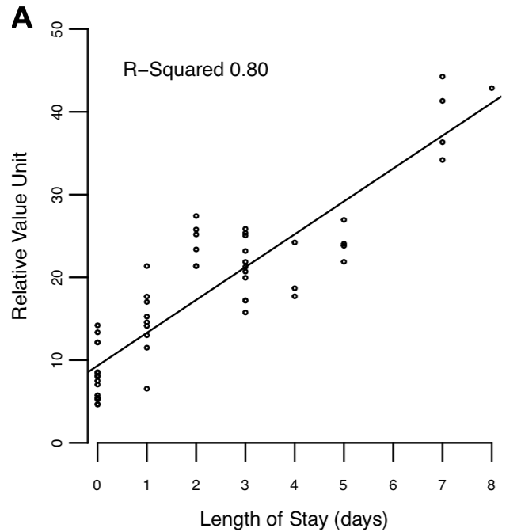
LOS
Outlying Procedures:
Lap Partial Nephrectomy
  RVUs: 27.4
  Median LOS: 2

Slide 18
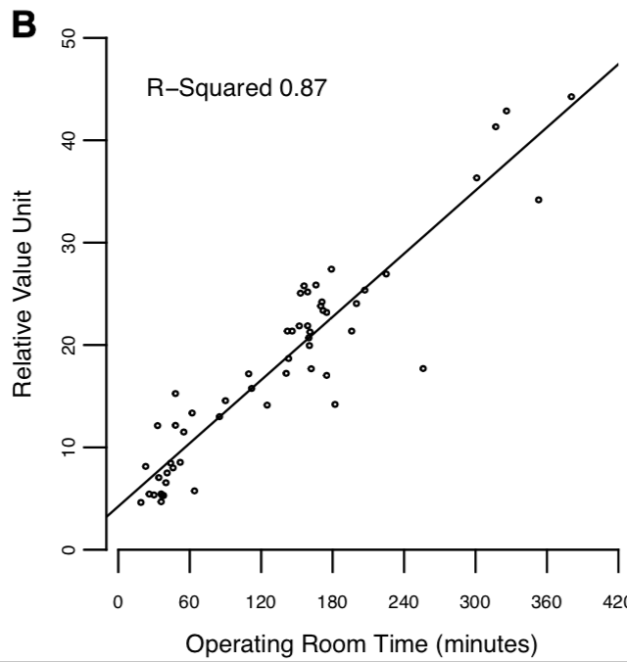
Op Time
Outlying Procedures:
Epididymovasostomy
  RVUs: 14.2
  OR Time: 182 mins
RPLND
  RVUs: 17.7
  OR Time: 256 mins

Slide 19
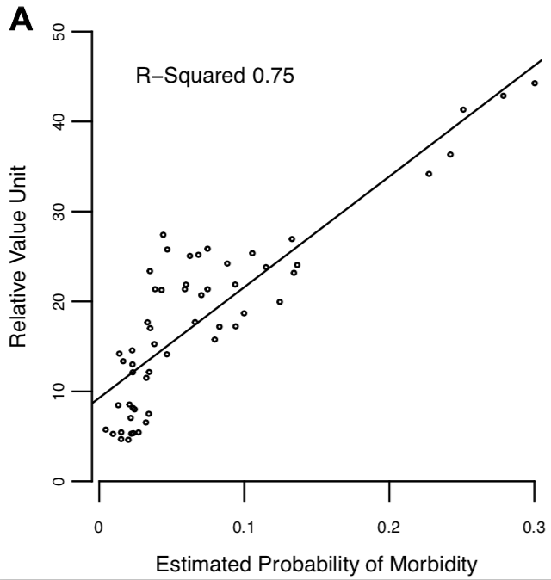
Morbidity
Outlying Procedures:
Lap Partial Nephrectomy
  RVUs: 27.4
  Median Morbidity %: 4.4
Lap Ureteroneocystotomy
  RVUs: 25.7
  Median Morbidity %: 4.7

Slide 20
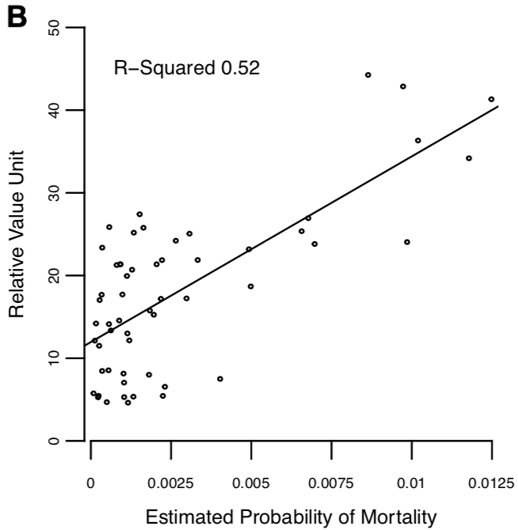
Mortality
Outlying Procedures:
None

Slide 21
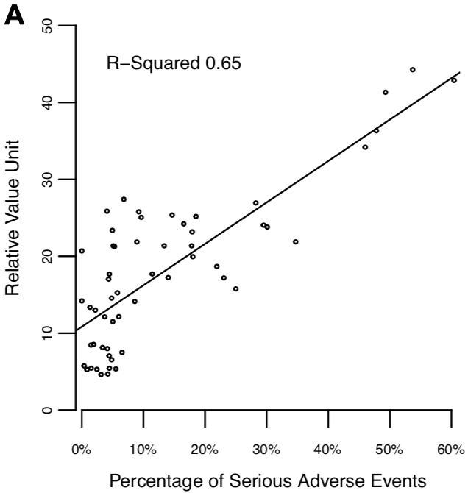
SAEs
Outlying Procedures:
Pyeloplasty (complicated)
  RVUS: 25.8
  SAEs (%): 4.1
Lap Partial Nephrectomy
  RVUs: 27.4
  SAEs (%): 6.8

Slide 22
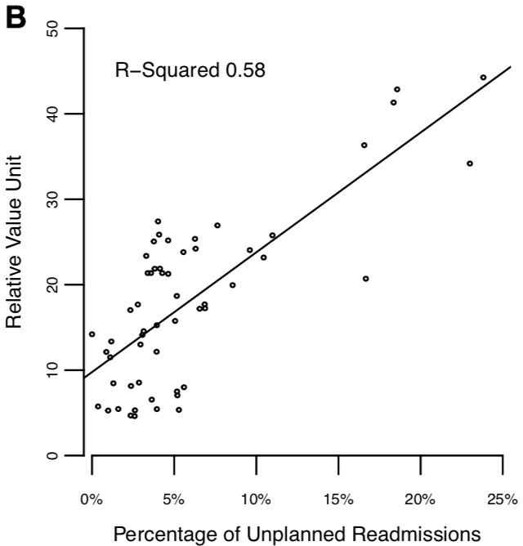
Readmission
Outlying Procedures:
Ureteroneocystotomy (with ureteral tailoring)
  RVUs: 20.7
  Unplanned Readmissions (%): 16.7

Slide 23
RESULTS
NSQIP Variable | R-Squared
Length of Stay (LOS) | 0.80
Operating Room Time | 0.87
Morbidity | 0.75
Mortality | 0.52
Adverse Events | 0.65
Unplanned Readmissions | 0.58
Notes:
As the existing methodology for determining work RVU values is multifactorial, taking into account both time and intensity (the latter of which includes effort, risk to the patient, etc.), we felt that a multivariable model would more robustly identify procedures with outlying RVU values and project appropriate changes

Slide 24
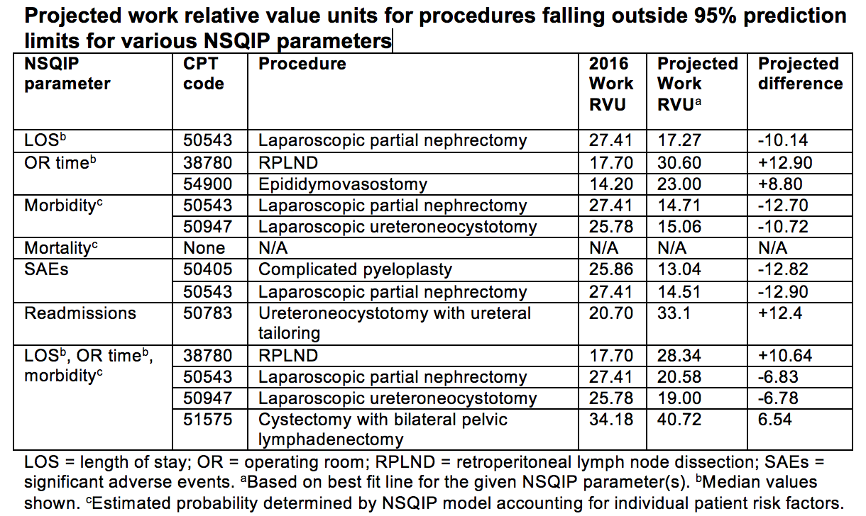
RESULTS
Notes:
We have identified RPLND, laparoscopic partial nephrectomy, laparoscopic ureteroneocystotomy, and cystectomy with bilateral pelvic lymphadenectomy as codes that may benefit from re-evaluation in the future
Retroperitoneal lymph node dissection had a projected increased of 10.6 RVUs, likely due to its median operative time of 256 minutes
Cystectomy with bilateral pelvic lymph node dissection (currently the lowest RVU of the cystectomy CPT codes) had a projected increase of 6.5 RVUs
Laparoscopic ureteral reimplantation had a projected decrease of 6.7 RVUs, likely due to its lower morbidity when compared to similarly valued procedures
Similarly, laparoscopic partial nephrectomy has a projected decrease of 6.8 RVUs due to a shorter length of stay, lower morbidity, and less frequent SAEs

Slide 25
DISCUSSION
Work RVUs in urology correlate well with:
  Op time (R² = 0.87)
  LOS (R² = 0.80)
  Morbidity (R² = 0.74)
Only moderately correlate with:
  Mortality (R² = 0.51)
  Serious Adverse Events (R² = 0.65)
  Readmissions (R² = 0.57)
Outliers
Data-driven approach to improve RVU assignments
wRVU = 3.14 + 6.64*(operative time in hrs) + 0.59*(LOS in days) + 0.37*(readmission rate) + 0.06*(SAE rate) – 0.13*(death rate).
Notes:
RVUs generally appear to account for physician workload generated by postoperative morbidity
This does, however, appear to be less reflective measure of more severe complications warranting unplanned readmission or those resulting in mortality
While interpretation of our results is limited by the subjectivity of our endpoints as being reflective of physician workload and surgical complexity, however we do feel that the study highlights the need to incorporate objective data in an effort to improve RVU assignments for CPT codes

Slide 26
DISCUSSION
Importance of wRVU to fairly and accurately measure work
Need to move from subjective assessment to objective measure
  Effort over 30-day post-operative period
  Reflect patient co-morbidities
Does not include quality / cost of care
Need to be consistent within specialty and across specialties

Slide 27
 | Op Time |  |  | Length of Stay
Surgical Specialty | Correlation Coefficient (R) | Estimated mRVU for 1hr procedure | Increase in mRVU per hour of op time | Correlation Coefficient (R) | Estimated mRVU for 1 day admission | Increase in mRVU per hospital day
Cardiac Surgery | 0.51 | 27.21 | 9.20 | 0.47 | 27.20 | 4.43
General Surgery | 0.86 | 14.84 | 11.28 | 0.60 | 16.58 | 2.93
Gynecology | 0.84 | 13.47 | 11.45 | 0.72 | 18.67 | 7.38
Neurosurgery | 0.80 | 17.65 | 12.90 | 0.42 | 29.95 | 2.25
Orthopedics | 0.80 | 12.04 | 12.55 | 0.33 | 16.21 | 1.98
Otolaryngology (ENT) | 0.97 | 9.04 | 9.51 | 0.81 | 17.24 | 5.83
Thoracic | 0.91 | 16.15 | 8.12 | 0.54 | 17.48 | 2.20
Urology | 0.92 | 11.85 | 8.70 | 0.81 | 15.38 | 5.50
Vascular | 0.85 | 13.07 | 11.24 | 0.41 | 18.91 | 1.88
Overall | 0.85 | 13.57 | 11.16 | 0.58 | 17.50 | 3.05

Slide 28
Op time

Slide 29
Correlation and Linear Regression between Risk Variables mRVU
 | Readmission Rate |  | SAE Rate |  | Morbidity Rate |  | Mortality Rate
Surgical Specialty | Correlation Coefficient (R) | Change in mRVU for 10% increase | Correlation Coefficient (R) | Change in mRVU for 10% increase | Correlation Coefficient (R) | Change in mRVU for 10% increase | Correlation Coefficient (R) | Change in mRVU for 10% increase
Cardiac Surgery | 0.01 | 0.65 | 0.60 | 6.82 | 0.59 | 6.99 | 0.71 | 50.58
General Surgery | 0.46 | 14.32 | 0.65 | 9.20 | 0.63 | 7.36 | 0.22 | 11.69
Gynecology | 0.70 | 29.15 | 0.61 | 8.27 | 0.65 | 8.33 | 0.36 | 98.72
Neurosurgery | 0.43 | 17.34 | 0.45 | 6.32 | 0.39 | 4.11 | 0.08 | 2.32
Orthopedics | 0.20 | 6.61 | 0.32 | 3.62 | 0.31 | 3.10 | 0.04 | 3.33
Otolaryngology | 0.72 | 40.87 | 0.84 | 23.35 | 0.84 | 13.85 | 0.13 | 36.97
Thoracic | 0.33 | 11.41 | 0.67 | 6.33 | 0.69 | 5.96 | -0.03 | -1.28
Urology | 0.74 | 17.96 | 0.83 | 9.01 | 0.82 | 8.02 | 0.34 | 40.39
Vascular | 0.01 | 0.17 | 0.71 | 5.32 | 0.71 | 5.21 | 0.47 | 10.45
Overall | 0.42 | 13.00 | 0.61 | 6.70 | 0.62 | 6.10 | 0.29 | 12.50

Slide 30
Readmissions

Slide 31
SAEs

Slide 32
Morbidity

Slide 33
Conclusions
Importance of wRVU to fairly and accurately measure work
Need to move from subjective assessment to objective measure
  Effort over 30-day post-operative period
  Reflect patient co-morbidities
Does not include quality / cost of care
Need to be consistent within specialty and across specialties
wRVU = 3.14 + 6.64*(operative time in hrs) + 0.59*(LOS in days) + 0.37*(readmission rate) + 0.06*(SAE rate) – 0.13*(death rate).

Slide 34

QUESTIONS

Slide 35
Notes:
Thank you. I’m happy to hear of peoples thoughts or comments and to answer any questions and would love

