Slide 1
Free-Flap Phalloplasty: Complications, Prevention Strategies and Realities of Repair Options
Richard A. Santucci, MD, FACS, HON FC Urol(SA)
Crane Surgical Services-Austin (and San Francisco)

Slide 2
Brief Intro
I am a reconstructive urologist (18 years) who has decided to devote the rest of my career to the “Mount Everest” of transgender surgery.
Newest member of Crane Surgical Services-Austin.
Formerly full professor and reconstructive urology Fellowship director at the Detroit Medical Center and newly (re)minted Texan.

Slide 3
Incidence
Probably not truly known
Estimates of up to 1/200 Americans : 1.6 million
Perhaps 25% of transgender men want surgery: maybe 1/100 have bottom surgery
Perhaps 50% of transgender women want surgery: up to 30% get bottom surgery
205,850 people (0.66%) in 18-24 age range
967,1000 (0.58%) in 25-64 age range

Slide 4
Practice had done over 600 phalloplasties In one year 2018 our Practice did:
Phalloplasty- 108
Vaginoplasty-139
Top surgery-124
Penile Implants (in phalloplasty patients)-46
Metoidioplasty-24

Slide 5
How to do it: Forearm Phalloplasty (and VaginectomY, scrotoplasty and urethral lengthening) in 10 easy steps

Slide 6
Mark the arm

Slide 7
create urethal, penile, and coronoplasty portions while preserving nerve, vein and artery

Slide 8
tubularize the urethra/penis, create corona

Slide 9
Close the arm with local tissue flaps and thigh STSG. Cover with wound vac.

Slide 10
Vaginectomy

Slide 11
Free up the clitoris, Urethral lengthening

Slide 12
Clitoral reduction and creation of neopallus Base

Slide 13
Find and expose a clitoral nerve

Slide 14
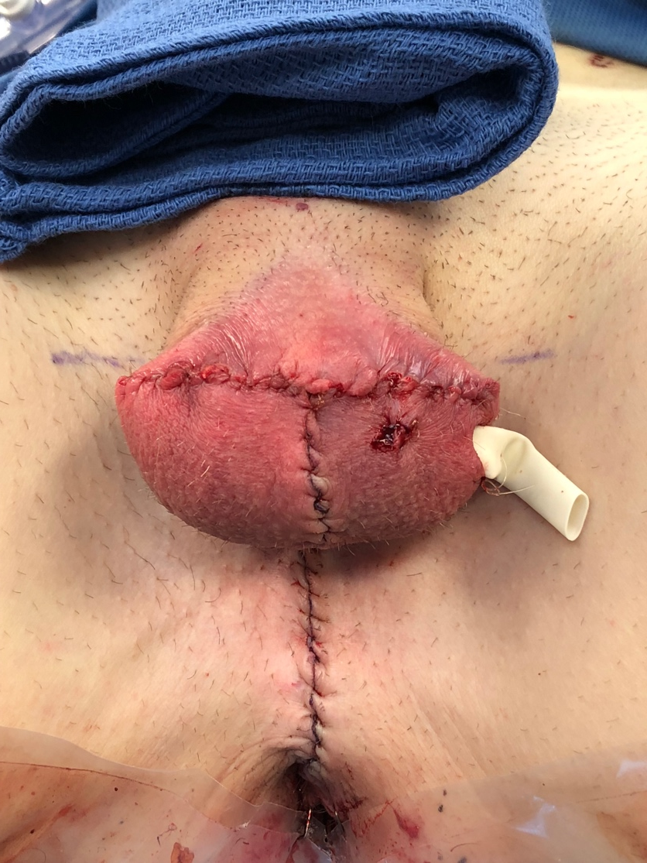
Create Neoscrotum

Slide 15
Microvascular anastomosis of artery/Vein. Connect nerve

Slide 16
Voila

Slide 17
Quick intro to alternate method: Anteriolateral Thigh Flap Phalloplasty (ALT=“leg”)

Slide 18
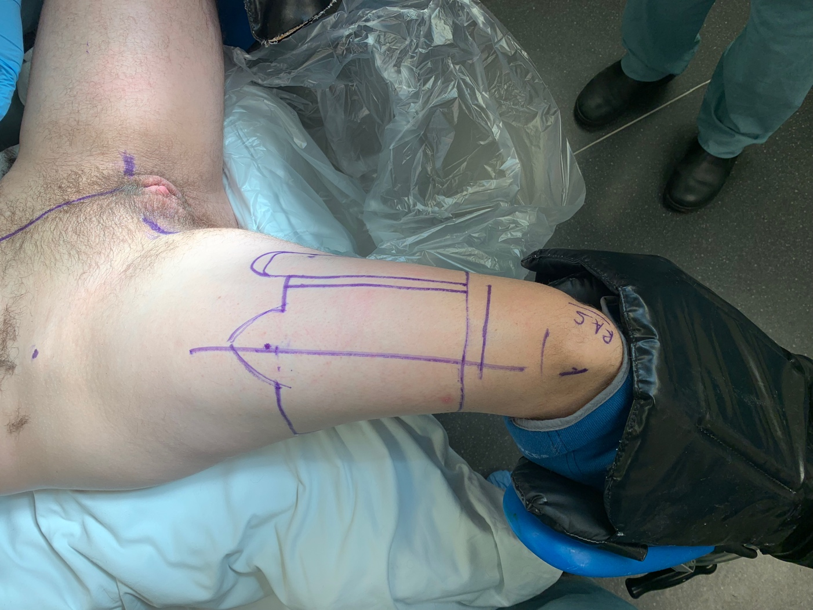
ALT
Mark
Free up pedicle
Make urethra

Slide 19
ALT steps
Move under muscles
Inset (affix) in place

Slide 20
General Complications of Phalloplasty
“The 1/10/40/100 rule”

Slide 21
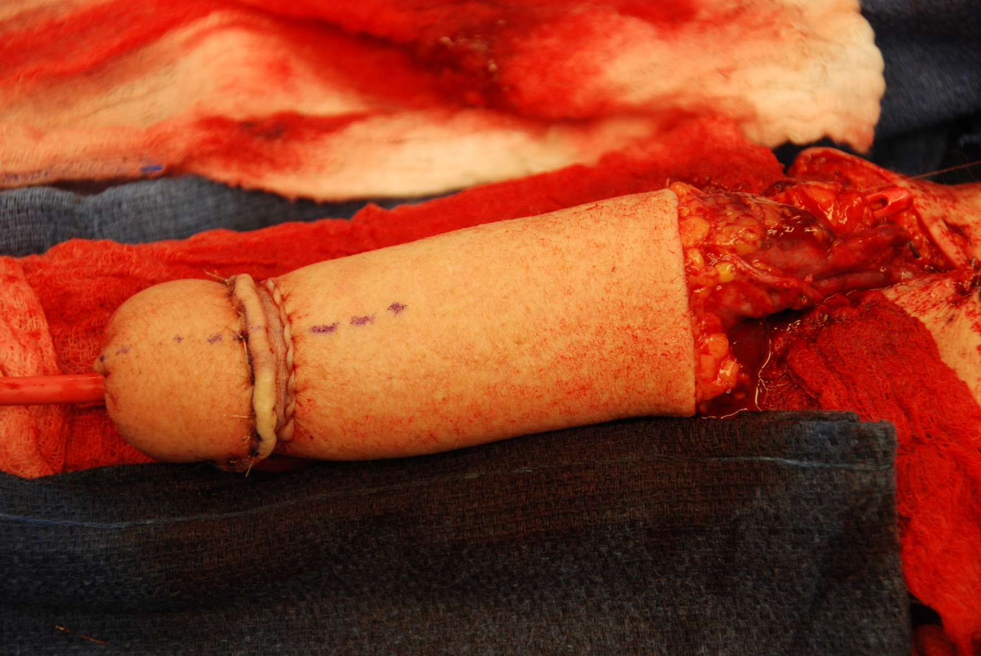
1%: the risk of major vascular disaster
A 12 hour surgery(we do it in 6 with two simultaneous teams): massive operation.
An 22X16 cm wide flap of skin, fat, blood vessels and more is freed, folded twice, and then moved a long distance to a new location. It relies on just ONE LITTLE artery and vein to keep it alive/well.
Flap surgery invented 1970’s. When used, usually 10X6 cm flap. This pushes the limits of flap technique

Slide 22
The artery can clot unexpectedly, creating a huge surgical emergency. If blood flow cannot be restored, the phallus is lost without immediate intervention. The vein can clot. This is also an emergency but less dramatic in presentation.

Slide 23
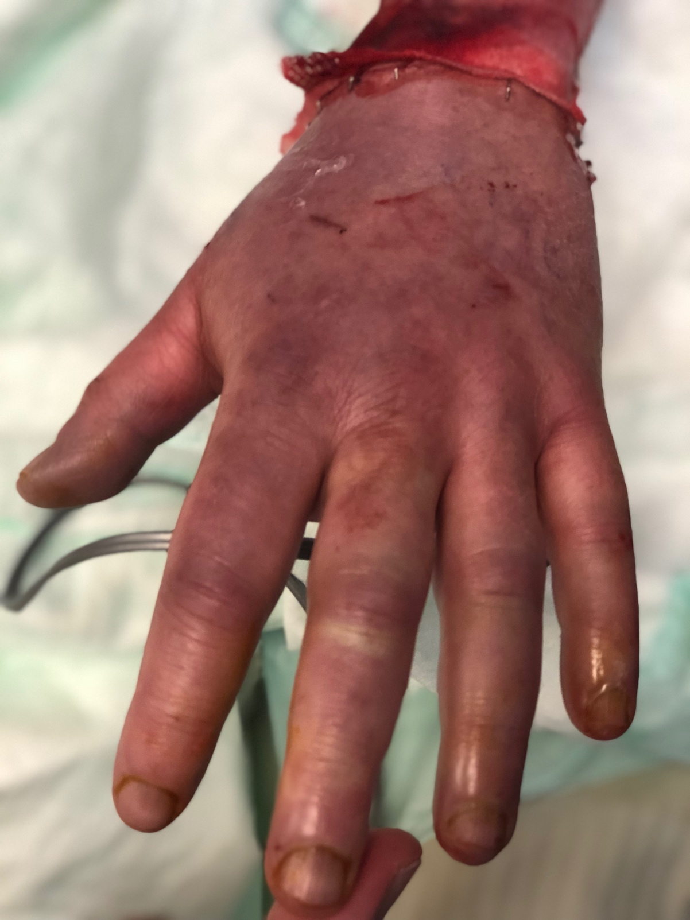
10% Chance of a “notable” complication while in hospital
These tend to be unexpected and a sometimes a bit random. Like….
Hematoma near vessels, that requires surgical evacuation
Pneumonia (bed rest, narcotics, sedatives, big surgery)
Problems with the hand blood supply requiring acute reexploration and vessel grafting
New carpel tunnel syndrome requiring immediate carpel tunnel surgery (more than once)
And more….

Slide 24
40% urinary complication rate…. About 20% Fistula and about 20% stricture
Historically had a 50% (!) rate, fell over time to 23-35% in contemporary series.
However the literature is “silo-ed”, single center, “smallish” numbers and skimpy

Slide 25
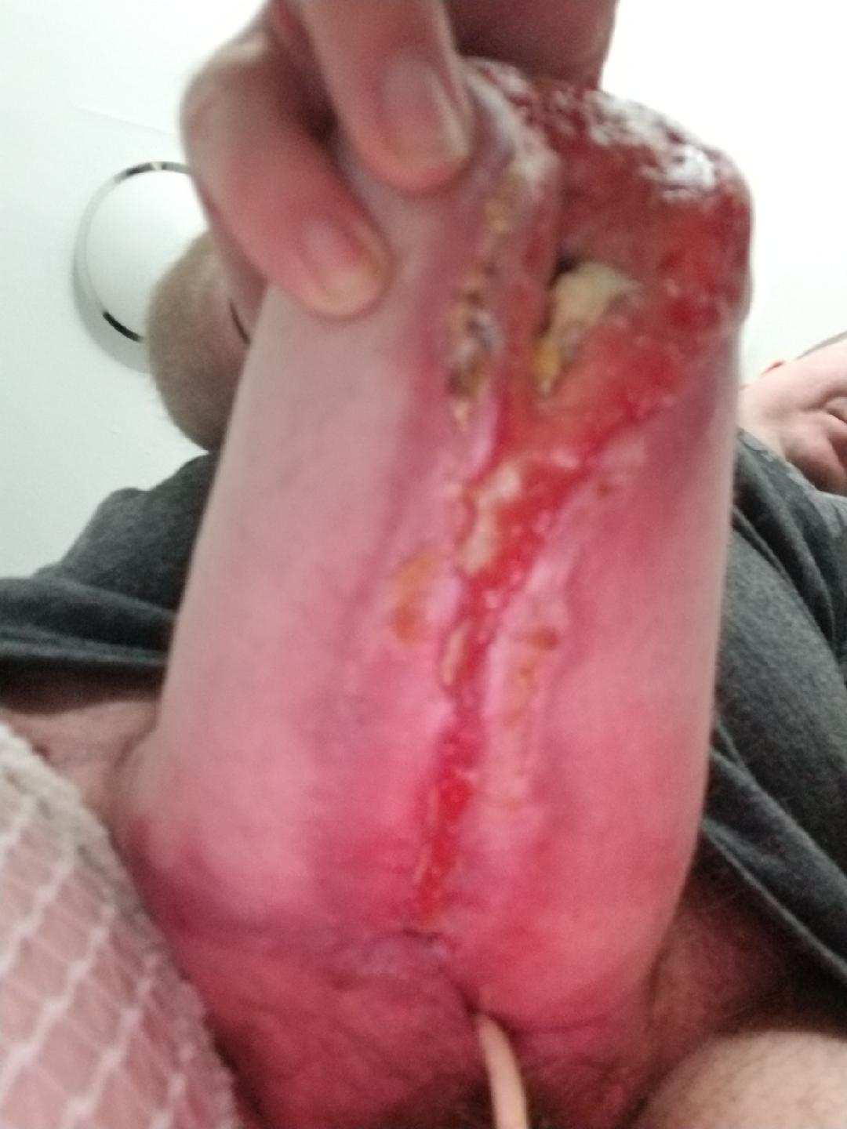
100% minor complication rate
Big thigh=big phallus
Secret smoker until 3 days of
surgery=edge loss
Too fat phallus to make
urethra in first stage
Small dehiscences
Necrosis of the flap edges of the flap: the areas with the worst blood supply
“the Edge Problem”
Small abscesses
(late) Asymmetric healing, significant scarring
And more

Slide 26
ALT (leg) vs RFF (arm) Phalloplasty complications: which one is better
Truly, one is not better than the other. They both have unique benefits and costs.
Quickest summary
RFF (arm) THE GOOD
Normal size/configuration penis out of the box
Slightly more robust blood supply
Less fistula?
Better nerve density? --unproven
RFF (arm) THE BAD
One must accept microvascular (1%) or other acute problems that send pt back to the operating room (3%)
Arm scar

Slide 27
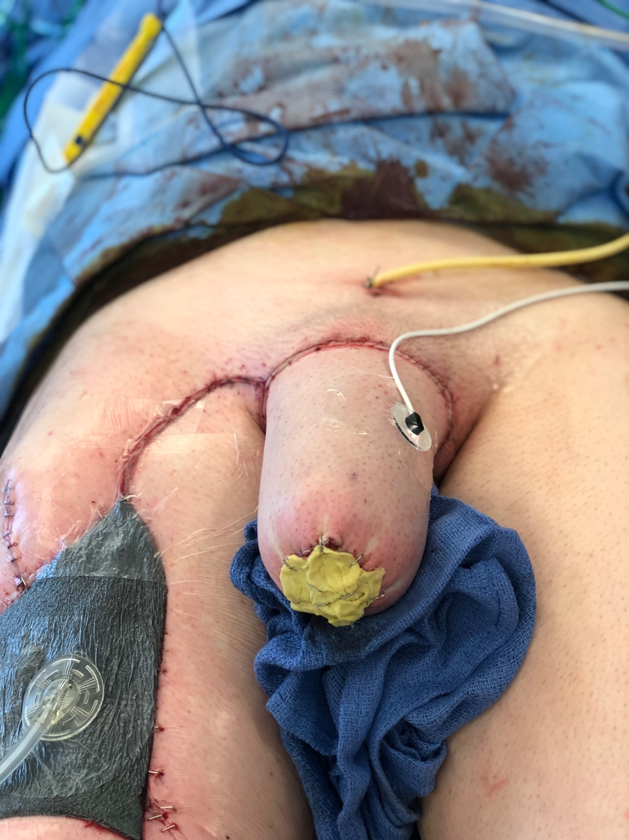
ALT (leg) vs RFF (arm) Phalloplasty complications
ALT (leg) THE GOOD
No artery/vein connection needed: you bring artery/vein with you from the leg up to the groin
No arm scar
ALT (leg) THE BAD
Always a “too fat” phallus out of the box that requires one or more liposuctions and maybe other size reduction surgeries
Slightly less robust blood supply
More fistula?
Less nerve density?--unproven
A reality of ALT. If you have a thigh with a lot of fat, you will have a fat penis.

Slide 28
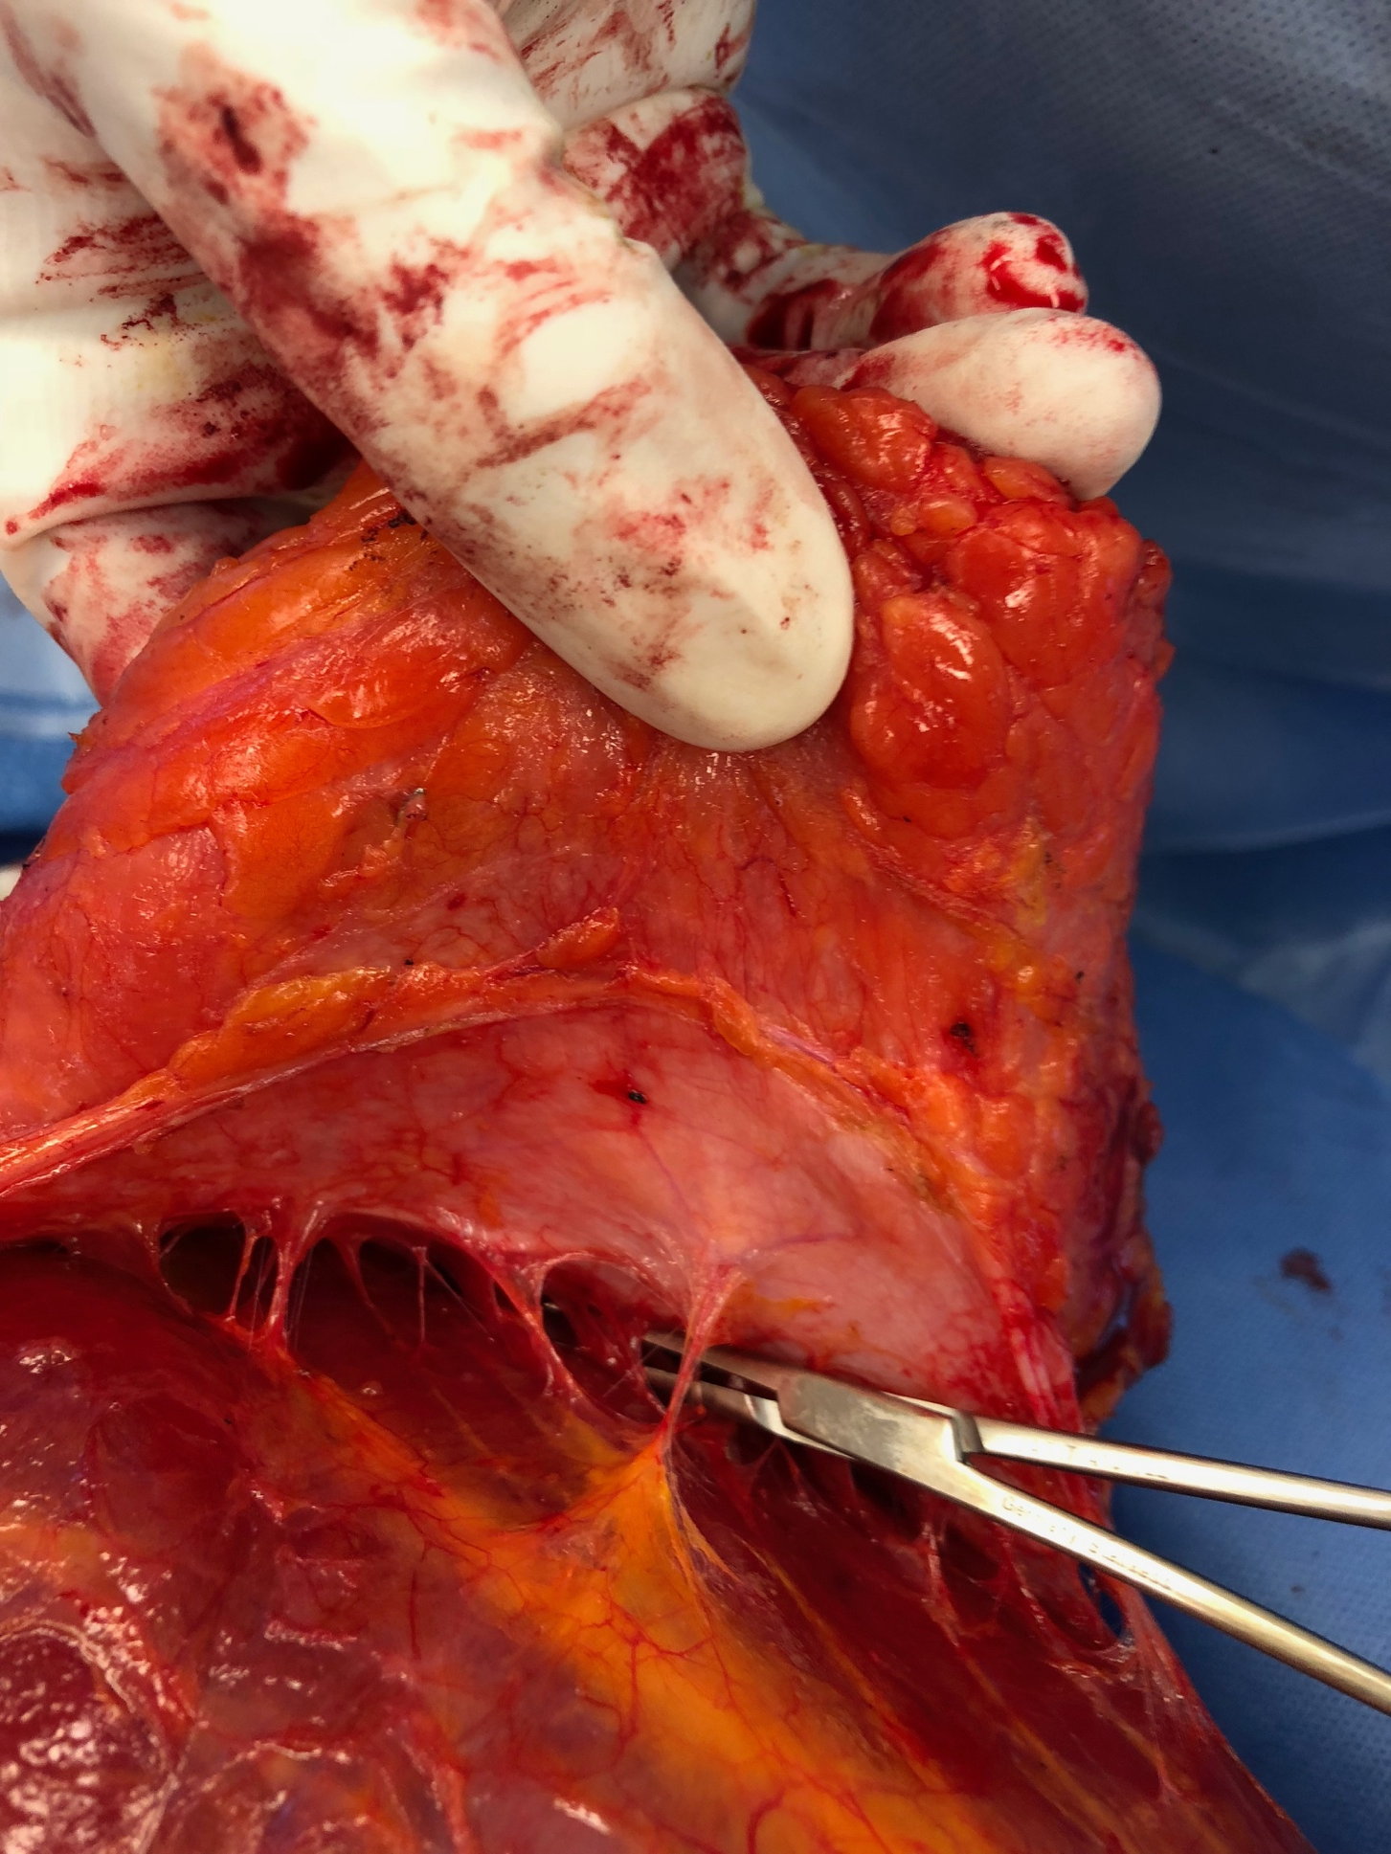
ALT (leg) vs RFF (arm) Phalloplasty complications continued…
The dicey blood supply to this area can mean:
The surgery is NOT POSSIBLE, and the flap must be “delayed” and completed in 6 months. 3%?
The phallus can be constructed but the urethra can’t in first stage. Do in 6 months

Slide 29
Back to urethral stricture

Slide 30
no magic for eliminating strictures, but Good strategy to decrease in the “Pars Fixa”: robust flaps, good secondary coverage
Use well vascularized perivaginal flaps to create urethra
Cover with bulbospongiosus muscle proximally and periurethral tissue (dartos?) distally

Slide 31
And…make urethral template longer than penis template to allow well spatulated tensionless urethral anastomosis

Slide 32
Some data to support thE Benefits of good second layer to approach is indirect:
In patients who did not have vaginectomy at time of phalloplasty, and thus these flaps were not available, had 2.5 fold higher urethral stricture rates (37% stricture in perivaginal flap patients rising to 67% stricture in those without perivaginal flaps).
About 40% rate of fistula if you DON’T do a simultaneous vaginectomy

Slide 33
What about…….
1)staged surgery (vaginectomy and urethroplasty followed by later phallo when healed)?—YES if you accept the math of two surgeries instead of one
2)Prelaminated arm grafts with buccal or vaginal mucosa?--NO
3)Supporting urethra with gracilis flap?—Maybe, and must accept the increased risk/time of graciis harvest
We tend towards a one stage procedure with an industry-low 22% stricture rate.
Surely staged procedures will have fewer (or at least spaced out) complications but at a high cost in $$$$ and patient convenience.
Gracilis flap extra coverage conceptually excellent but currently experimental, and worth the time/morbidity?
Gracilis flaps clearly decrease the rate of fistula……
Time/research will tell.

Slide 34
TRUTHS: In cases of urethral stricture, urethroplasty is ultimately required in 94-96% of affected patients. Surgery should be delayed until all acute inflammation has subsided. (6 months? More?) Urethroplasty Can Be technically challenging and fails in up to 50% of cases. (Our rate 80% (?) success) Repeated surgery can be required.
Two common locations generally requiring two different approaches:
At the labial urethra (pars fixa)-forearm flap anastomosis—generally short-anastomotic
In the phallus (usually the tip)—generally longer—usually two stage (Johanson) approach but maybe can be done in one stage especially with soft, well vascularized phallus

Slide 35
Anastomotic urethroplasty
Usually for anastomotic strictures, usually short, between (proximal) labial urethra and (distal) phallo urethra.
Often can be done as Heineke-Mikulicz type repair where the ventral urethra is incised longitudinally and closed transversely.
Also as “standard” anastomotic type repair.
If fails? Repeat or convert to a two stage Johanson type repair……
OR alternatively do complicated double” dorsal/ventral urethroplasty

Slide 36
Anastomotic urethroplasty closure

Slide 37
Bonus Round
Same operation (nontransecting anastomotic urethroplasty using ventral Heineke-Mikulicz technique) but a different patient

Slide 38
“Johanson type” one stage with dorsal split thickness skin graft (STSG) also might be called “asopa”
For penile urethral strictures: often longer
Get full thickness skin from flank: thin by hand to split thickness
Surely ONE stage has a higher failure rate than two stage, but a reasonable approach in first occurrence of stricture in penile location, and where penis is supple and well vascularized

Slide 39
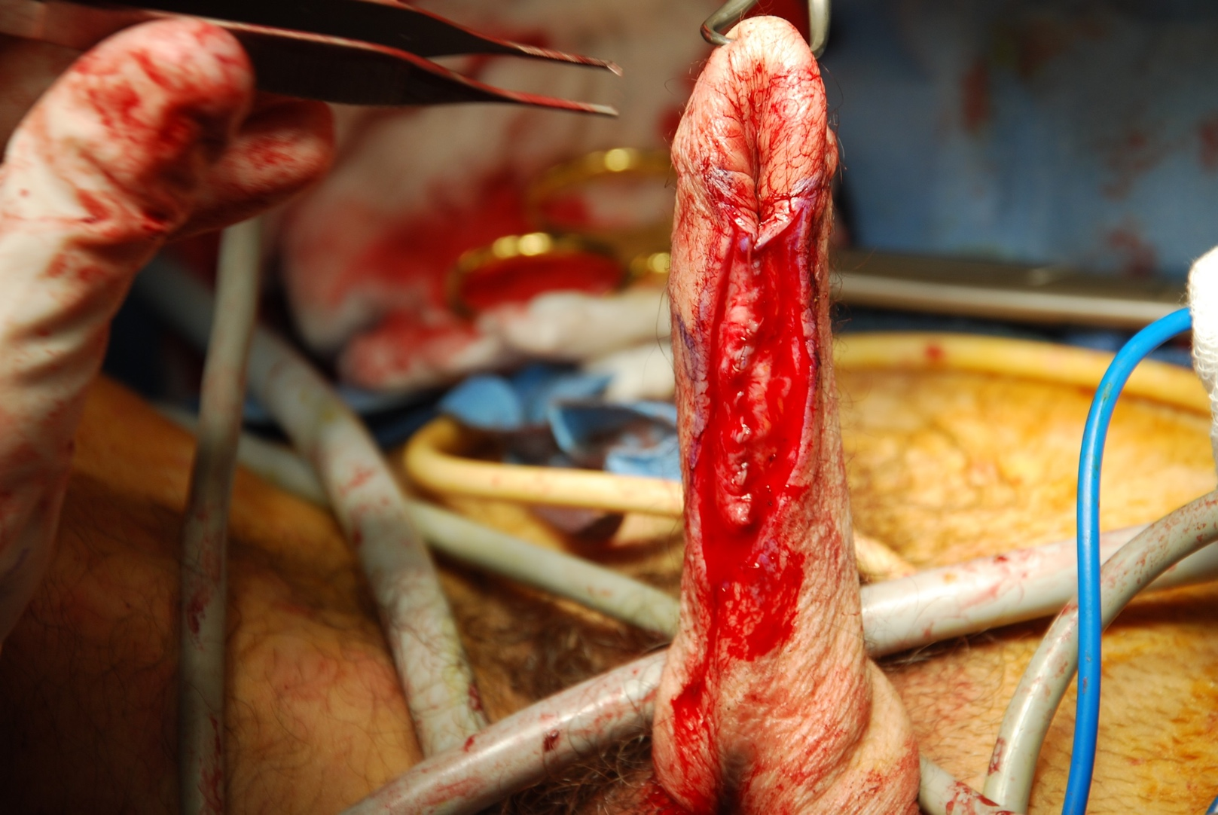
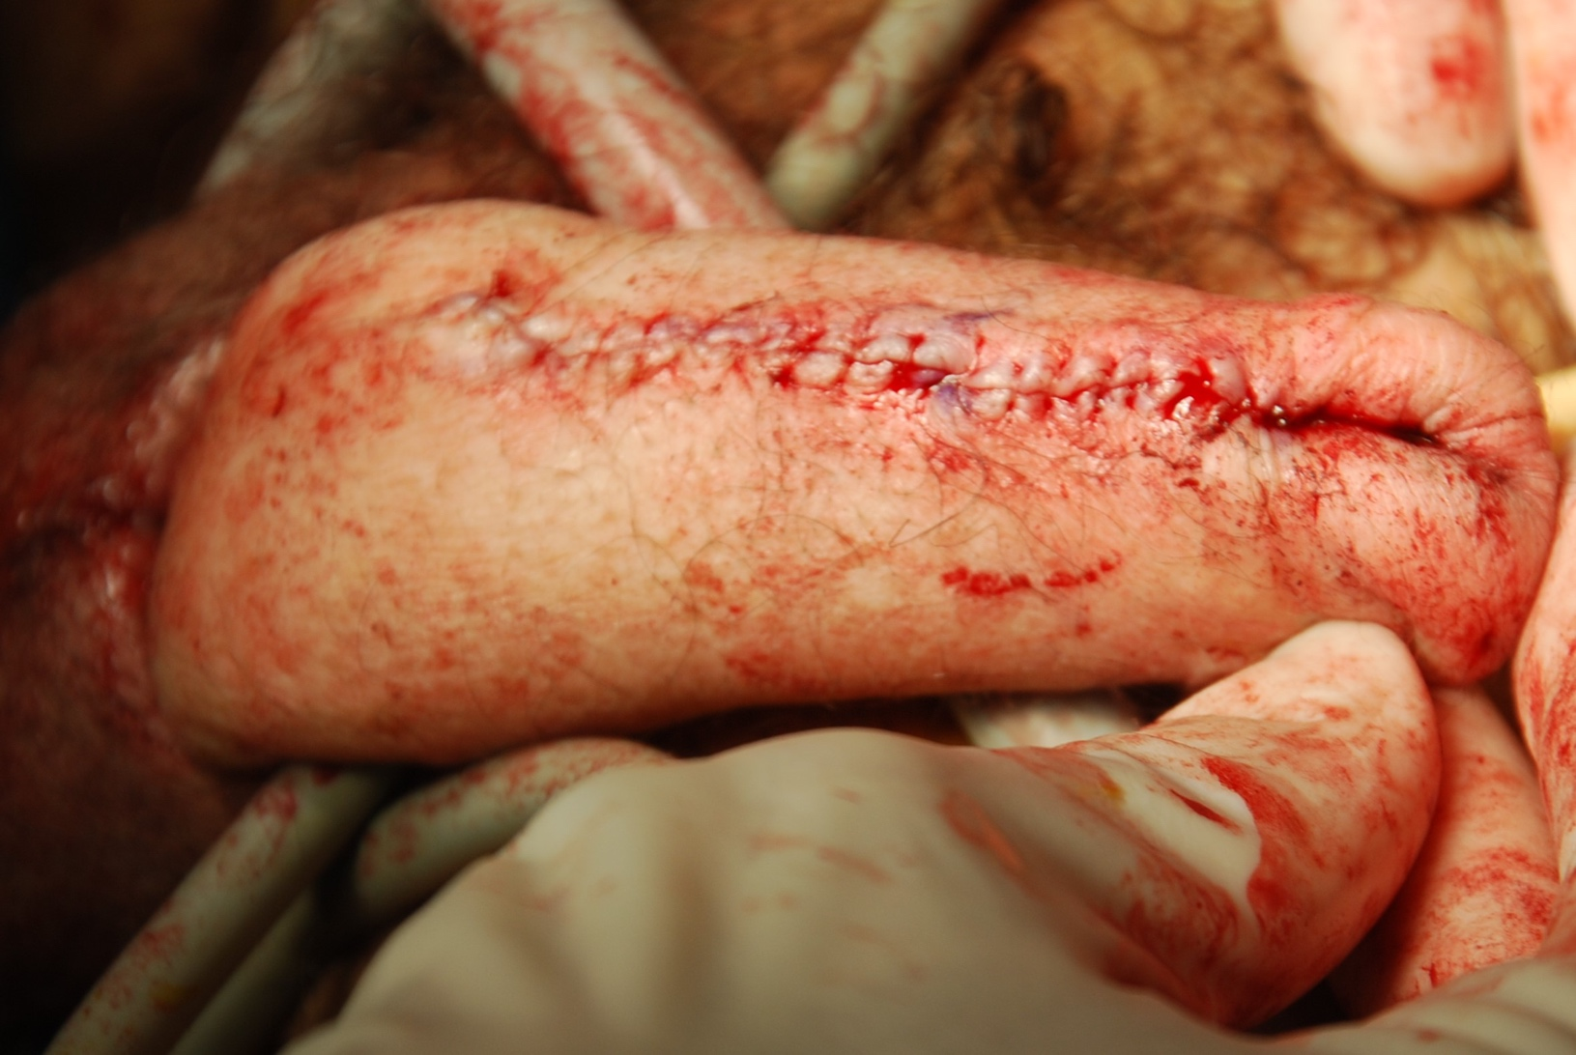
Second Stage Johanson urethroplasty after graft placed in first stage
Second Stage Johanson
Urethroplasty—6 months later
Make a WIDE urethral plate (4 cm?)
Close in many layers.
Suprapubic tube a must.

Slide 40
Bonus round: Repair of Mature fistula
Again occurring in the angle of sorrow between the most tenuous portion of the labial urethra and the most tenuous portion of the phallo skin urethra
Wait for all acute inflammation to subside (6 months)
Cover with many periurethral layers
Consider configuring incision to allow non overlapping suture line (open longitudinally, close transversely)

Slide 42
Tough Case. Long penile stricture in “old” non-microvascular flank phalloplasty
Stricture is long
Penis is not supple or particularly well vascularized
Proximal portion can be done without STSG, distal requires grafts in first stage

Slide 43
Second Stage Johanson on similar patient with buccal grafts in first stage
Note terrible “take” of buccal grafts.
Buccal VERY useful in cis-male urethra but limited use in PENILE LOCATION phallo urethra
Use skin graft (flank, thinned, close donor primarily)
Place a suprapubic tube in all these patients

Slide 44
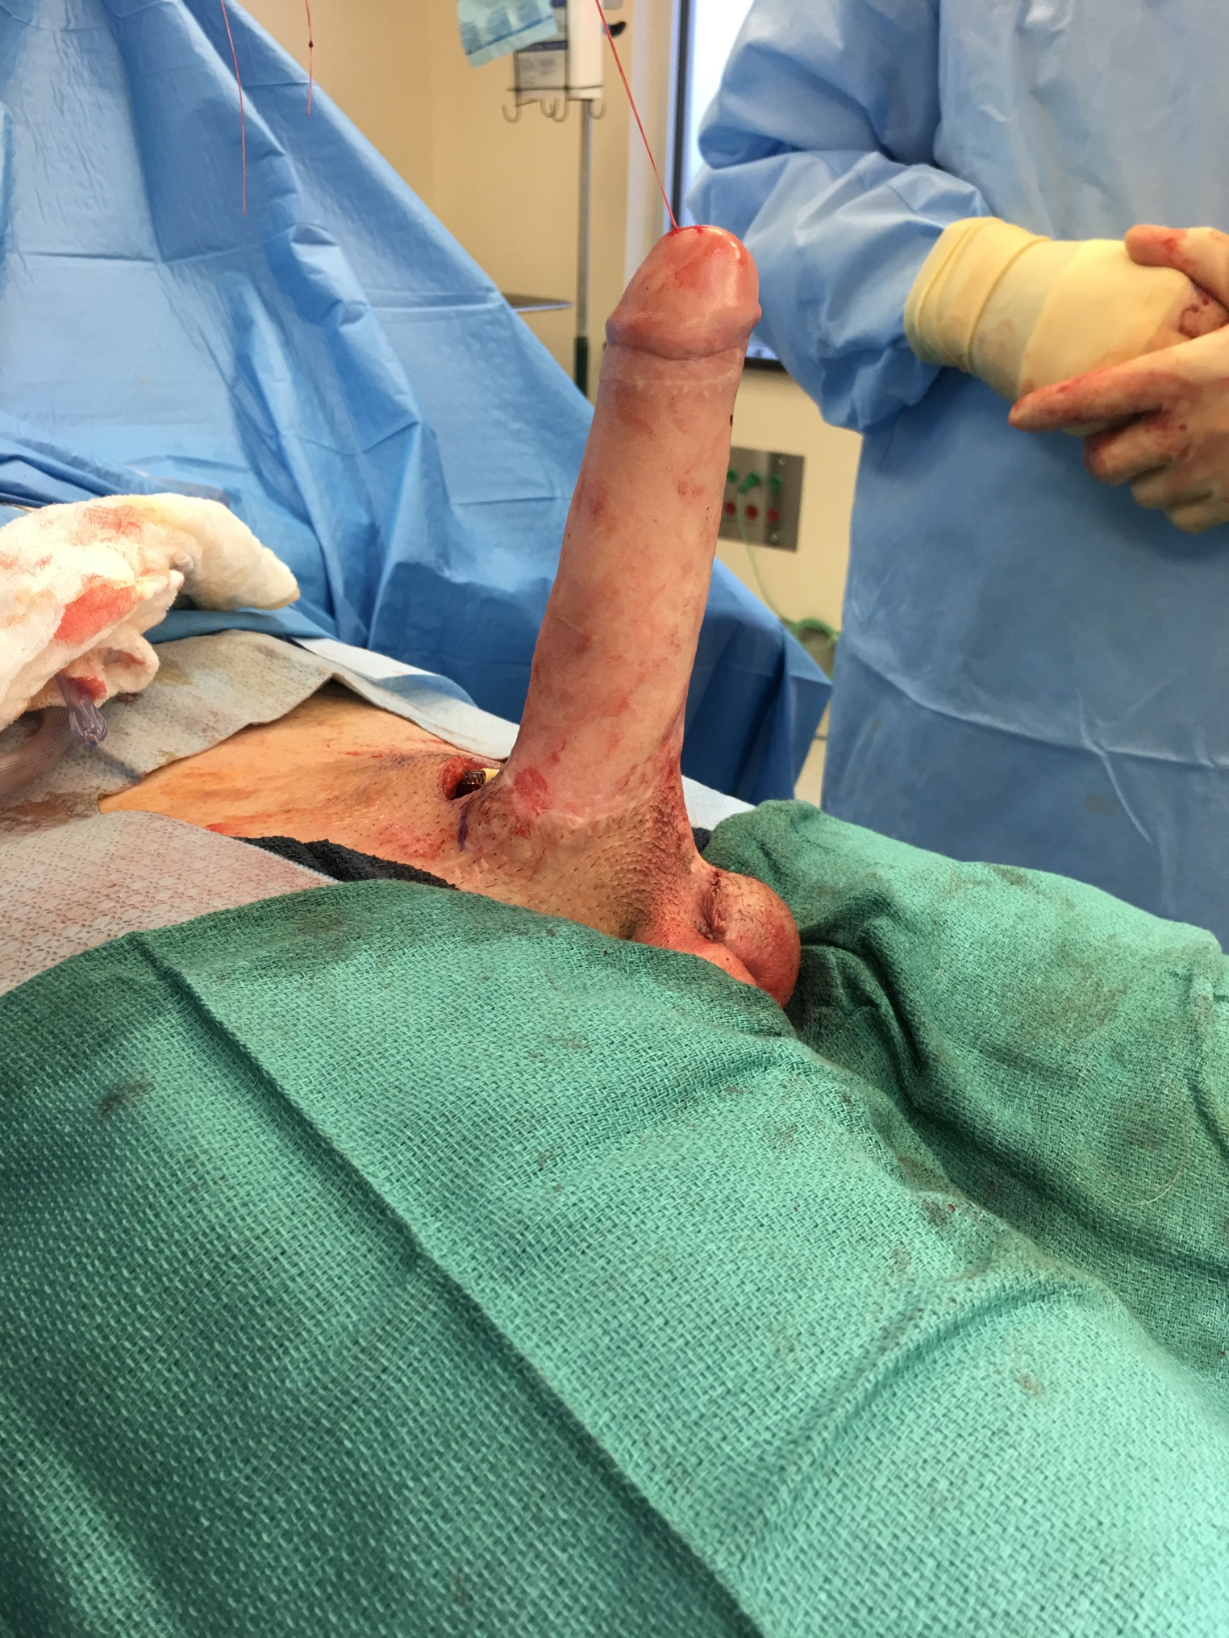
Penile Prosthesis Complications (in brief)
17% infection/revision/all cause removal in first year
100% all cause revision by 4 years? (ours lower)
If it survives that first year, each year there is a certain chance it will a)break b)move c)erode the phallus and it will have to be removed or replaced
It is sewn into the BONE and while this is done diligently with unbreakable titanium sutures, it can come unmoored

Slide 45
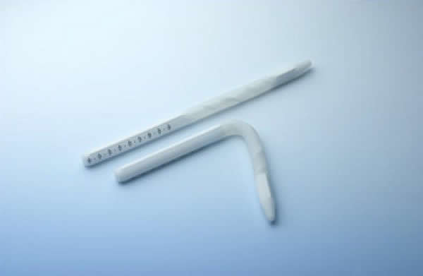
Penile prosthesis: Semirigid and inflatable, either works
One is not really better than the other. Both have costs and benefits.
Semirigid GOOD
Simple design
Never or almost never breaks
2. Semirigid BAD
Always have an erection. Its either bent UP or bent down
Semi rigid end pushes on the soft fat of the delicate phallus flap, and may push all the way to the level of skin
Late, after years?

Slide 46
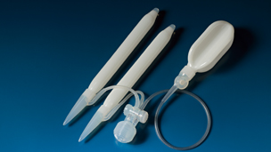
Penile prosthesis: Semirigid v inflatable
Inflatable GOOD
More “natural” erection that can be pumped up and down
Less erosion?
2. Inflatable BAD
More complicated: can break
3 parts: abdominal component (reservoir), penile cylinder and testicle “pump” in scrotum. Any one of these can migrate or be a source of revision.

Slide 47
Thank you!
Richard@brownsteincrane.com

