Slide 1
Forearm Phalloplasty for Female to Male Gender Confirmation Surgery
Richard A. Santucci, MD, FACS, HON FC Urol(SA)
Crane Surgical Services-Austin

Slide 2
Brief Intro
I am a reconstructive urologist (18 years) who has decided to devote the rest of my career to the “Mount Everest” of transgender surgery.
Newest member Crane Surgical Services (Austin).
Formerly full professor and reconstructive urology Fellowship director at the Detroit Medical Center and newly (re)minted Texan.

Slide 3
Today’s format
This is a “12 hour surgery” (Three surgeon working for 6-8 hours each with breaks) which doesn’t lend it easily to a 20 minute video. Todays talk will summarize with slides then present necessarily too short video after.
thanks

Slide 4
Step 1: WPATH (World Professional Association for Transgender Health) appropriate clearance for gender confirmation surgery
Persistent, well-documented gender dysphoria
Capacity to make a fully informed decision and to consent for treatment
Be of the age of majority in the country of surgery
Significant medical or mental health concerns, if present, must be reasonably well controlled at the time of surgery

Slide 5
Step 2: (Generally)
Mastectomy/chest gender confirmation surgery first
Then (Usually minimally invasive) hysterectomy
Depilitate the nondominant arm or donor leg

Slide 6
Incidence of Transgenderism
Probably not truly known
Estimates of up to 1/200 Americans : 1.6 million
Perhaps 25% of transgender men want surgery: maybe 1/100 have bottom surgery
Perhaps 50% of transgender women want surgery: up to 30% get bottom surgery
205,850 people (0.66%) in 18-24 age range
967,1000 (0.58%) in 25-64 age range

Slide 7
Our Practice had done over 600 phalloplasties In one year 2018 our Practice did:
Phalloplasty- 108
Vaginoplasty-139
Top surgery-124
Penile Implants (in phalloplasty patients)-46
Metoidioplasty-24

Slide 8
Step 3: Mark the arm

Slide 9
Step 4: Incise the arm, creating urethal, penile, and coronoplasty Doonr portions and preserving nerve, vein and artery. Takes HOURS

Slide 10
Step 5: tubularize the urethra/penis, create corona

Slide 11
Step 6: Close the arm with local tissue flaps and thigh STSG. Cover with wound vac.

Slide 12
Step 7: (but simultaneous) Vaginectomy

Slide 13
Step 8: Free up the clitoris, Urethral lengthening

Slide 14
Step 9: Clitoral reduction and creation of neopallus base

Slide 15
Step 10: Find and expose a clitoral nerve

Slide 16
Step 11: Create Neoscrotum

Slide 17
Step 12: Microvascular anastomosis of artery/Vein. Connect nerve

Slide 18
Voila

Slide 19
Quick intro to alternate method: Anteriolateral Thigh Flap Phalloplasty (ALT=“leg”)

Slide 20
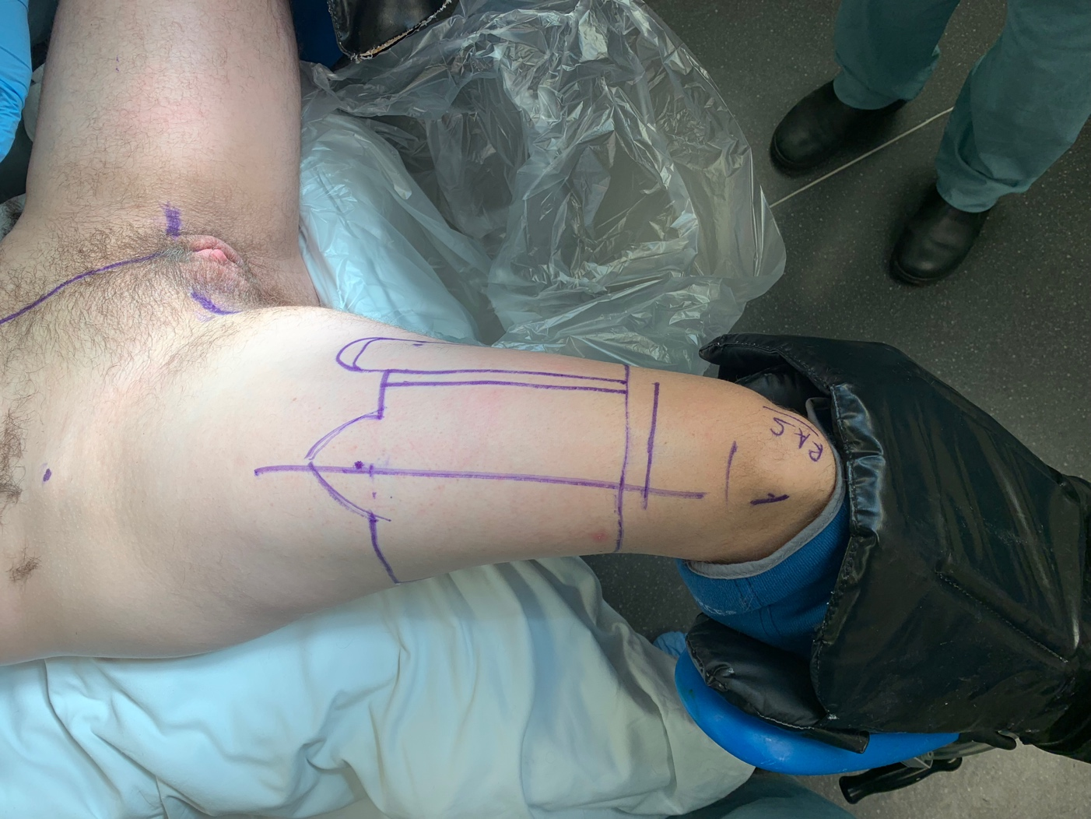
ALT
Mark
Free up pedicle
Make urethra

Slide 21
ALT steps
Move under muscles
Inset (affix) in place

Slide 22
Neophallus Can be made with Latissum Dorsi flap too if desired
Good for those who want NO visible scar.
We try to avoid this as all if its performance characteristics seems worse than ALT (leg) or RFF (arm)

