Slide 1

BCG-Refractory NMIBC Treatment:
Present and Future
Angela B. Smith, MD, MS, FACS
Associate Professor
UNC Department of Urology
Director of Urologic Oncology
Lineberger Comprehensive Cancer Center
@angiesmith_uro

Slide 2
Disclosures
Research Funding
  PCORI
Advisory Board
  Photocure
  Urogen
Consultant
  Merck

Slide 3
Outline
Definitions
Evaluation
Treatment
  Surgery
  Chemoradiation
  Chemotherapy
  Immunotherapy
Future Directions

Slide 4
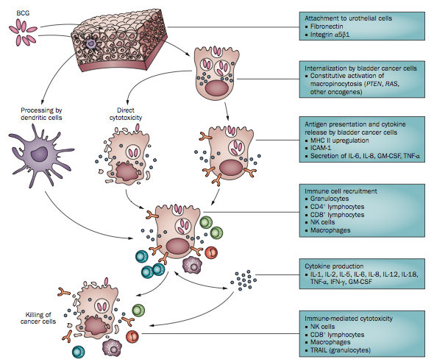
BCG
First reported by Morales et al. in 1976
Superior to chemotherapy in both recurrence and progression

Slide 5
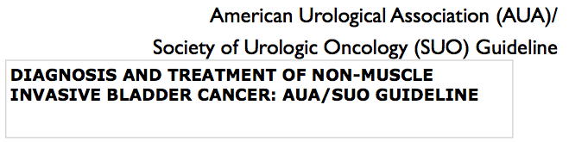
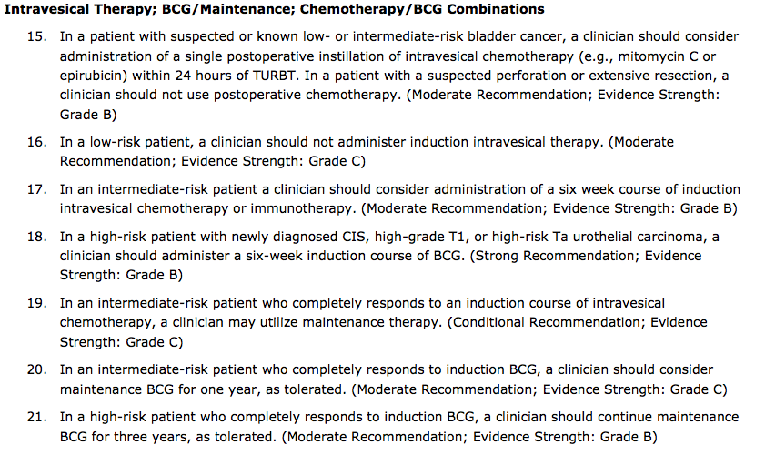
Notes:
As many as 75% of patients will develop a new tumor within 5 years and a proportion will experience disease progression to MIBC.
Definition of what defines BCG refractory disease is critical in deciding what should be done. Prognosis of patients who recur with LG papillary is better than those with a HG recurrence, particularly if T1.
A few principles to remember:
How much is enough
Terminology of specific BCG states

Slide 6
63yo M with history of HGT1. He undergoes BCG induction. During his first surveillance, a bladder tumor is noted and found to be HGTa. How would you describe this patient?
Inadequate BCG
BCG intolerant
BCG refractory
BCG relapsing
BCG unresponsive

Slide 7

Adequate BCG

Slide 8
Adequate BCG
6 week induction + 3 week maintenance
  SWOG protocol: 3, 6, 12, 18, 24, 30, 36 months
“Adequate BCG” clinical trial design standpoint
  At least 5 of 6 intended weekly induction treatments (one induction course) +
  At least 2 additional weekly maintenance treatments or a second re-induction in a 6-month time period
Kamat et al, 2016 J Clin Oncol 34: 1935-1944

Slide 9
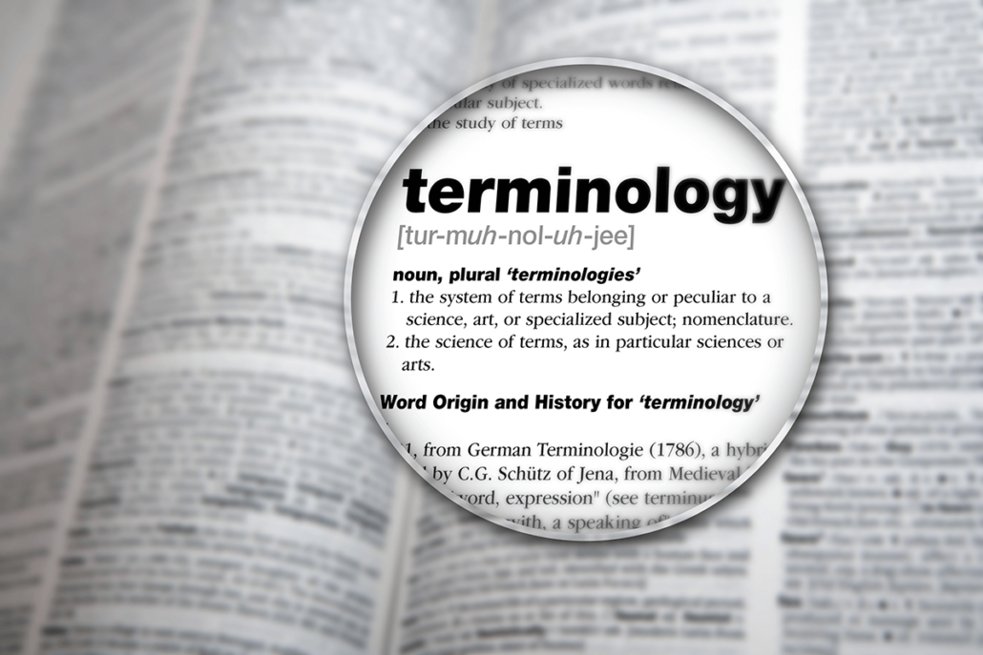
Intolerant
Refractory
Relapsing
Unresponsive

Slide 10
BCG Terminology
BCG Intolerant
  Cannot receive due to treatment-related adverse effects
BCG Refractory
  Persistent high grade cancer 6 months after start of induction therapy OR
  Progresses grade/stage 3 months after start of induction
BCG Relapsing
  Recurrence after achieving disease-free state at 6 months
BCG Unresponsive
  Combination of BCG refractory + BCG relapsing whose tumors recur within 6 months of last BCG exposure (early)
Kamat et al, 2016 J Clin Oncol 34: 1935-1944

Slide 11

EAU
Cystectomy preferred option
Repeat BCG induction or intravesical chemo viable option for intermediate risk disease
ICUD-EAU
Best option might be repeat induction BCG but cystectomy also indicated
AUA
Radical cystectomy
No additional BCG
Consider clinical trials

Slide 12
Optimally stage
Evaluate sanctuary sites
  Prostatic urethra
  Upper urinary tract
Notes:
Before considering bladder-sparing therapies (or even cystectomy), optimal staging of tumor must be confirmed.
Evaluate sanctuary sites, particularly if positive cytology and no visible tumor in bladder
Biopsy prostatic urethra and upper urinary tract (imaging and/or selective cytological sampling) – can be positive in up to 50% of cases (Birkha, 2014, EU 65: 825-831)

Slide 13

Surgical Options for
BCG-Refractory NMIBC
When?
Why?

Slide 14
Surgical Options
Notes:
Herr- those who underwent early cystectomy within 2 years of initial BCG had substantially longer DSS than those with delayed surgery

Slide 15
Risk Factors for ACM:
Upstaging to T1
LN invasion
+ Prostatic urethral
Group 1: 80%
Group 2: 85%
Group 1 (n=61): BCG with or without IFN
Group 2 (n=56): At least 1 additional salvage IVC after BCG
Notes:
117 patients who underwent RC for recurrent NMIBC
Group 1 (n=61) treated only with BCG with or without IFN
Group 2 (n=56) treated with at least 1 additional salvage intravesical chemotherapy after BCG
Final path and survival outcomes didn’t differ significantly between groups
Group 1 overall survival 80%; Group 2 overall survival 85%
MVA – delayed cystectomy not significant hazard for all-cause mortality
Risk factors- upstaging to cT1 (HR 1.88), LN invasion (HR 2.58), prostatic urethral involvement (HR 1.95)
Haas, JU 2016 ; 195:1704-1709

Slide 16
Surgical Options for
BCG-Refractory NMIBC
Immediate cystectomy not mandatory if expeditious cystectomy after salvage attempt
Staging is critical
Notes:
Bottom line- data suggest that immediate cystectomy after BCG failure is not mandatory- but rather prudent and expeditious cystectomy after attempt at salvage can be an effective strategy. But every attempt should be made to stage high risk NMIBC properly.
Cystectomy should also not be taken lightly – 90-day major complication rate is 17%, overall complications 67% - readmissions 40% at 90 days and mortality 2-10%

Slide 17
Chemo-Radiation
Notes:
Radiotherapy with limited role in management of NMIBC.
Historic series reported 42% 5-year RFS – major late toxicities common
Gospodarowicz, Clin Oncol 3, 155-161 1991
RCT radiotherapy vs. conservative/intravesical therapy with HGT1- no oncologic benefit to radiation- so inappropriate adjuvant for NMIBC (Harland, J Urol 2007)
Weiss
Wo- median f/up 7 years, 18 patients with T2 recurrence after BCG failure for T1 – 10 (59%) free of recurrence at 7 years; 7yr OS and DSS 70% and 58%. 54% alive at 7 years with intact bladders and free of reucrreunce

Slide 18
Group 1: New HGT1, no CIS
  Observation vs. radiotherapy
Group 2: CIS
  Intravesical therapy vs. radiotherapy
No difference between radiotherapy and conservative management in progression, recurrence or survival

Slide 19
Non-randomized
CR achieved in 88%
70% “pleased” or “delighted” with urinary function
80% preserved bladder
Notes:
Radiation is not appropriate if extensive CIS present

Slide 20
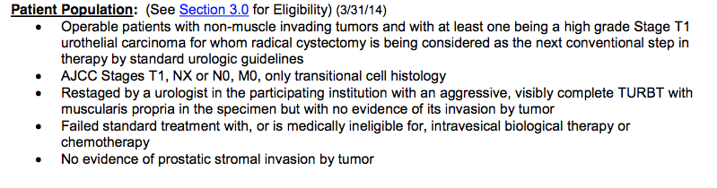
RTOG 0926:
A PHASE II PROTOCOL FOR PATIENTS WITH STAGE T1 BLADDER CANCER TO EVALUATE SELECTIVE BLADDER PRESERVING TREATMENT BY RADIATION THERAPY CONCURRENT WITH RADIOSENSITIZING CHEMOTHERAPY FOLLOWING A THOROUGH TRANSURETHRAL SURGICAL RE-STAGING
  Single arm study to evaluate chemoradiation in patients with HGT1 UCC bladder
  Primary endpoint: Radical cystectomy rate at 3 years
  Accrual is closed, estimated completion 2023
Notes:
Shipley – J Urol 134, 679-683
Estimated Completion Date: October 2018
Study Completion Date: 2023
https://clinicaltrials.gov/ct2/show/NCT00981656
Study Type :Interventional (Clinical Trial)Actual Enrollment :37 participantsIntervention Model:Single Group AssignmentMasking:None (Open Label)Primary Purpose:TreatmentOfficial Title:A Phase II Protocol for Patients With Stage T1 Bladder Cancer to Evaluate Selective Bladder Preserving Treatment by Radiation Therapy Concurrent With Radiosensitizing Chemotherapy Following a Thorough Transurethral Surgical Re-StagingActual Study Start Date :November 2009Estimated Primary Completion Date :October 2018Estimated Study Completion Date :October 2023

Slide 21
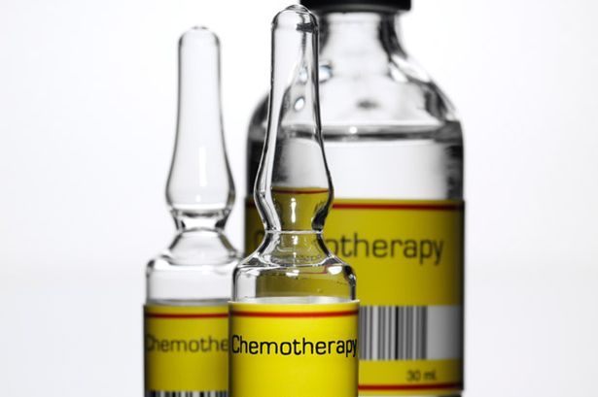
Chemo after BCG Failure

Slide 22
Valrubicin
Only approved intravesical agent for BCG-Refractory CIS when cystectomy not an option
Single-arm study of patients with BCG Failure
  70% with >=2 prior BCG courses
  81% with 3-24mo interval between last tx and valrubicin
  Unclear % BCG unresponsive
Primary outcomes DFR 6 months = 21%
Suboptimal salvage therapy for BCG failure
Steinberg et al, J Urol, 2000
Notes:
Valrubicin only approved agent for intravesical use for BCG-refractory CIS when cystectomy is not an option- either because patient refuses or medically unfit
(with additional data, perhaps lower at 18%)

Slide 23
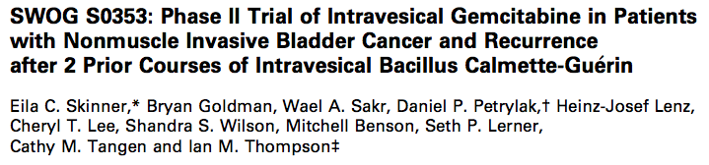
BCG Failure: Gemcitabine
  Single arm study, 55 patients
  2g gemcitabine/100cc NS
    Weekly x 6
    Maintenance: monthly x 1
    Dwell time: 1hr
Notes:
Multicenter phase II study

Slide 24
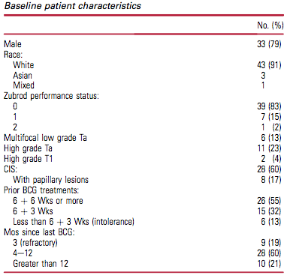
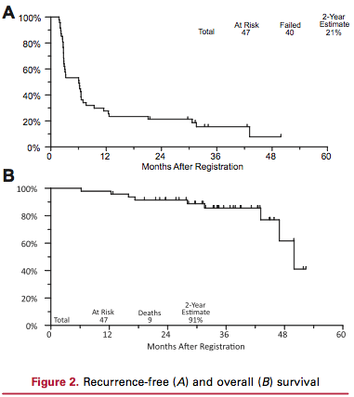
RFS
3mo: 59%
12mo: 28%
24mo: 21%
53/55 completed induction
No toxicity: 18 (33%)
Gr 1-2: 34 (62%)
Gr 3: 3 (5%)
Gr 4-5: 0
Intravesical gemcitabine may be better than BCG for Refractory NMIBC
Notes:
Although true efficacy for BCG unresponsive disease is unknown, additional trials have shown that intravesical gemcitabine might be better than additional BCG for NMIBC that recurs after a single course of BCG (Lorenzo, Cancer 116; 2010)- and that those with HG recurrences seem to have better RFS than when treated with MMC (Addeo, J Clin Oncol; 2010)

Slide 25
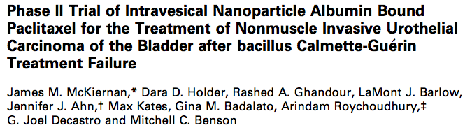
BCG Failure: Nab-Paclitaxel
  Prospective single institution: 28 patients
  Regimen:
    Nab-Paclitaxel 500mg/100ml NS
    Induction weekly x 6
    Maintenance monthly x 6
Notes:
Nanoparticle albumin-bound paclitaxel (abraxane, thought to have increased intravesical bioavailability compared with docetaxel)

Slide 26
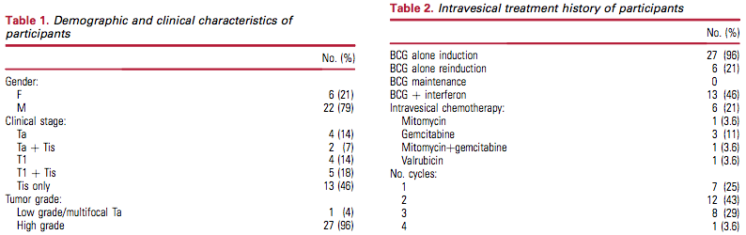
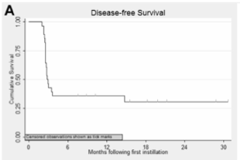
RFS
3mo: 36%
12mo: 36%
Mean f/u: 21mo
Toxicity
9/28 (32%) grade 1-2
NO discontinuation of therapy
McKiernan et al. J Urol 2014:1633

Slide 27
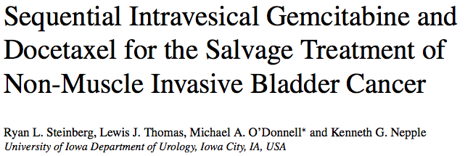
BCG Failure: Combo Chemo
  Retrospective case series: 45 patients
  Regimen:
    Gemcitabine 1g/50cc NS x 90min
    Followed by docetaxel 37.7mg/50ml NS x 2hrs
    Induction weekly x 6
    Maintenance monthly x 24

Slide 28
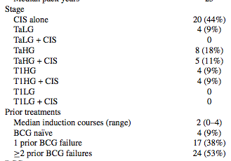
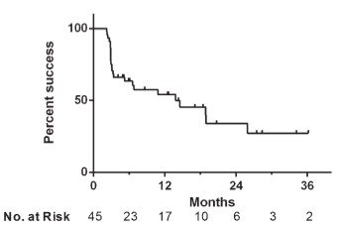
RFS
3mo: 66%
12mo: 54%
24mo: 34%
40/45 (89%) tolerated full induction
28/45 (62%) with symptoms during induction
7/45 (16%) impacted treatment schedule

Slide 29
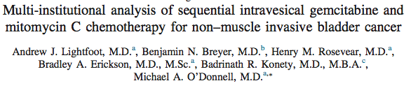
BCG Failure: Combo Chemo
  Multi-institutional retrospective series: 47 patients
  Regimen:
    Gemcitabine 1g/50cc NS x 90min
    Followed by MMC 40mg/20ml NS x 90min
    Induction weekly x 6
    Maintenance monthly x 12

Slide 30
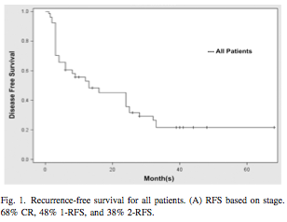
  87% high grade
  Median # prior tx: 2
    55% ≥ 2 prior tx
  30% grade 1-2 toxicity
    4/47 (9%) discontinued induction
RFS
3mo: 68%
12mo: 48%
24mo: 38%
0

Slide 31
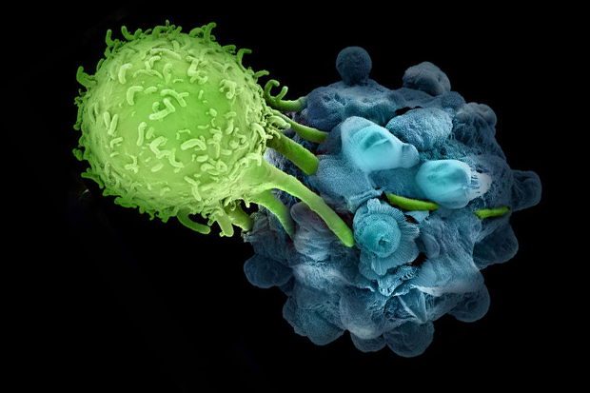
Immunotherapy
BCG
Interferon
Emerging Therapies

Slide 32
Repeat BCG
Persistent disease after single induction course, repeat induction
  43-63% response rate
Additional >=3 courses not recommended
  20% response rate
  80% rate of progression/metastasis
  Increased toxicity
Bui, Urology 1997:49
Reijke et al, J Urol 2005; 173
Notes:
Numerous studies have supported these data – that patients with persistent NMIBC despite >=2 BCG courses, BCG performs poorly

Slide 33
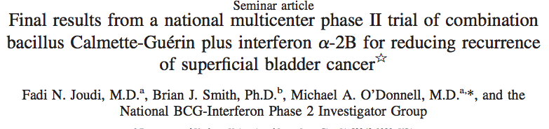
BCG + Interferon
Large non-randomized phase 2
  Group 1- BCG Failure (n=467)
    1/3D BCG + 50m u INF-α (+maintenance)
  Group 2- BCG Naive (n=536)
    FD BCG + 50m u INF-α (+maintenance)
Joudi et al. Urol Oncol 2006:344

Slide 34
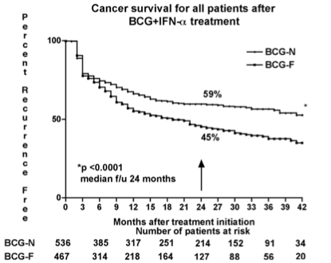
BCG + Interferon
Consideration for BCG failure after 1 course (HR 1.5 for failure after ≥2 courses)
Not directly compared to BCG re-induction alone
Multiple design concerns (BCG naïve patients)
Notes:
Multiple design concerns (particularly including BCG naïve patients)
Led to clinical practice of using BCG+IFN for BCG-relapsing NMIBC, particularly after disease free interval of >=12 months

Slide 35
BCG + Interferon
Further data demonstrate that BCG-IFN no more effective than BCG alone¹
Response rate at 24 months 23% for truly BCG unresponsive disease²
  Similar to historic BCG rates
Bottom line: BCG+IFN has a limited role in treatment of BCG refractory NMIBC
¹Nepple, J Urol 2010; 184.
²Roseveat, J Urol 2011; 186

Slide 36
Emerging Immunotherapies

Slide 37
SWOG S1602 (PRIME)
PI: Rob Svatek
Intradermal injection to augment BCG response
Leads to BCG-specific memory T cell response→ increased bladder infiltration by cytotoxic CD8+ T cells upon repeated BCG exposure
Intravesical BCG
TICE (50 mg/dose)
PPD -
CIS, HG TA, or HG T1 bladder cancer
Randomize
Intravesical BCG
(Tokyo strain 80 mg/dose)
Prime: intradermal BCG
(Tokyo strain 100 µl at 0.5 mg /ml)
+
Intravesical BCG
(Tokyo strain 80 mg/dose)
Notes:
To test that Tokyo-172 BCG is non-inferior to Tice BCG
2. To test that Priming (intradermal BCG) followed by intravesical BCG is superior to intravesical BCG alone (Tokyo strain)
Primary Study End-Point:
Time to high grade recurrence (TTHGR)
Accrual period: 3 years Follow-up: 5 years
Randomization 1:1:1 Total patients = 969 (n=323 per arm)
Objective #1 (Strain comparison):
Non-inferiority margin (HR) = 1.34, α=0.025, Power = 84%
68% vs. 75% one-year FFS estimate in Tokyo vs. Tice
Objective # 2 (Priming):
83% power to detect a HR= 1.40, one-sided α=0.025
75% vs. 81% one-year FFS estimate in no priming vs. priming

Slide 38
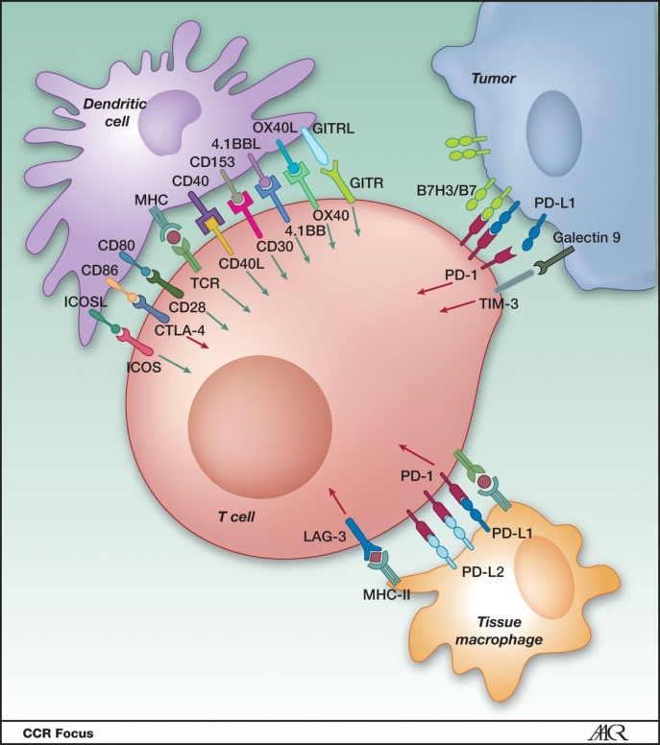
SWOG 1605
Phase 2 trial of Atezolizumab in
BCG-unresponsive NMIBC
  Single agent IV Atezolizumab
    Antibody targets PD-L1
  BCG unresponsive population
  Building on success seen in metastatic UCC
  Opened first quarter 2017
PI: Peter Black
Notes:
Atezolizumab and other anti-PD-L1 antibodies being studied in BCG unresponsive disease
KEYNOTE-057

Slide 39
Viral Gene Therapy: CG00700
CG0070 – oncolytic adenovirus
  Expresses GMCSF transgene
  Selectively replicates in Rb-deficient cells
Phase I: 49% RR at 10.4 months
Phase III: Single arm study, RR at 18 months
  NCT02365818
  PD-1 and PD-L1 immunohistochemistry scores of tumor cells and infiltrating immune cells

Slide 40
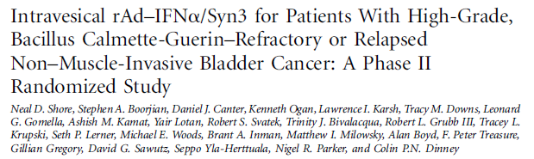
Instiladrin rAd-IFN-CS-003
BCG-unresponsive NMIBC
rAd-IFN/Syn3 3x10¹¹ vp/mL Intravesical q3m x 4
CR in CIS
PI Boorjian
Adenovirus vector harboring human IFN alpha2b gene
  Gene incorporated into bladder lining → expression of large amount of protein
40 patients
35% high-grade 12mo RFS
No grade 4/5 AE or tx discontinuation
Phase III trial now completed accrual (n=157)
J Clin Oncol, 2017
Notes:
INSTILADRIN is a non-replicating adenovirus vector harboring the human IFN alpha2b gene. When combined with the excipient Syn3, intravesical administration of the rAd-IFN results in transduction of the virus into the epithelial cell lining in the bladder. The IFN alpha2b gene is incorporated into the cellular DNA resulting in the synthesis and expression of large amounts of IFN alpha2b protein.

Slide 41
Future Directions
Targeted therapy
  VEGFR3-FGFR3 inhibitor (dovitinib) (NCT01732107)
  mTOR inhibitor (everolimus) + gemcitabine (NCT01259063)
  Vicinium (EpCam Ab conjugate)
  Oral sutinitinib (NCT 01118351)
  ALT-801 + gemcitabine (NCT 01625260)
Drug delivery
  MitoGel – thermosensitive hydrogel MMC
  Taris GemRIS
Notes:
Much of the targeted therapy is focused on the metastatic setting, but some (e.g. dovitinib – dual inhibitor of VEGFR3 and FGFR3 are underway in BCG unresponsive disease--
Dovitinib consistently achieved biologically active concentrations within the urothelium and demonstrated pharmacodynamic pFGFR3 inhibition. These results support systemic administration as a viable approach to clinical trials in patients with NMIUC. Long-term dovitinib administration was not feasible due to frequent toxicity. Absent clinical activity suggests that patient selection by pFGFR3 IHC alone does not enrich for response to FGFR3 kinase inhibitors in urothelial carcinoma.
mTOR inhibitor RAD001 (everolimus) investigated with intravesical gemcitabine- phase I/II trial with CIS BCG-failure (intolerant, unresponsive or relapsing)
Vicinium (VB4-845) contains a pseudomonal exotoxin conjugated to a moiety that targets epithelial cell adhesion molecule (EpCAM) – DFS 39% - phase III trial now ongoing- evaluating DFR 24 months
Oral sunitinib – (NCT 01118351) – completed but not yet reported
ALT-801 – p53-specific T cell receptor fused to IL-2 that has shown modest activity in patients with p53-expressing solid tumors. Trialed in combination with gemcitabine (both systemically administered) in NMIBC with BCG failure (NCT 01625260)
Mitogel – being investigated in UTUC but will be opening for lower tract as well
Taris GemRIS is an investigational intravesical drug delivery system- remains indwelling for 1st week of treatment, then removed, and then reinserted for another week after a week without treatment. Then removed at time of TURBT. Not yet evaluated in BCG unresponsive setting but might warrant formal study

Slide 42
Ongoing Trials: BCG-Refractory NMIBC
Agent | Mechanism | Sponsor | Phase | NCT#
Panvac +/-BCG | Vaccine | NCI | II | NCT02015104
ALT-801 + gem | Vaccine | Altor Bioscience | I/II | NCT01625260
rAD-IFN/Syn3 | Gene therapy | FKD Therapies Oy | III | NCT02773849
CG0070 | Oncolytic virus | Cold Genesys | III | NCT02365818
Pembrolizumab | PD-1 blockade | Merck | II | NCT02625961
Atezolizumab +/- BCG | PD-L1 blockade | Hoffmann-La Roche | I/II | NCT02792192
Vicinium | Ab target EpCAM | Viventia Bio | III | NCT02449239
VPM1002BC | Modified BCG | Swiss Group for Clinical Research | I/II | NCT02371447

Slide 43
Take-Home Points
  BCG + maintenance remains first-line standard of care therapy for high risk NMIBC
  Defining BCG unresponsive disease consistently is paramount
  Cystectomy is standard of care for BCG unresponsive disease for now
  Bladder-preserving regimens available - including intravesical chemo, immunotherapy and radiation
  Large amount of clinical investigation ongoing for improving outcomes for BCG unresponsive patients

Slide 44

@angiesmith_uro
angela_smith@med.unc.edu

