Slide 1
Controversies in Endourologic Kidney Stone Management
Davis P. Viprakasit, MD, FACS
Clinical Associate Professor
June 21, 2019

Slide 2
Disclosures
Consultant: Olympus Corporation of the Americas

Slide 3
Outline
Review of controversial topic in regards to:
Kidney stone diagnosis and evaluation
Surgical treatment of kidney stones
Postoperative care of kidney stone patients

Slide 4
Diagnosis and Evaluation:
Optimal Initial Imaging For Stone Diagnosis

Slide 5
What imaging do you use first to assess patients with flank pain concerning for stones?
Standard CT scan
Low dose CT scan
KUB
Renal ultrasound
I do not routinely obtain imaging for stone symptoms

Slide 6
What Does the AUA Recommend?
Fulgham et al. J Urol 2013; 189, 1203

Slide 7
Noncontrast CT abdomen / pelvis
1st Line Imaging for flank pain / suspected stone
Sensitivity (95-98%), Specificity (96-98%) for renal and ureteral stone identification
Evaluation of obstruction
Alternative diagnosis (10%)
Preoperative evaluation / predicts treatment success
Stone composition
Metabolic activity
Lipkin and Preminger. Urol Clin N Am 2013; 40, 47

Slide 8
Noncontrast CT abdomen / pelvis
15 mSv
Smith-Birdman et al. Arch Intern Med 2009; 169, 2078

Slide 9
Review of 108 patients evaluated for symptomatic stone episode
Evaluated # of stone imaging studies within 1 year of episode
Mean = 4 studies
Mean = 1.7 CT scan
Mean effective dose = 29.7 mSv
20%
Ferrandino et al. J Urol 2009; 181, 668

Slide 10
Risk of Secondary Malignancy
Biological Effects of Ionizing Radiation Committee (BEIR) evaluated health effects of radiation exposure largely from atomic bomb survivors
Concluded there is a linear no-threshold dose responsible link between radiation exposure and development of cancer
Modeling suggests 1/100 people exposed to 100mSv above baseline would develop cancer within their lifetime compared to 42/100 from other causes
https://www.nap.edu/catalog/11340/health-risks-from-exposure-to-low-levels-of-ionizing-radiation

Slide 11
Low Dose Noncontrast CT scan
Utilizes new CT scanner technology and software
Adjustments in:
Current (mA) = total number of x-rays
Voltage (kV) = permeability of x-rays
Image quality reference
Generally defined as total effective dose ≤ 3 mSv
Lipkin and Preminger. Urol Clin N Am 2013; 40, 47

Slide 12
Meta-analysis of 12 studies including 1529 patients
Reference standard: Standard dose CT KUB or physical stone demonstration
Low dose CT (2.1-4.5 mSV)
Different settings required for larger BMI
Stones <3mm may be missed
Ultra Low dose CT (0.48-1.9 mSV)
Rodger, Roditi, Aboumarzouk. Urol Int. 2018;100(4):375

Slide 13
Utilization of Low Dose CT
Fulgham et al. J Urol 2013; 189, 1203

Slide 14
What about using renal ultrasound?

Slide 15
Renal Ultrasound
Estimated radiation dose = None
(Renal) Sensitivity (29-81%), Specificity (82-90%)
(Ureteral) Sensitivity (11-93%), Specificity (87-100%)
Effective evaluation for obstruction (hydronephrosis)
First-line imaging for pediatric / pregnant patient
Technician dependent
May have increased sensitivity combined with KUB (58-100%)
Lipkin and Preminger. Urol Clin N Am 2013; 40, 47
Fulgham et al. J Urol 2013; 189, 1203

Slide 16
Pragmatic, comparative effectiveness trial of 2759 ED patients with suspected stones
Patients at high risk for alternative diagnosis excluded
Additional imaging obtained at discretion of provider
41% of POC US had CT scan
27% of RUS had CT scan
5.1% of CT scan had RUS
US can be used as initial test of renal colic in ED
Smith-Bindman et al. N Engl J Med. 2014 Sep 18;371(12):1100

Slide 17
Secondary analysis of 1,666 patients diagnosed with stone in ED
14.5% had urology consult in ED
30% had follow-up urology consult
12% required surgery
26% emergently
74% electively within 90 days with no difference in time to follow-up between imaging types
Of elective cases, 78% of patients had CT scan prior to surgery
Patients with POC US more likely to have CT scan prior to surgery compared to RUS (OR 2.55)
Metzler et al. J Urol. 2017 Mar;197(3 Pt 1):710

Slide 18
Retrospective, single institution review of 10,680 stone episodes in 7,659 patients over 6 years
76% underwent imaging at index visit (ED, walk in clinic)
47% had CT scan at index visit
Of 53% without initial CT, 10% had subsequent CT scan within 90 days
20% had primary RUS
10% had CT scan during same index visit
10% had CT scan during subsequent 90 days
Total 90 day imaging costs / radiation exposure higher if CT scan performed at index visit
Sternberg and Littenberg. J Urol. 2017;198:383

Slide 19
Retrospective review of 486 stone patients with 552 US / CT pairs
Assuming patients with stones ≤ 4mm counseled for observation and ≥ 5mm would consider alternative intervention:
22% would receive inappropriate counseling due to US based on discordance with CT
Overall sensitivity 54%
Ganesan et al. BJU Int 2017;119:464

Slide 20
Improved stone detection through optimizing and standardization of stone twinkling on color doppler
Improved stone sizing accuracy through measurement of posterior acoustic shadow width
May be combined in stone specific algorithms to optimize stone imaging
Dai et al. Urol Clin North Am 2019 May;46(2):273

Slide 21
Summary
Excessive radiation exposure is a concern in stone patients
Ultrasound can be used as the initial imaging study for suspected stones without significant delay in subsequent care
CT imaging may still be needed particularly if surgery required
Low dose CT protocols should be followed when possible
New refinements in US may improve accuracy with stone imaging

Slide 22
Surgical Treatment:
Optimal Method For Stone Removal During Ureteroscopy

Slide 23
During flexible ureteroscopy, what is your typical approach to stone treatment?
Dust stone for spontaneous passage
Fragment stone for active removal
Combination of dusting and active fragmentation
I do not typically treat stones with URS

Slide 24
URS Treatment Options of Renal / Ureteral Stones
Dusting stone small enough for spontaneous passage of tiny stones through urinary tract
Breaking stone into multiple fragments that can be actively removed using a basket

Slide 25
Stone Dusting
Typically utilizes laser setting at High frequency / Low energy
Technique:
Painting / Chipping stone from edge towards center
Popcorning residual fragments
Aldoukhi, Black, Ghani. Urol Clin North Am 2019; 46(2):193.

Slide 26
Stone Dusting
Less pain?
Lower costs
Less trauma
Aldoukhiet et al. Front Surg 2017 Sept 29; 4:57

Slide 27
Utilization of Dusting Technique
Survey of the Endourology Society
414 respondents (20.7%)
Dauw et al. J Endourol 2015; 29(11):1221

Slide 28
Stone Fragmentation / Extraction
Typically utilizes laser setting at Higher energy / Low frequency
Often combined with ureteral access sheath
Technique:
Targets mid-portion of stone to break into halves until sized amenable for basket extraction
Aldoukhi, Black, Ghani. Urol Clin North Am 2019; 46(2):193.

Slide 29
Stone Fragmentation / Extraction
More appealing
to patients?

Slide 30
152 patients with radio-opaque stones
Mean stone surface area larger in dusting group (96 vs 63mm², p<0.001)
Basketing procedure longer (67 vs 36 min , p<0.001)
Ureteral access sheath use: 16% dusting group vs. 100% basketing group
Stone-free defined as no stone on RUS / KUB at 4-6 weeks postop
SFR significantly higher in basketing group (74% vs. 58%) on univariate analysis but no difference on multivariate analysis
No difference in complication rates, readmissions or additional procedures
No clear difference in SFR between techniques
Humphreys et al. J Urol 2018; 199(5):1272

Slide 31
Importance of Minimizing Fragment Size and Residual Stones

Slide 32
Retrospective review of 232 patients from EDGE Consortium with residual stone after URS (dusting or basketing)
Mean follow-up: 17 months
56% no stone event
29% stone event requiring intervention
15% stone event not requiring intervention
Stones > 4mm
More likely to grow with time (p<0.001)
Associated with more complications (p=0.039)
More likely to require intervention (p=0.017)
Chew et al. J Urol. 2016; 195:982

Slide 33
New Advances in Laser Technology to Minimize Residual Fragments

Slide 34
Moses Platform for Holmium Laser
Modulates vapor channel / bubble that forms to transmit laser energy to stone
Holmium absorbed by H₂0
Delivery of 2nd energy pulse within already formed vapor channel increases energy delivery to stone
May decrease retropulsion and increase stone ablation
Aldoukhi, Black, Ghani. Urol Clin North Am 2019; 46(2):193.

Slide 35
Moses Platform for Holmium Laser
In vitro study assessing laser stone ablation efficiency using “hard” and “soft” stones
Compared Moses technology contact / distance modes to Ho:YAG short / long pulse modes
Winship et al. J Endourol 2018; 32(12):1131.

Slide 36
Thulium Fiber Laser
Not same technology as Thulium:YAG laser for prostate
Energy generated by chemically doped small laser fiber and transferred to stone through another fiber
Higher H20 absorption
Can be coupled to smaller diameter laser fiber
Can be used at very high pulse frequencies
Traxer and Keller. World J Urol 2019 Feb 6. doi: 10.1007/s00345-019-02654-5

Slide 37
Thulium Fiber Laser
In vitro comparison showed faster ablation / less retropulsion
Andreeva et al. World J Urol 2019 May 4. doi: 10.1007/s00345-019-02785-9

Slide 38
Summary
Stone dusting vs. fragmentation / basketing are comparable methods for stone treatment during ureteroscopy
Regardless of technique, goal is to minimize residual stone fragments
New laser advances may improve treatment efficiency and potentially outcomes

Slide 39
Postoperative Care:
Optimal Pain Management After Stone Surgery

Slide 40
What pain med regimen do you typically prescribe after URS for stones?
NSAIDS
Acetaminophen
Tramadol
Oral Narcotics
Other medication
I do not prescribe medication for pain

Slide 41
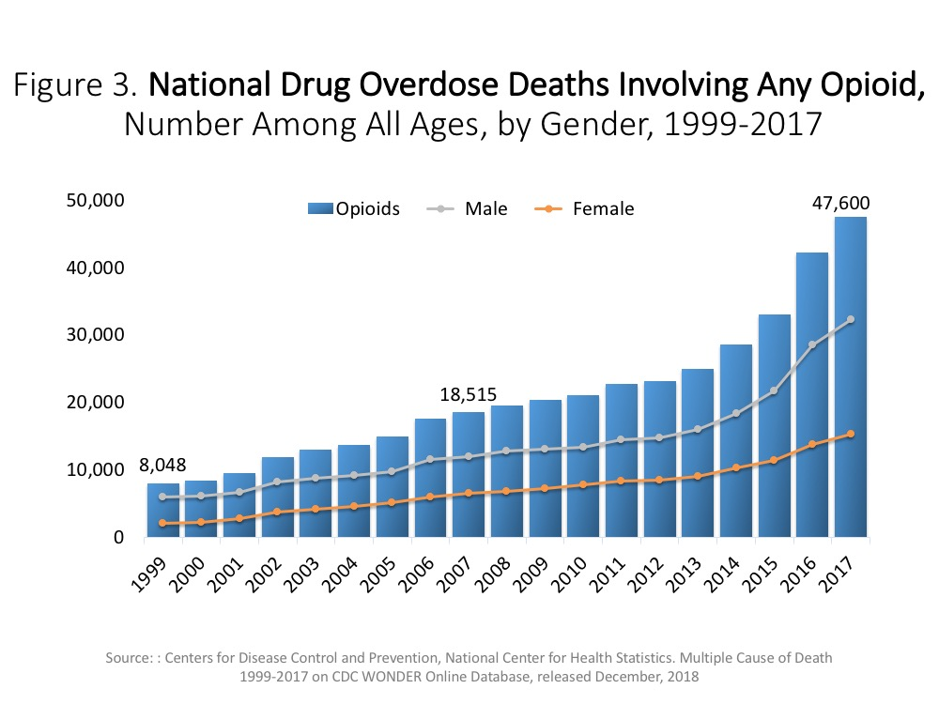
Cicero et al. JAMA Psych. 2014 Jul; 71(7):821

Slide 42
Retrospective review of NHANES surveys between 2007-2014
History of stones independently associated with opioid use (OR 1.27, p=0.006) when adjusting for age, gender, smoking status, number of healthcare visits in past year, and comorbid conditions
Shoag et al. J Urol. 2019 May;201(4S):e171

Slide 43
Review of MarketScan claims data between 2009-2015
50,249 opioid naïve patients who underwent SWL, URS, PCNL and filled perioperative narcotic script identified
8.1% patients continued to fill narcotic script between 90-180 days after surgery
Prolonged use significantly associated with:
Greater perioperative total oral morphine equivalent prescribed
History of pain / mental health disorders
Substance / alcohol / tobacco use
Said et al. J Urol. 2019 May;201(4S):e325

Slide 44
How to address this issue?

Slide 45
Prospective assessment of patients at UNC undergoing 10 different types of urologic surgery
Postoperative pain medication regimen queried
Patients surveyed at 2 weeks postop regarding postoperative opioid usage, storage and disposal habits
Overall, 70% of respondents had unused meds
Urologic Surgeries
Stent placement
Ureteroscopy
Cysto / TUR
Perc Nephrolithotomy
Penile / Urethral
Scrotal / Testis
Lap Nephrectomy
Prostatectomy
Cystectomy
Major Oncology
Hacker et al. J Urol. 2018 May;199(4S):e1093

Slide 46
47 URS patients received 792 opioid tablets
31 tablets
16 tablets
5 tablets
Hacker et al. J Urol. 2018 May;199(4S):e1093

Slide 47
Of 792 opioid tablets, 498 pills unused
Only 34% reported receiving counseling on proper storage and disposal of meds
63% of pills unused
Hacker et al. J Urol. 2018 May;199(4S):e1093

Slide 48
Adherence to Protocol
88% for URS
97% for PCNL
No observed difference in post-op calls for narcotics or patient satisfaction with pain management scores
Hacker et al. J Urol. 2018 May;199(4S):e1093

Slide 49
How about eliminating postoperative opioid use altogether?

Slide 50
Retrospective review of non-opioid protocol in selected patients
Unanticipated phone calls, ED visits and need for opioid refills evaluated
Sobel et al. J Endourol. 2018 Nov;32(11):1044

Slide 51
Sobel et al. J Endourol. 2018 Nov;32(11):1044

Slide 52
Retrospective review of patients without contraindication / allergy to NSAIDS receiving postop diclofenac instead of narcotics
Matched to prior patients receiving standard postop narcotics
Equivalent of 2500 hydrocodone tablets avoided
No narcotic naïve patient prior to surgery in NF-URS group required narcotic script compared to 4 of 20 in S-URS group
Valadon et al. J Urol. 2019 May;201(4S):e844

Slide 53
Prospective assessment of standardized ERAS pathway for anesthetic care and postop management of URS patients
Urinary symptoms, pain and PROMIS surveys scores assessed before and after surgery
Unanticipated phone calls, ED visits and need for opioid refills queried using TN CSMD
Gridley et al. J Urol. 2019 May;201(4S):e549

Slide 54
Peri-op Protocol
- Patient counseled multiple times regarding no opioid plan
- Gabapentin, Acetaminophen, B&O supp and Ketorolac given
- Narcotic free intraoperative anesthesia per protocol
- Written postop scripts for acetaminophen, ibuprofen, oxybutynin, tamsulosin given
Postop Escalation protocol if patients calls
- 1st confirm patient is taking postop meds as written
- If pain > 4/10 severity, initiate escalation
- Tramadol 50 mg q 4-6 hrs prn, sig. 12 tablets
Courtesy of N Miller, MD

Slide 55
Courtesy of N Miller, MD

Slide 56
Total # pts n=80
No difference between the groups in demographic data
 | Pre-ERAS n=28 | ERAS n=52
 | N (%) |  | p-value
Total Opioid Prescription Dose (Mean MME) | 60.1 (41) | 7.7 (26) | <0.01*
Patients Discharged with Opioid | 26 (93) | 0 (0) | <0.01*²
Total Discharge Rx (Mean MME) | 57.9 (39.8) | 0 (0) | <0.01*
Postop Opioid Refill (VUMC) | 1 (3.6) | 3 (5.8) | 0.5
Postop Opioid Rx (non-VUMC) | 0 (0) | 2 (3.8) | 0.16²
Postop Calls for Pain | 7 (25) | 10 (19) | 0.9
Postop Acute Encounters for Pain | 0 (0) | 2 (4) | 0.46²
Postoperative Outcomes:
Multivariable Analysis¹
¹Controlling for Age, Sex, Preoperative PROMIS 3a T score
²Univariate analysis – too few events for multivariable regression
Courtesy of N Miller, MD

Slide 57
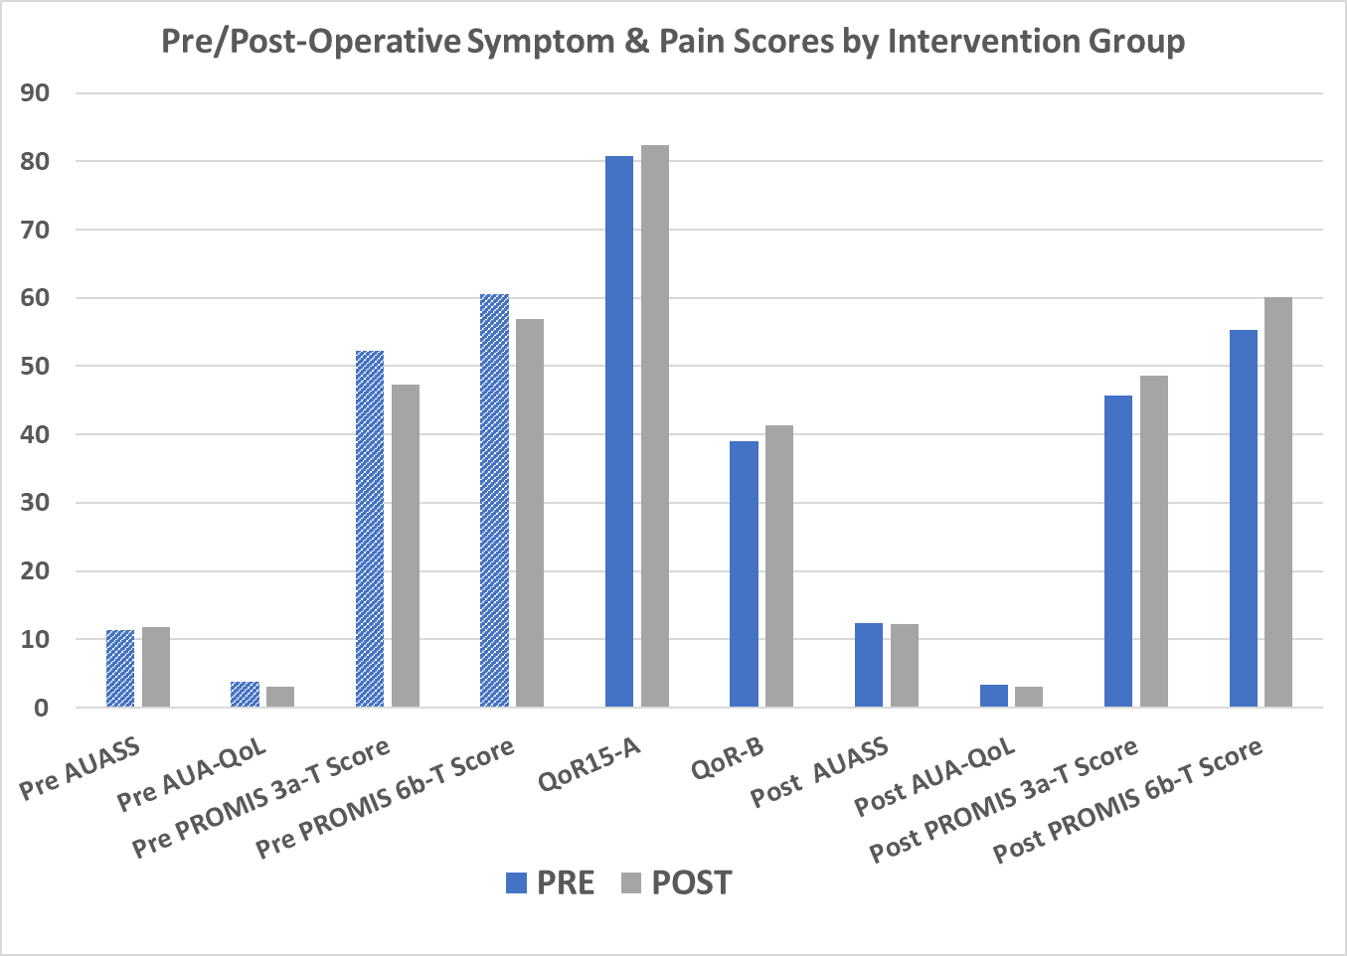
Minimally important difference in PROMIS pain intensity and interference scores is 4-6 points to be clinically significant
*
p = 0.03
*
p = 0.03
*
p = 0.04
Courtesy of N Miller, MD

Slide 58
Summary
Current kidney stone treatment contributes to the opioid epidemic
Minimizing narcotics exposure is key
Patient education and understanding regarding realistic expectations with pain management with stone treatment important
No or minimal narcotic protocols possible with ureteroscopy without clear negative patient effects

Slide 59
davis_viprakasit@med.unc.edu
@dviprakasit

