Slide 1
Whitehead Medical Society Interest Meeting

Slide 2
Who We Are
The WMS is the officially recognized student government of the UNC SOM and serves the social, educational, and personal interests of the UNC SOM medical students.
@unc_wms

Slide 3
Positions Available
Foundation Phase Co-Presidents (2)
VP of Student Affairs (2)
Foundation Chief Advocate (1)
VP of Curriculum Affairs (2)
VP of Research and Publications (1)
VP of Education Development (1)
VP of Information Technology (1)
VP of Community Service (1)
VP of Student Recruitment (2)
VP of Financial Affairs (1)
VP of Campus and Diversity Affairs (1)
NEW: VP of Advertising and Outreach (1)

Slide 4
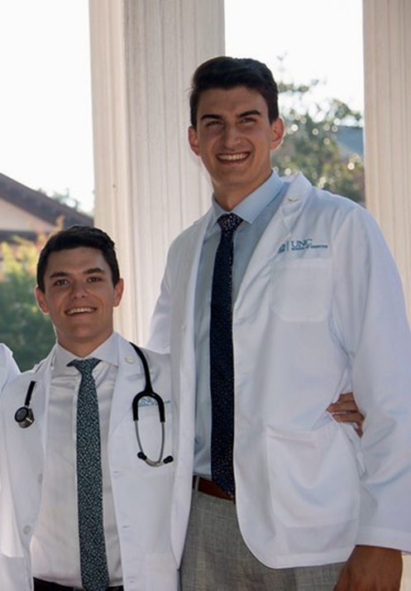
Foundation Phase Co-Presidents
Ryan & Sean
Act as liaisons between the Foundation Phase classes and the faculty, staff and administration:
Dean’s Luncheons
Curriculum Meetings
Town Halls
WMS Monthly Meetings
Organize important events for UNC SOM:
Annual UNC Cadaver Memorial Service
Winter Gala
Fall and Spring Apparel Sales
Graduation and White Coat Ceremony Committee Members
Mixers with other schools
Whatever fun event your heart/class desires!
Writing witty/informative Weekly Blasts
Act as a source of information about Whitehead and the School of Medicine for your peers and non-SOM students
Work with and support WMS representatives to ensure the successful development of the MS1/2 UNC SOM experience
Sean_Donohue@med.unc.edu
Ryan_Searcy@med.unc.edu

Slide 5
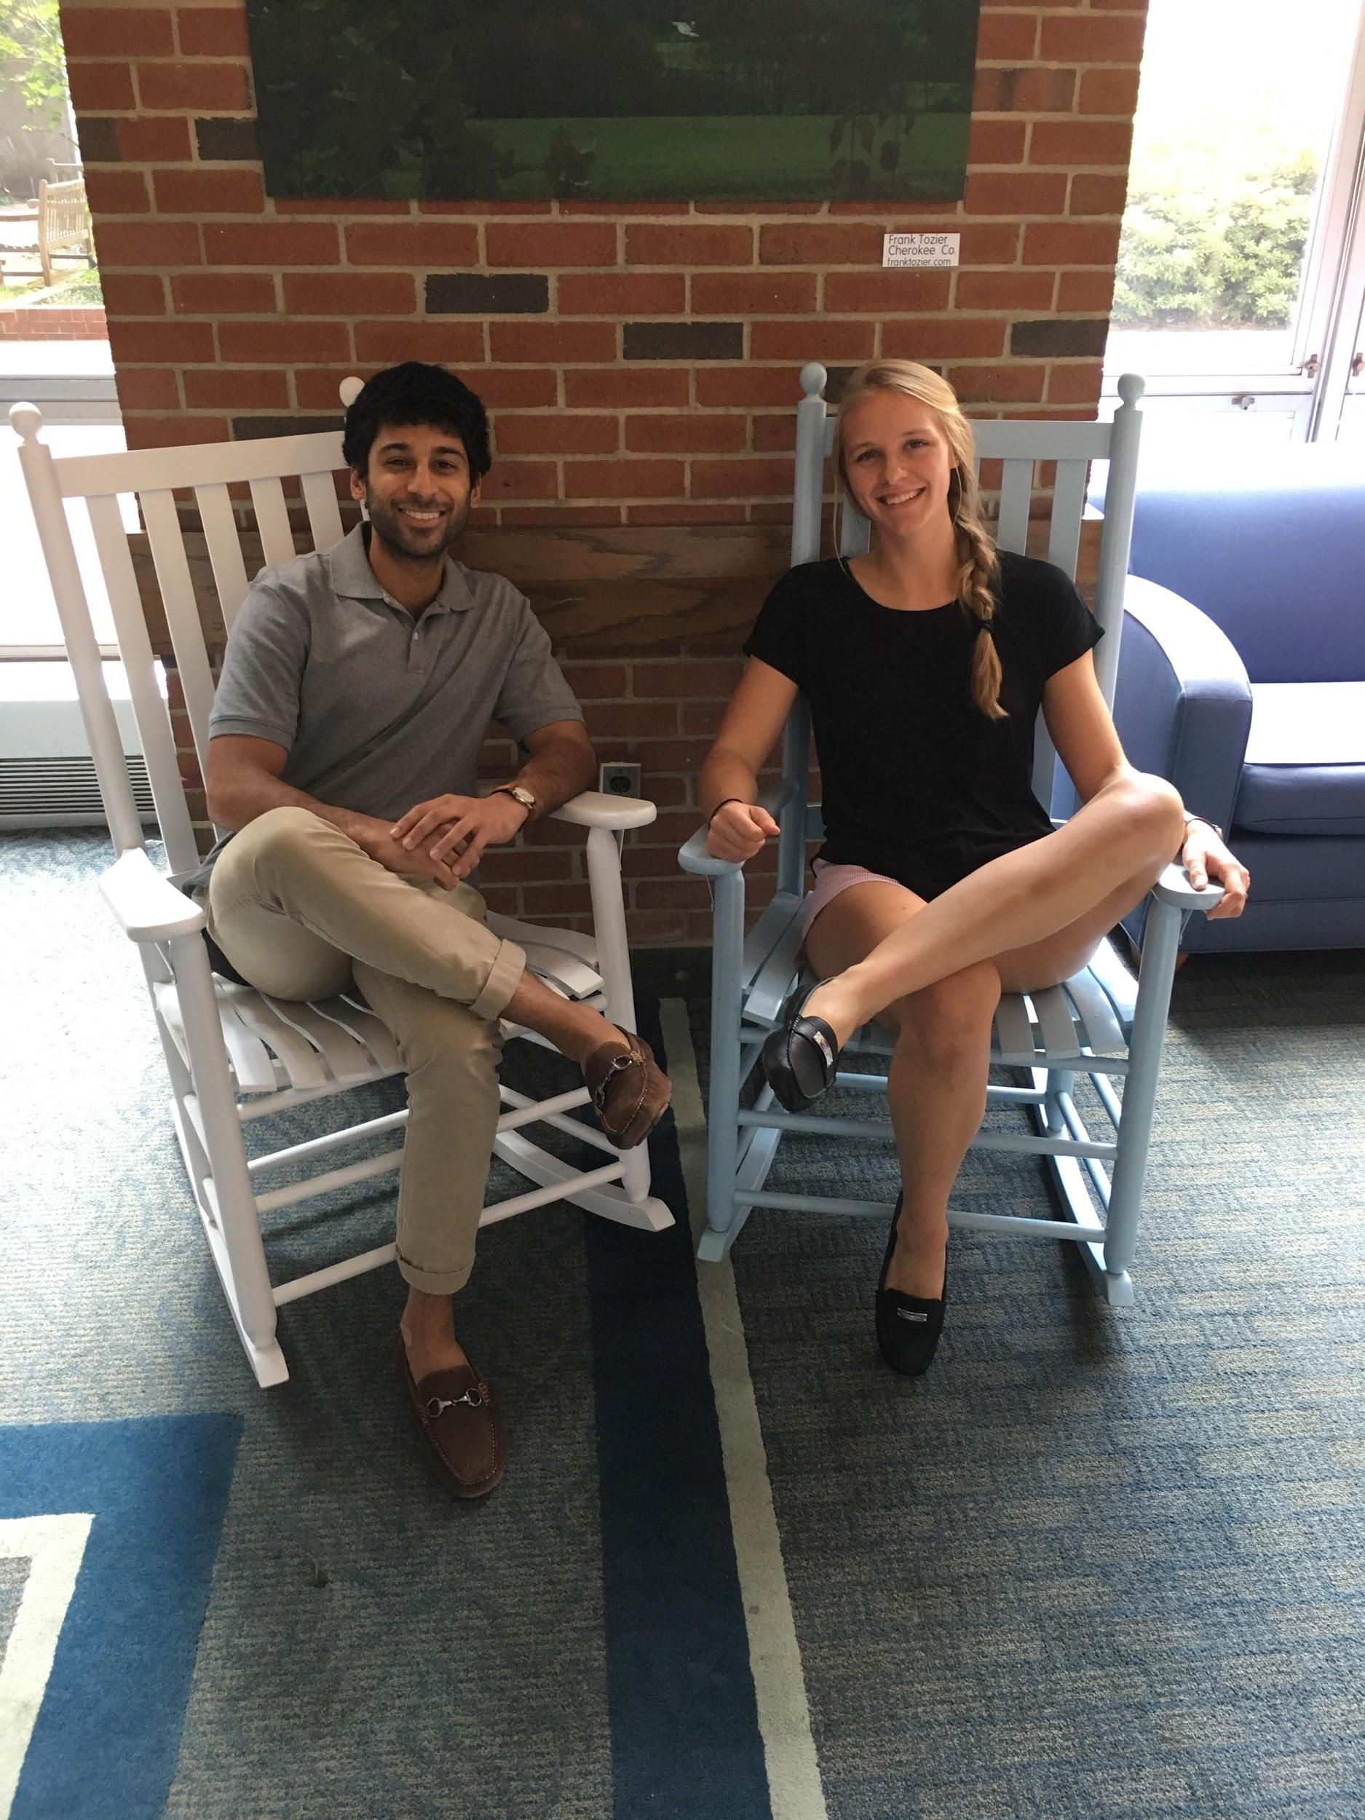
VPs of Student Affairs
Abby & Asim
Oversee all student organizations
Maintain updated list of registered orgs
Assist with the UNC registration process
Serve as liaison for the Student Union
Direct transition of leadership
Allocate funding
Facilitate reimbursements for activities/expenses
Help organize the activities fair
Coordinate Career Opportunities Series Lunches
Maintain student lounge and active lounge
Participate in the HSL library committee

Slide 6
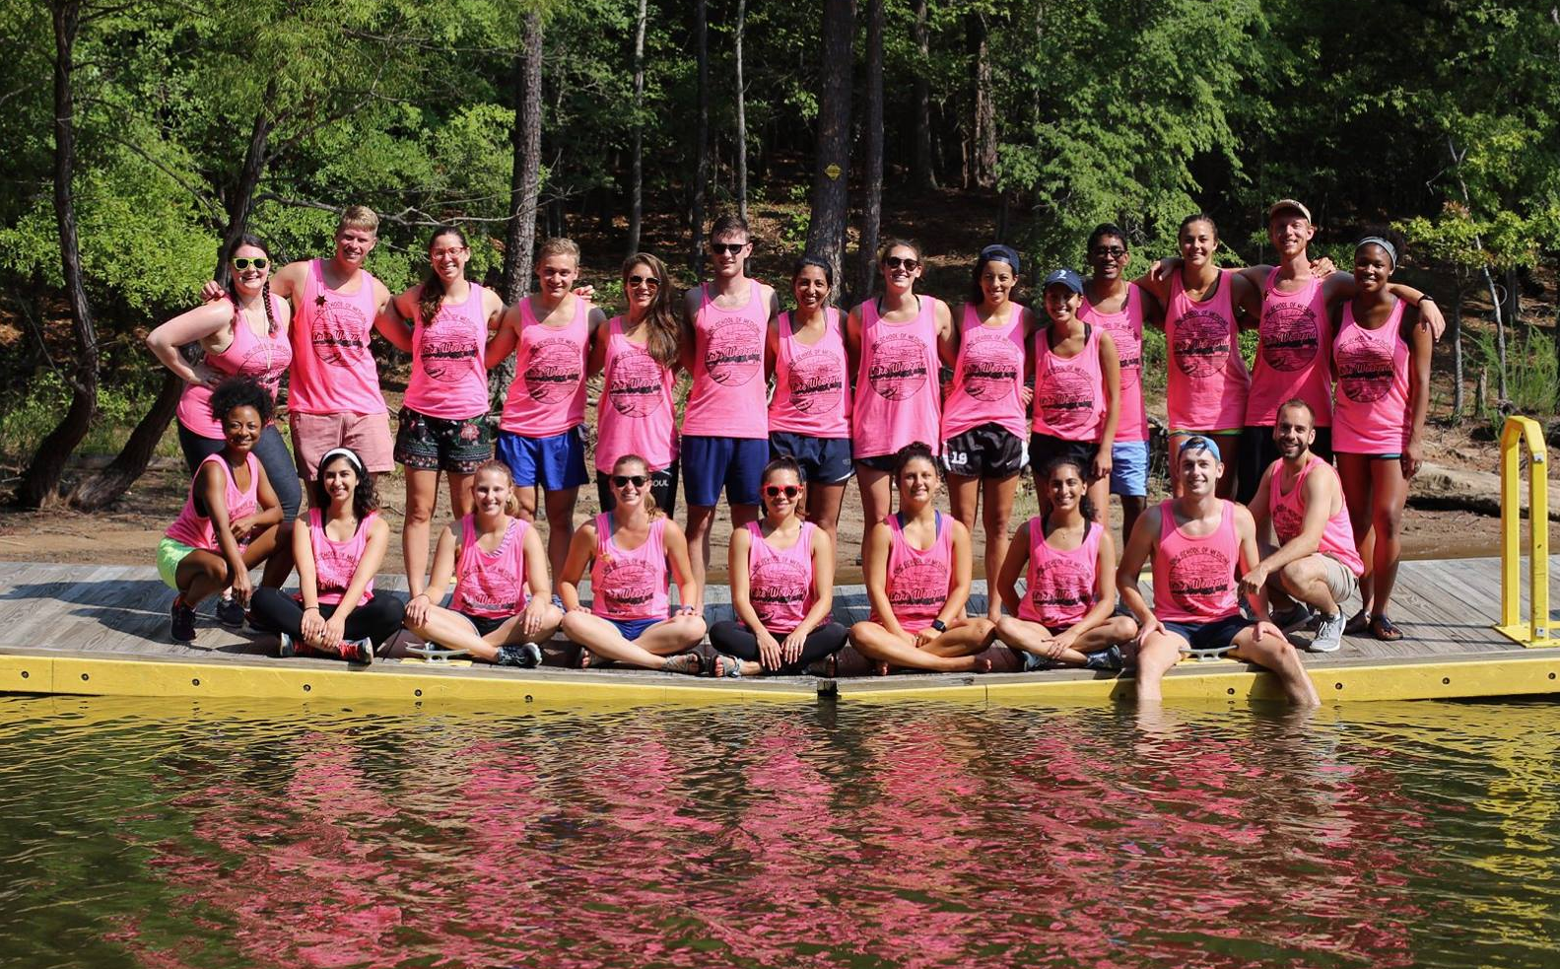
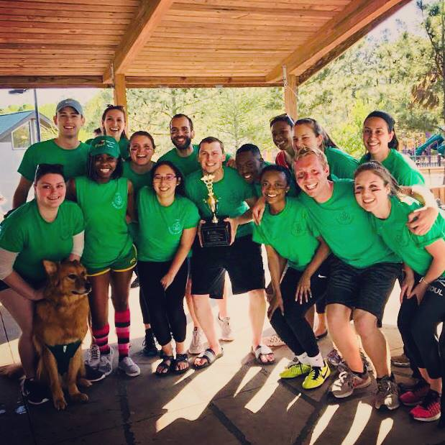
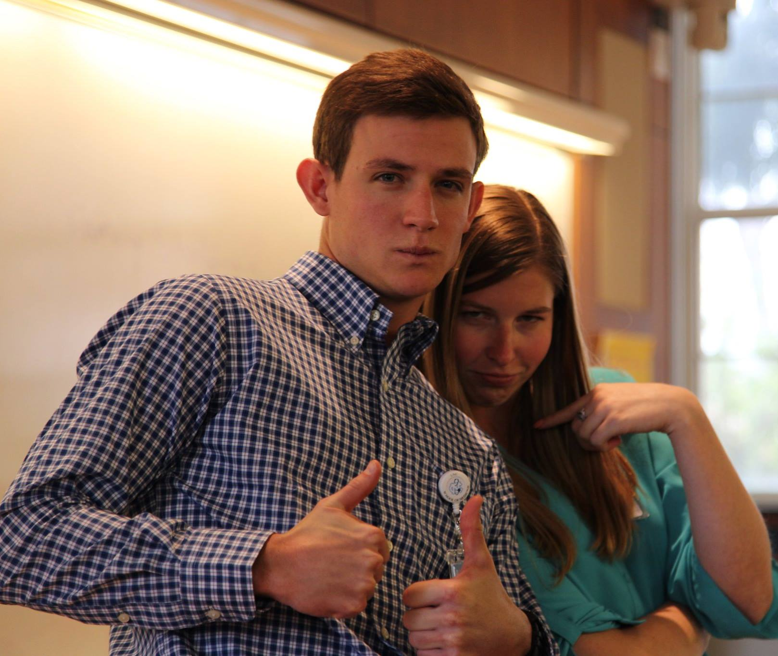
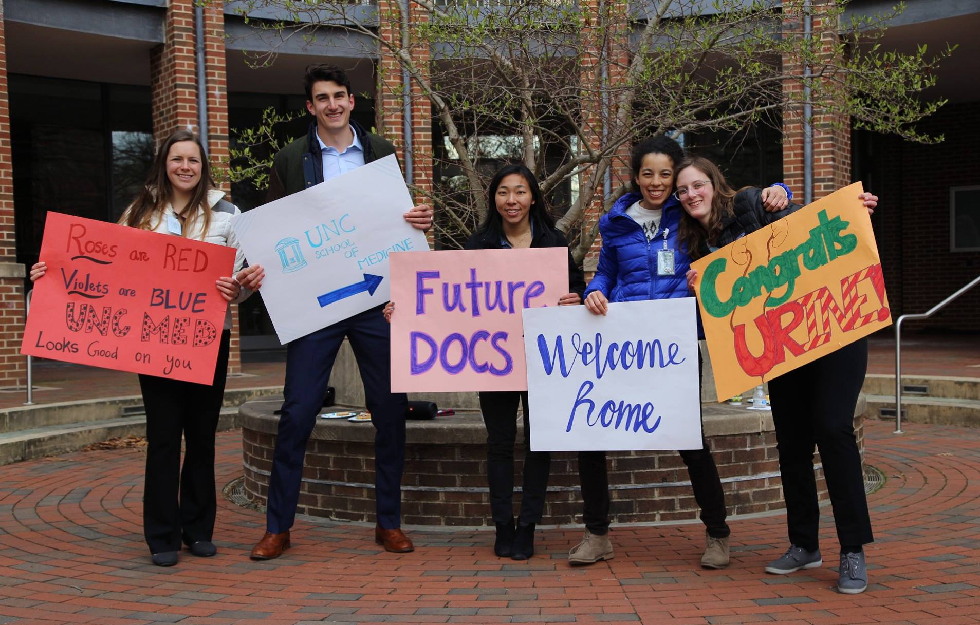
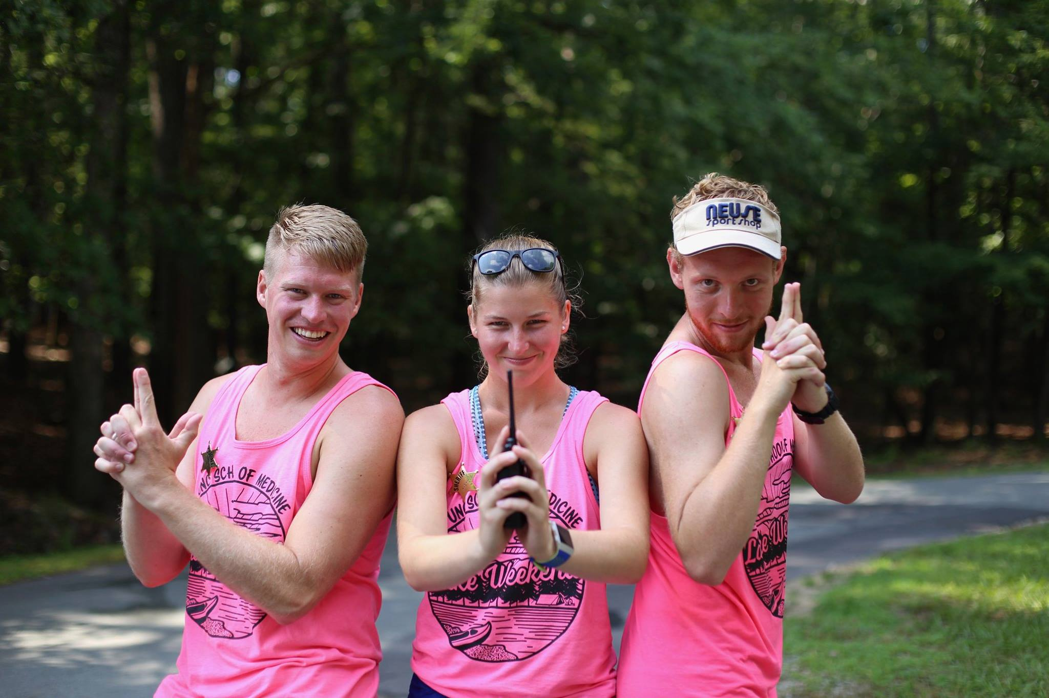
Chief Advocate
Kelli Klinc
Responsibilities= All the FUN things!
Lake Weekend
College Cup
MS1 Orientation
Brown Bag Lunches
College Events
Working with some awesome classmates
You should run for this if…
You love people!
Your backup plan was to be a career camp counselor
You enjoy event planning
kelli_klinc@med.unc.edu
919-880-0972

Slide 7
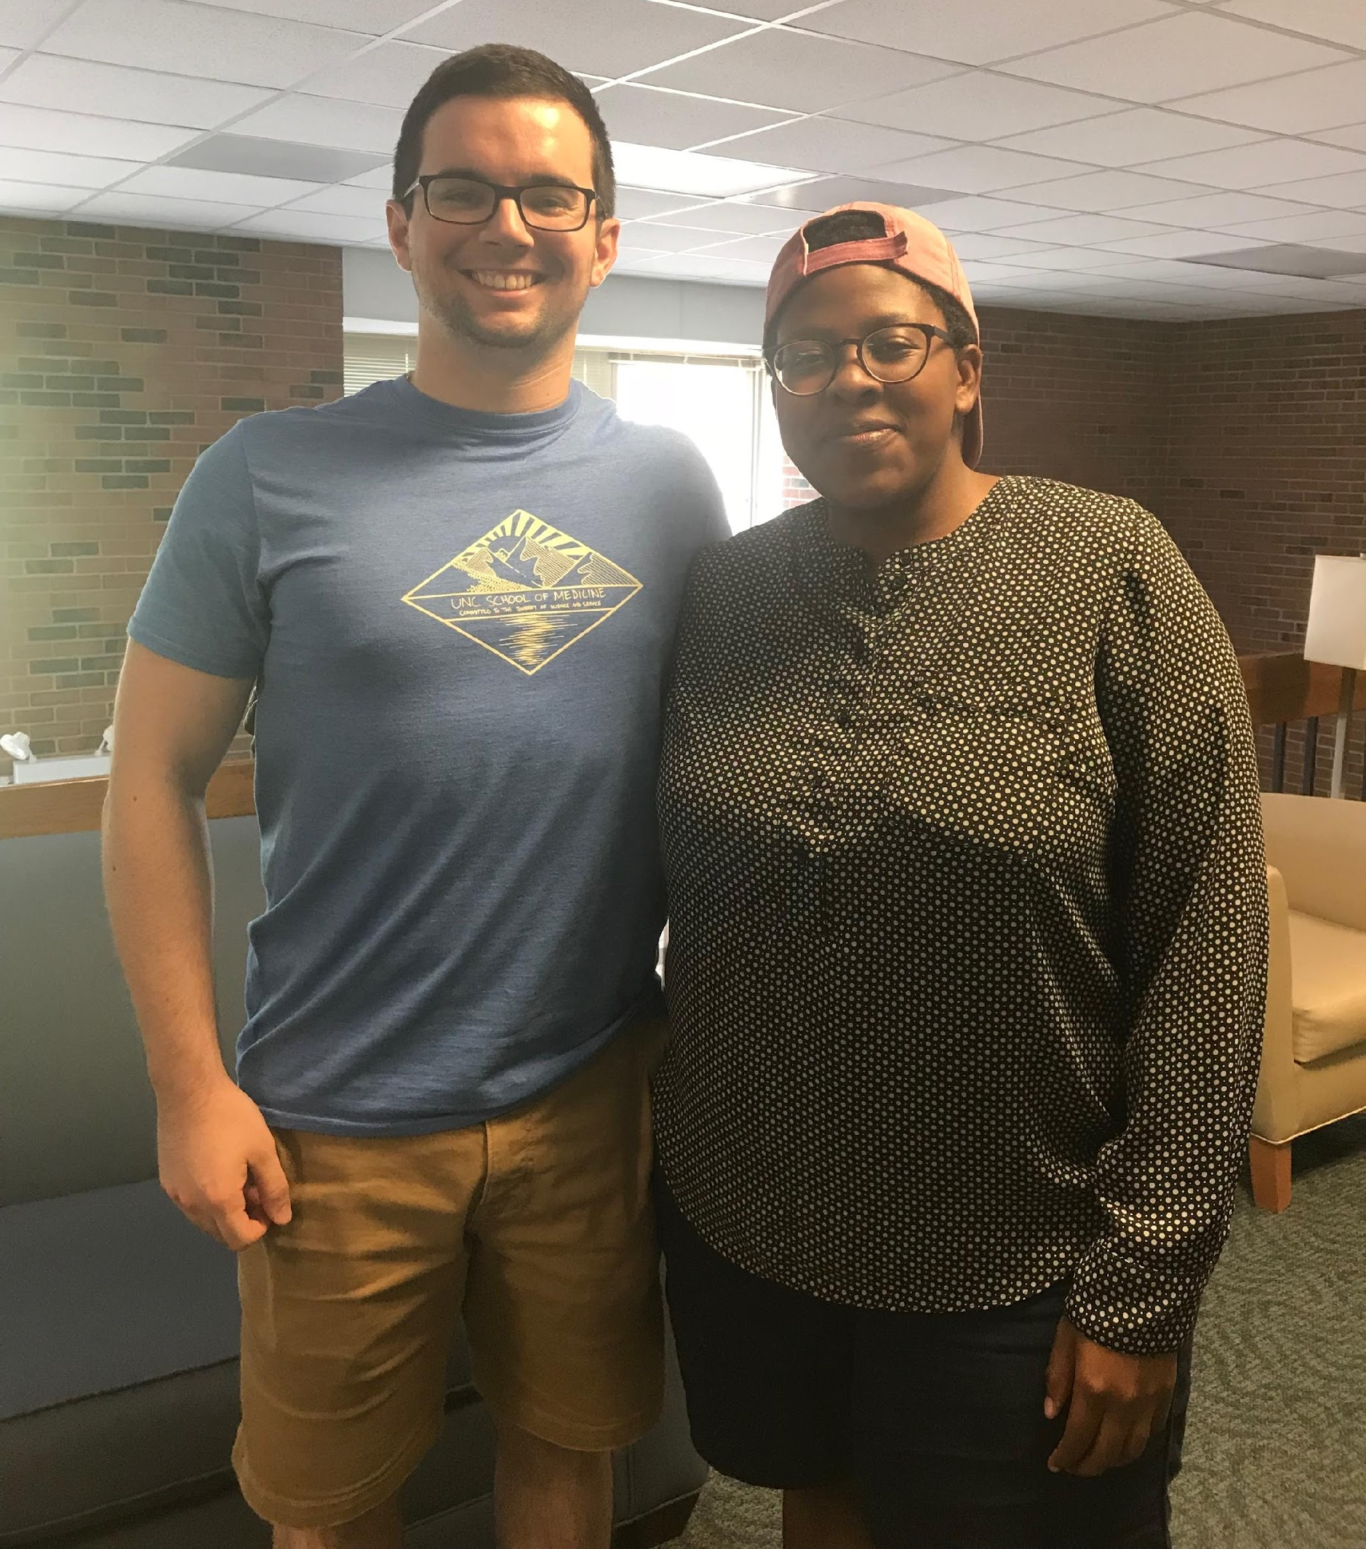
VPs of Curriculum Affairs Portia Nleya and Bailey Allen
Job Description
Serve as a liaison between the student body and the Foundation Phase faculty for curricular matters.
Day-to-Day
Organize and lead block-reviews with course directors and educational support staff.
Set agenda for and lead curriculum-focused meetings with education administration.
Attend faculty-lead Foundation Phase meetings.
Be a voice for your class.
Perks
You get to know many faculty members really well.
You will get to know your class even better.
You advocate for curricular changes – and see them happen!

Slide 8
VP of Research and Publications Allie
Research liaison for medical students
WMS Website: Maintain content on research opportunities, resources, and funding sources
Upcoming: “Student Research Spotlight”
JBG Student Research Day: Host abstract drop-in/workshop; coordinate with JBG Research Society as needed
Coordinate and host case conference lunches for each block
Assist with other aspects of WMS website, social media, and activities calendar (as needed)
Current officer:
Allie Bukowski
alexandra_bukowski@med.unc.edu
Notes:
Alexandra_bukowski@med.unc.edu
203-947-2593

Slide 9
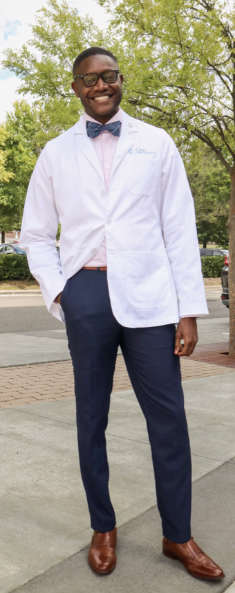
VP of Educational Development
Malcolm Chapman
Responsibilities
TEC Foundation Phase Committees
Serve as a liaison to the student body by conducting opinion polls/focus groups during the year as needed.
Task Force
Represent the student body on task forces/committee meetings that pertain to educational development and curriculum revision.
Accreditation
Be involved with the LCME (Liaison Committee for Medical Education) routine reaccreditation process.
Alumni
Serve as the student representative for both the Alumni Affairs and Foundation office.
AAMC/AMA
Serve as AAMC/AMA Organization of Student Representatives (OSR) delegates through attendance of the AAMC/AMA Annual Meeting.
Notes:
Examples: Bi-weekly curriculum meetings, Academic Technology Services, Alumni Buddy Progra

Slide 10
VP of IT
Kyle
Run elections each year
Update and maintain the website
Facilitate Microsoft Teams for WMS
Attend IT meetings with OIS
Attend WMS meetings
Support other roles
Make the role your own!
Current officer:
Kyle Bingham
Kyle_binghami@med.unc.edu

Slide 11
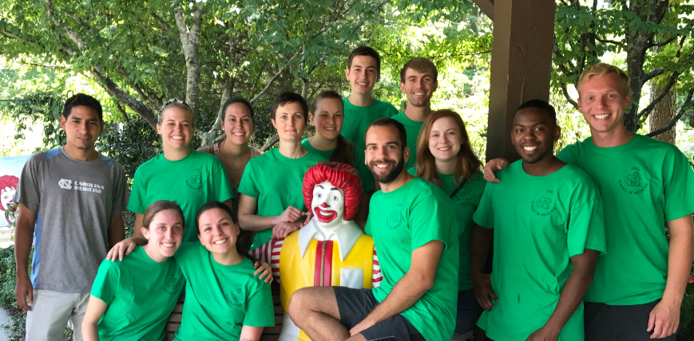
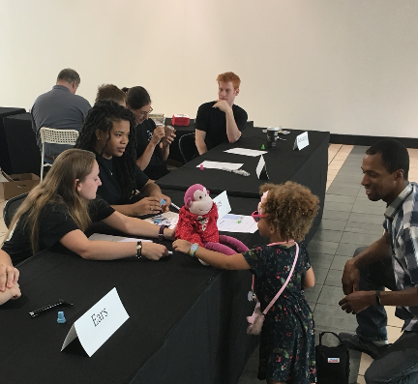
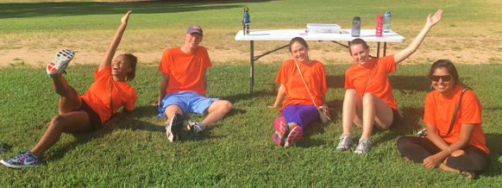
VP of Community Service
Francie Jenkins
Main job: MS1 Day of Service
Open position to promote community service however you want
Be creative
Platelet donations
Medical supply drive
Fundraisers
Health fair

Slide 12
VPs of Student Recruitment
Chamara & Jackson
Overview
2 Co-VPs of Student Recruitment
Work closely with the UNC Admissions Office (especially Ms. Randee Reid and Joni James)
Weekly commitment = ~1-2hrs/person, closer to 3hrs when planning Second Look (overall = low stress and really rewarding!)
Tasks
Coordination and Management of the MS1/MS2 Admissions Ambassador Team
Selection and training of MS1/MS2 Ambassadors
Scheduling of paired MS1/MS2 Ambassadorsfor prospective students during the regular interview season
Management of Ambassador resources (polos, celebration dinner, etc)
Management of the Overnight Hosting (and Airport Transportation) Program
Selection of UNCSOM overnight hosts from all years
Coordinate scheduling between interviewing students and overnight hosts/drivers
Coordination of Second Look and Facebook Page for prospective students
Primary contact for prospective student questions and tours
Provide resources and contacts for prospective student inquires
Coordinate individual and/or group tours for prospective students outside of the regular interview season
Chamara and Jackson (uncsomrecruitment@gmail.com)

Slide 13
VP of Financial Affairs
Craig Sweeney
Weekly Responsibilities:
Bookkeeping and reimbursement/payment processing (very simple)
Serve as liaison between WMS officers and WMS financial accounts
Touch base with finance sub-committee
Annual Responsibilities:
Develop and maintain annual budget for WMS
Facilitate financial transparency
Help plan fun and important events!
Big Picture:
Support great initiatives put on by class leaders
Have a small role in many different facets of UNC SOM
WMS Budget = WMS Priorities
Ideal Candidate: initiator, team player, organized

Slide 14
VP for Diversity and Campus Affairs
Josh & Kedeja
Promote a culture of inclusion and climate of respect
FUN Events
Doctors for Diversity
Multi-cultural Night
Diversity Cafe
Representation
GPSF (General/Committee mtgs)
Facilitate dialogue among diversity-related Student Orgs (SNMA, LMSA, AMWA, QSA, MEMO, AAMSA)
Liaison between students, admin, WMS
hit us up: joshua_onyango@med.unc.edu/kedeja_adams@med.unc.edu

Slide 15
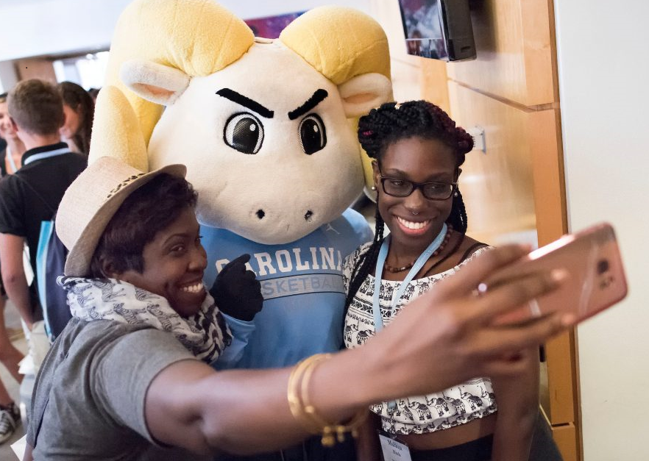
VP of Advertising & Outreach
Manage external communications to promote WMS, advertise UNC SOM events, and communicate with student body
WMS Website: Keep content up-to-date, create new content as necessary (work with VPs of IT and Research)
WMS Social Media: Post regularly, advertise events, brag about UNC SOM, become Instagram influencer, etc.
Student Activities Calendar: Maintain activities calendar on Teams
Liaison between UNC SOM and other student groups for joint events
Current contacts:
Allie Bukowski & Malcolm Chapman
alexandra_bukowski@med.unc.edu
Malcolm_chapman@med.unc.edu

Slide 16
Current Foundation Phase Officers
Foundation Phase Class Presidents | Sean Donohue | sean_donohue@med.unc.edu | 919-747-1751
Foundation Phase Class Presidents | Ryan Searcy | ryan_searcy@med.unc.edu | 919-610-5653
VP of Student Affairs | Abby Loszko | abigail_loszko@med.unc.edu | 980-322-2140
VP of Student Affairs | Asim Lal | asim_lal@med.unc.edu | 404-791-9066
VP of Curriculum Affairs | Portia Nleya | portia_nleya@med.unc.edu | 704-928-5369
VP of Curriculum Affairs | Bailey Allen | bailey_allen@med.unc.edu | 910-840-0651
VP of Student Recruitment | Chamara Dharmasri | chamara_dharmasri@med.unc.edu | 336-541-2998
VP of Student Recruitment | Jackson Perry | jackson_perry@med.unc.edu | 252-560-6833
VP of IT | Kyle Bingham | kyle_bingham@med.unc.edu | 828-748-1121
VP of Research and Publications | Allie Bukowski | alexandra_bukowski@med.unc.edu | 203-947-2593
VP of Education Development | Malcolm Chapman | malcolm_chapman@med.unc.edu | 904-504-0029
VP of Community Service | Francie Jenkins | francie_jenkins@med.unc.edu | 252-340-9529
VP of Diversity and Campus Affairs | Kedeja Adams | kedeja_adams@med.unc.edu
VP of Financial Affairs | Craig Sweeney | craig_sweeney@med.unc.edu | 540-850-9182
Chief Advocate | Kelli Klinc | kelli_klinc@med.unc.edu | 919-880-0972

Slide 17
Next Steps
Platforms and intent to run due: next Friday (9/14) by 5 pm.
Platforms Distributed: 9/14 - 9/16
Elections: Monday (9/17) - Tuesday (9/18)
Runoffs: Wednesday (9/19)
Save the date: Whitehead Officer Retreat in October (date TBD)

Slide 18
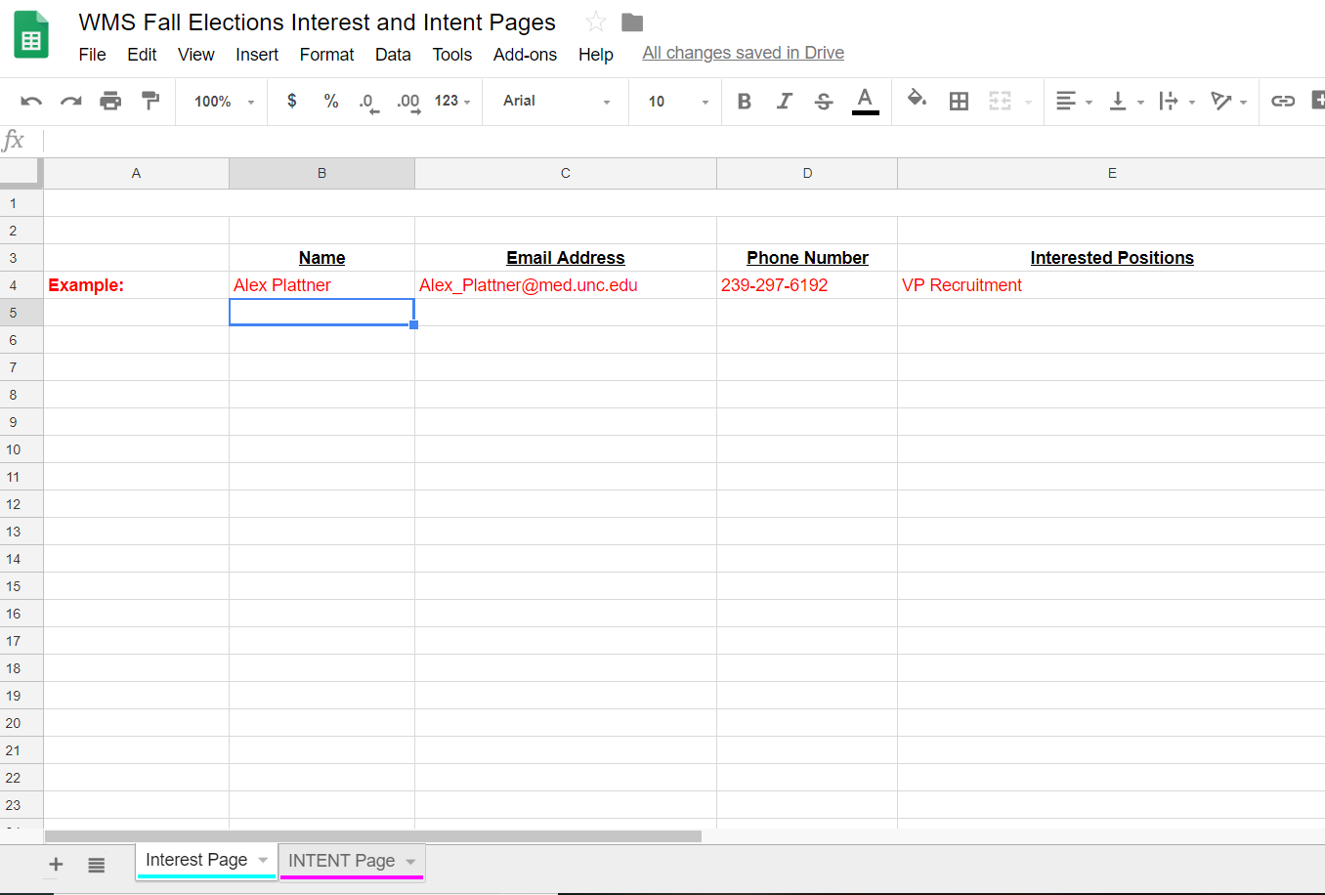

Slide 19
